Slide 1
Person-Centered Planning
A Team Approach

Slide 2
Notecard Activity and Introductions
Student is ______ Kaitlyn is happy at school.
Student can_____ Kaitlyn can put on her own backpack.
Student loves_____ Kaitlyn loves anything with glitter.
Notes:
Give diretions to group and introduce myself

Slide 3
What is A Person-Centered Planning Meeting? http://www.personcenteredplanning.org/index.cfm
Person-Centered Planning is a process-oriented approach empowering students with exceptionalities to reach goals through purposeful learning. A team of people who know the student well and work consistently with the student take part in the process of developing the person-centered plan.
Allows teams to share ideas and collaborate to create the best plan possible for the learner.
Opportunities are created that empowers the learner to reach new goals which will maximize the daily learning environment.
It is not a one-shot meeting, a set of forms to complete, a quick fix to all problems, a place to reflect on all that has not worked in the past.

Slide 4
Norms
Focus on the positives, have a solution-based mindset
Treat this meeting as coffee shop conversation
Focus on the opportunities for learning
Respect others opinion and perceptions
Communicate with the student at the focus
Expect and accept non-closure (Things to problem solve…)
Remember we are a team working together towards the common goal (the student)

Slide 5
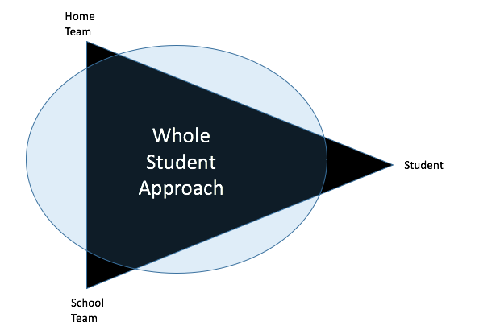
S.H.A.P.E
A Specialized and Holistic Approach to Personalized Education

Slide 6
The “Why” and Goals of the Meeting
To take stock of student’s abilities at school and home
To consider the big picture (now - ten years from now)
To listen to each other's hopes for student (home and school) in the areas of daily living, communication, social skills, programming, independent skills, general education and special education and anything else the team determines as a priority.
To avoid repeating instruction and skills
To create purposeful and meaningful short term and long term goals
To craft ideas that will help the student be successful

Slide 7
Areas of Focus, Fluid Thinking
Strengths, Gained Skills and Abilities (home and school)
Hopes and Dreams the team has for the student (now and the near future)
Parts of the day (determining all opportunities for learning)
Instructional Supports/The Vehicle for Learning (social stories, curriculum, programming, routines, visuals, communication device instruction etc.)
Action Plan and Next Steps
Things to problem solve

