Slide 1
FY2017 MIS Workshop
Trouble Shooting 101

Slide 2
My Car doesn’t start
Tell me why

Slide 3
My Car doesn’t start
I can’t find this student
2 students don’t import
Some buildings that don't show up
Service lines are missing total days
Providers are missing
Students are missing from the reports
This student has an error message

Slide 4
My Car doesn’t start
What is missing ?
I can’t find this student
Who is the student ?
2 students don’t import
What does the fail to import message say ?
Some buildings just don't show up
Which building doesn’t show up where ?
Neighborhood School
Responsible school
Service building

Slide 5
My Car doesn’t start
What is missing ?
Students are missing from the 12-1 reports
Are you claiming the student?
Is the student age 3-21 on December 1?
Are the disabilities and Gifted consistent?
Are the responsible schools consistent?
Is the student in Special Education on 12-1?
Are there December 1 services, how many days?
Zero days ?

Slide 6
My Car doesn’t start
What is missing ?
Service lines are missing total days
What does the building info read?
Providers are missing
Missing from the provider list, service lines?

Slide 7
Error messages
I get an error message on this student

Slide 8
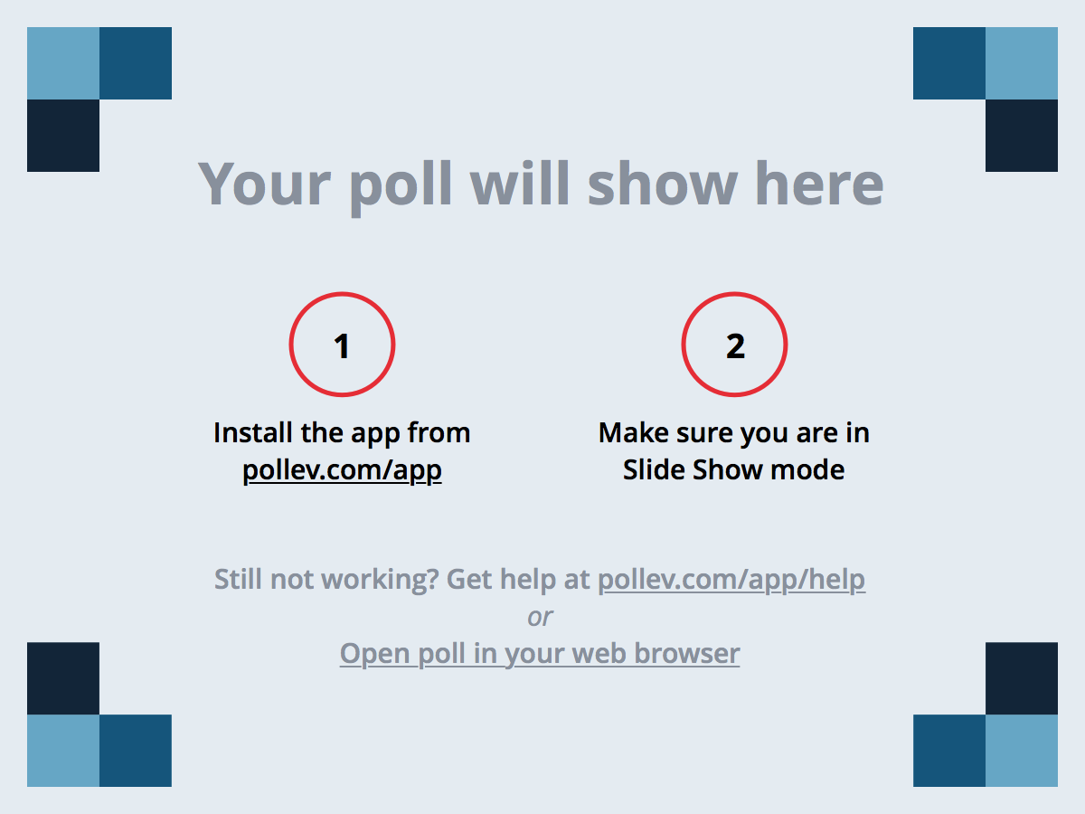
Notes:
Poll Title: How do I know what responsible school to report for student Joe Smith? https://www.polleverywhere.com/multiple_choice_polls/Y15vVdE2qedXF5f

Slide 9
My Car doesn’t start
What is missing ?
3 students have this error message
Who are the students?
What is the message / verification?
What actions triggered the message?
Where do you see the message?

Slide 10
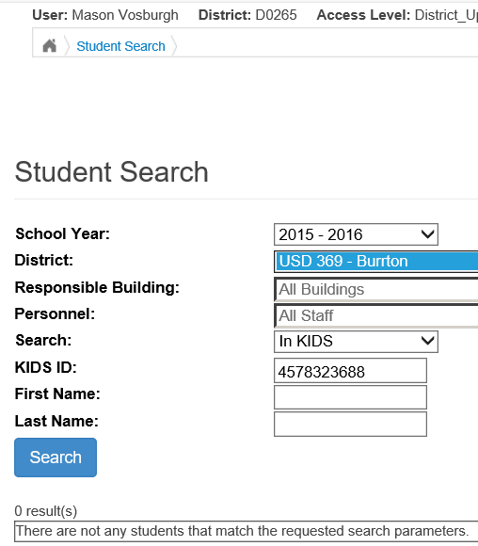
Students not Found
Select the organization you are working on. Specific USD will limit you to that USD. Selecting Coop or Interlocal gives all USD collectively

Slide 11
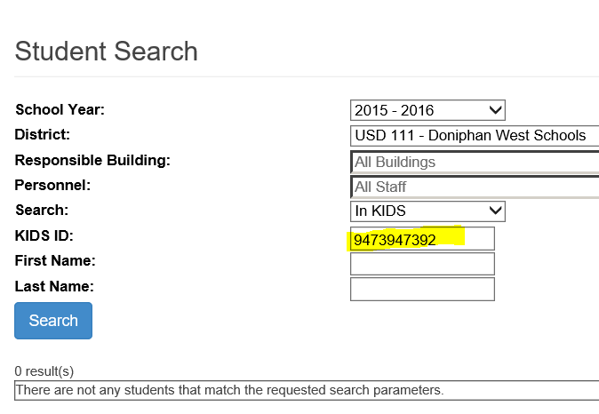
Students not Found
Unsuccessful searches in KIDS typically means there are no KIDS records for the organization and student or the ID number searched is not correct.

Slide 12
Notes:
Poll Title: Student Mary Ann Ginger was enrolled and received services in 3 different districts this school year. How do I know which organization counted the student on December 1? https://www.polleverywhere.com/multiple_choice_polls/4IdQzGzQT7yd9Mw

Slide 13
Fail to Import
What does the message mean ?
The line length is not correct for this type of file
Student record has either to few or to many fields
Fields in record imported do not match selected record type
Provider file format selected, student records imported.
Unable to match student information to a KIDS record
Last name is misspelled or different – student may get it.
Gender does not match – student may get it.
Date of Birth is incorrect – student may get it.
No student / district association in KIDS
Check to see if the imported record is in or out of the application
Invalid KIDS ID
No KIDS records found with this ID number

Slide 14
Fail to Import
What does the message mean ?
Import file format is in error or out of sequence.
The value 'D0123' is invalid for the field 'Assign Child Count Organization
Coop or Interlocal user has selected a member USD but is importing records for a different USD
The value '' is invalid for the field 'Responsible Building Identifier‘, Service Location (Attend Building), etc.
Responsible building, Service Location (Attend Building), etc., is blank / has Null value

Slide 15
Fail to Import
What does the message mean ?
Import file format is in error or out of sequence.
The line length is not correct for this type of file \?U???}3??????d6?4h??}}h?)?[?;?R?8???0??sK6?m?/?T$>??Mv!???9??/
You imported in something other than a text file. Excel, Word, PDF
The value '01/11/2015' is invalid for the field 'Service Start Date'.
The Service start or end date is in a different school year
The value '11/02/2016' is invalid for the field 'IEP Date‘
The IEP date is tomorrow or somewhere in the future.

Slide 16
Notes:
Poll Title: Why does a preschooler have every building in the organization listed for selection in the responsible school dropdown, including the middle and high schools and there are no preschools listed? https://www.polleverywhere.com/multiple_choice_polls/ELr7q8qW52dcyO6

Slide 17
Fail to Import
What does the message mean ?
Import file format is in error or out of sequence.
The value '2044' is invalid for the field 'Staff ID'.
Building number present in the Provider ID field
The value O is not an active status code. Annual status cannot be determined.
First record submitted cannot have an Exit status. Students must start the school year as Active, then exit after services were received.
The INSERT statement conflicted with the FOREIGN KEY constraint
Happens when the same batch file is imported more than once and the preceding files have not completed processing.

Slide 18
Buildings do not show up
All building data comes from the directory
Building information is searchable

Slide 19
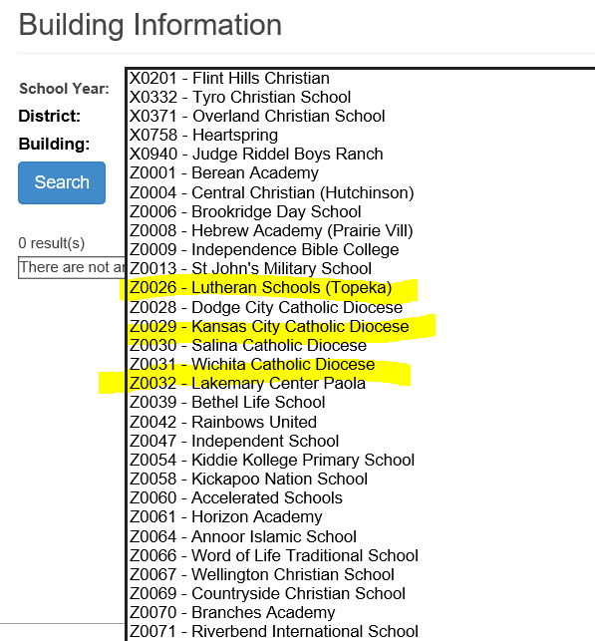
Buildings do not show up
Private and Parochial Schools are listed under their own organizations

Slide 20
Buildings do not show up
Buildings marked as attendance only are not listed for selection as Neighborhood or Responsible schools. Private and Parochial Schools in the catchment are listed below by their own organizations

Slide 21
Buildings do not show up
Accountability school in KIDS is listed as responsible. Only the district determines responsible school through KIDS.
No building present means there are no KIDS records

Slide 22
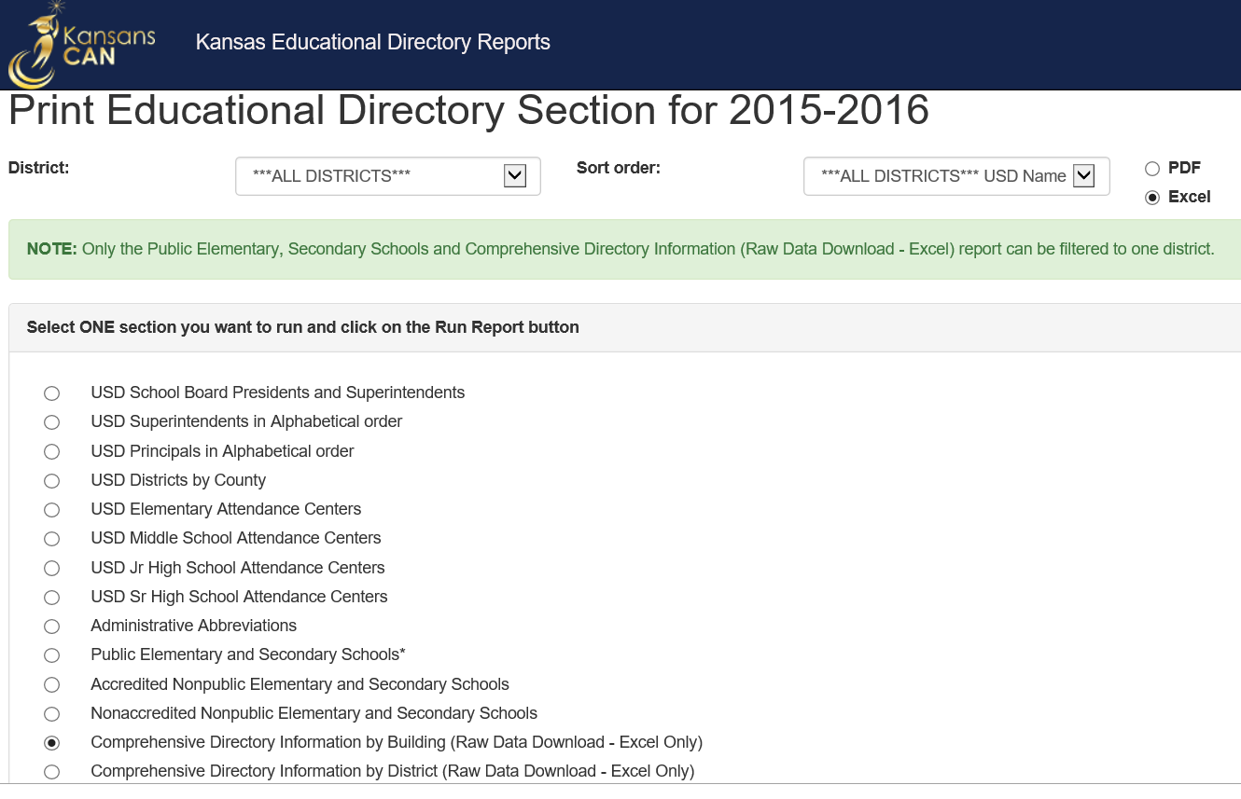
Print Directory data report

Slide 23
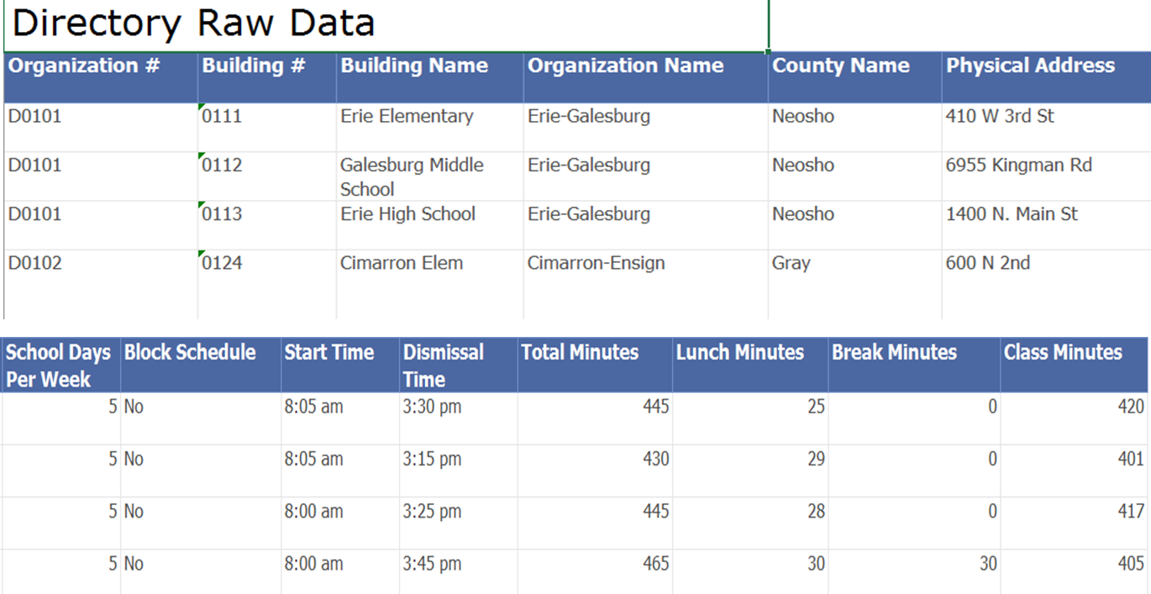
Print Directory data report

Slide 24
Notes:
Poll Title: A student moved into to my agency with an IEP. What is the first thing to do before entering the student in the MIS? https://www.polleverywhere.com/multiple_choice_polls/bgd0u7lW8fl6ZpI

Slide 25
School or Program
School
Seeks accreditation
Accountability / APY
Test Scores / Enrollment attributed to the building
Has a principal
Can be neighborhood or responsible school
West High
Lincoln Middle
Adams Elementary
Program
Not accredited
Not used for accountability
Principal not required
Service location only
Off Site building
Preschool
Incarnation facility
After School K time program

Slide 26
Notes:
Poll Title: A private school student is newly identified and begins receiving services at the private school. What is the first thing to do before entering the student in the MIS? https://www.polleverywhere.com/multiple_choice_polls/xB7Pg0Kxe257SPb

Slide 27
Total Days are Missing
Why don’t the total days calculate ?

Slide 28
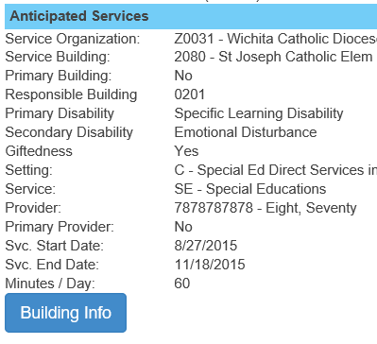
Total Days are Missing
Step 1 – Look at the service line
Click the Building Info button to see the information linked to the service location
A new browser tab opens displaying the associated information

Slide 29
Total Days are Missing
Step 2 – Is the grade level reported aligning with the program type?

Slide 30
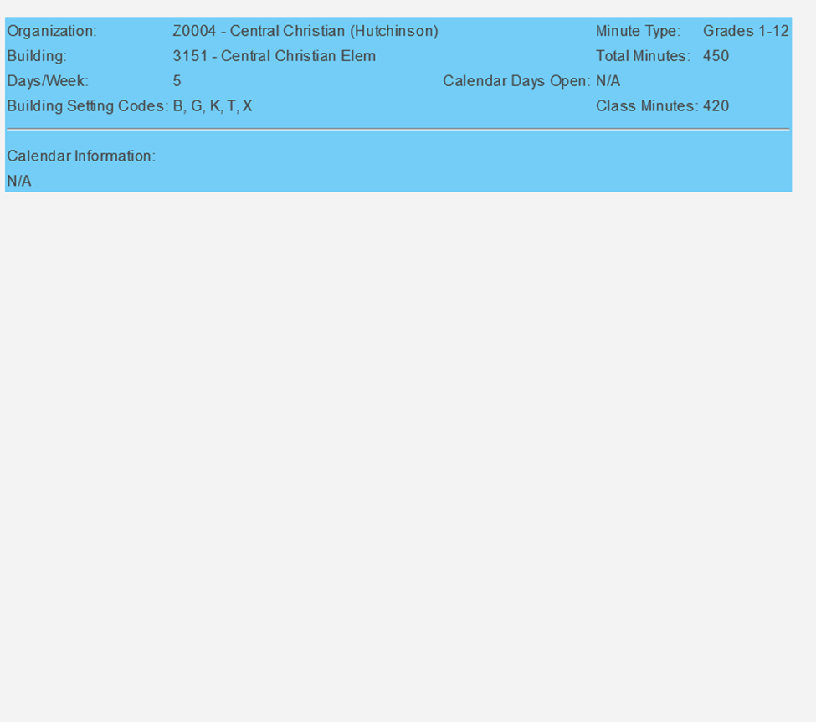
Total Days are Missing
Step 3 – Find the missing association

Slide 31
Total Days are Missing
Step 4 – Note the values listed and check their source

Slide 32
Notes:
Poll Title: A newly identified preschooler begins receiving services. What is the first thing to do before entering the student in the MIS? https://www.polleverywhere.com/multiple_choice_polls/5I2HxBofi6QtGY6

Slide 33
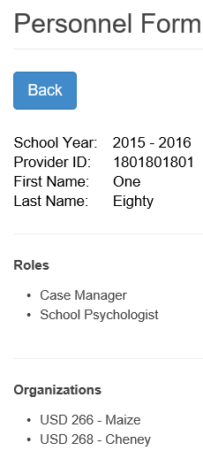
Providers not showing up
Check the provider roles. Look on the Personnel list
This provider is not found on service lines

Slide 34
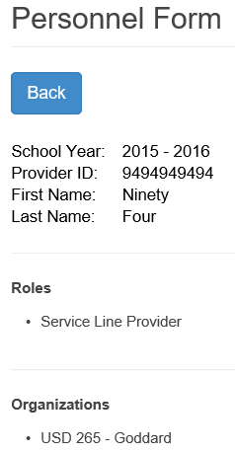
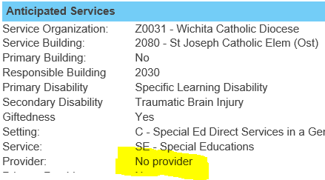
Providers not showing up
Check the provider assignments. Look on the Personnel list
This provider is not found on service lines

Slide 35
Notes:
Poll Title: How do I communicate to KSDE information about the data I submitted? https://www.polleverywhere.com/multiple_choice_polls/cokCV0ZWu3WOSya

Slide 36
Dec. 1 students are missing
Are you claiming the student ?
Look on the student profile
Claimed
Not Claimed

Slide 37
Dec. 1 students are missing
Is the student age 3-21 on December 1?
Look at the Student profile
Count on 12-1-15 ?
Count on 12-1-16 ?
Count on 12-1-15 ?
Count on 12-1-16 ?
Count on 12-1-15 ?
Count on 12-1-16 ?
No
Yes
Yes
No
No
No

Slide 38
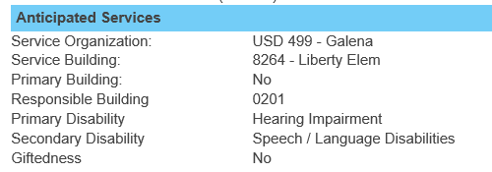
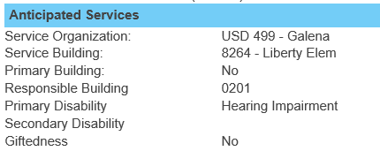
Dec. 1 students are missing
Does the Disability Contradict?
Look on the Service Lines
HI
SL
HI

Slide 39
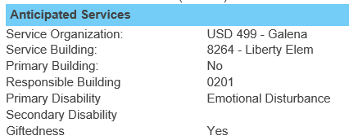
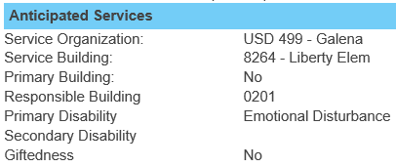
Dec. 1 students are missing
Does the Gifted Indicator Contradict?
Look on the Service Lines
GI = Yes
GI = No

Slide 40
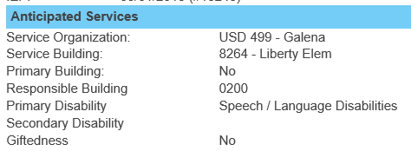
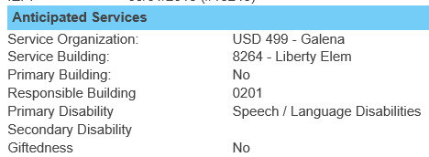
Dec. 1 students are missing
Does the Responsible School Contradict?
Look on the Service Lines
Lincoln Elementary
Reagan Elementary

Slide 41
Dec. 1 students are missing
Was the student in SPED on December 1?
Look on the Service Lines
In SPED on Dec. 1?
In SPED on Dec. 1?
In SPED on Dec. 1?

Slide 42
Dec. 1 students are missing
Are there December 1 services?
Look on the Service Lines
Dec. 1 services?
Dec. 1 services?

Slide 43
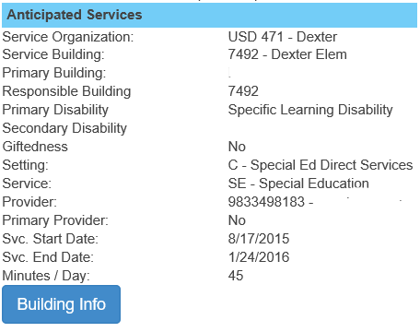
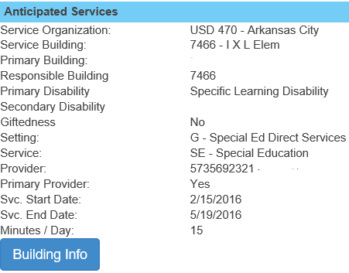
Dec. 1 students are missing
Did the student move?
Look on the Service Lines

Slide 44
Notes:
Poll Title: Which issue does not exclude students from the December 1 child count report ? https://www.polleverywhere.com/multiple_choice_polls/PZpLlF3AfqD8OBS

Slide 45
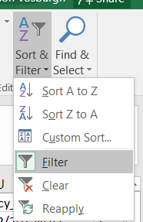
Report Verifications
December 1 and EOY reports
User the Excel Sort and Filter tools

Slide 46
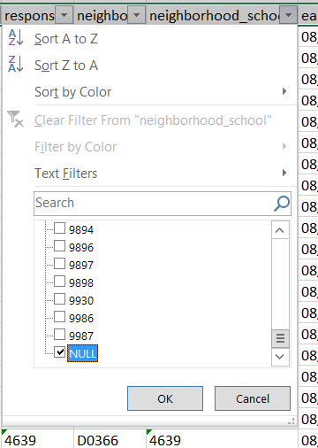
Report Verifications
December 1 and EOY reports
Check for blank or Null values where values are expected

Slide 47
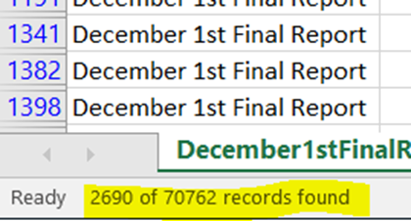
Report Verifications
December 1 and EOY reports
Filtered results are listed in the bottom left hand corner
This number of records by row will be listed in the report

Slide 48
Report Data Consistently
Data is collected by school year, not by IEP year
IEP data reported in the MIS can change from one school year to the next on the same IEP
Responsible school
Attendance location
Service setting

Slide 49
Report Data Consistently
Primary causes of verification 0176 – MIS not matching to KIDS records.
Last year’s responsible school is listed under first IEP reported in the school year
Organization has not submitted a KIDS record for the student for the current school year.
Organization reports different responsible school from the responsible school listed in the MIS

Slide 50
When to List K Time
K time and 6th birthday – IEP covering December 1
Age determinations are made on December.
Is the student 3, 4, or 5 on December 1
If yes, K time is applied to the OSEP environment calculation
If not 3, 4, or 5 on December 1, then K time is not factored even if reported.
What if the student turns 6 between July 1 and November 30?
K time is ignored in the OSEP environment calculation, even if reported.

Slide 51
When to List K Time
What if the student turns 6 between December 2nd and the last day of school?
The calculations are made as if the student is a 5-year-old.
What if the student turns 6 on April 15, does the system apply the K time according to the student’s birthday?
NO, the application does not make student age determinations on days other than December 1 or June 30.
Should I report the K time service lines with an end dates of the student’s 6th Birthday?
NO, this can have a negative impact on the LRE calculation
You can be artificially shorting the amount of K time measured

Slide 52
When to List K Time
How does the calculation apply K time?
It uses the collective set of service lines that cover December 1 as a group, based on the range of special education services
There is 1 K time test for the time the student receives IEP support.
Does the student participate in a regular early childhood program, yes or no?
If settings, B, C, W or K is present, then Yes
If yes, then how much time. Is it
10 or more hours per week?
Less than 10 hours per week?

Slide 53
When to List K Time
Example:
October 15 IEP, services from October 15 to last day of school.
140 school days / 28 weeks of the school year
Direct service range reported
October 15 to last day of school
140 school days / 28 weeks of the school year
K time, 120 minutes daily, from October 15 to Last day of school
120 MIN x 140 days = 16,800 minutes of K time
16,800 min / 28 week range = 600 minutes per week or 10 hours per week
K time, 120 minutes daily, from October 15 to April 1 (student’s 6th birthday)
October 15 to April 1
100 school days / 20 weeks of the school year
120 min X 100 days = 12,000 minutes of K time
12,000 min / 28 week range = 429 minutes per week or 7.15 hours per week

Slide 54
Notes:
Poll Title: To trouble shoot zero days of service, what should I look for on the building Info tab? https://www.polleverywhere.com/multiple_choice_polls/PUCnsGeNJUH7L83

Slide 55
Why do I see students from other districts on my verification list?
Because they are attending one of your programs.
MIS clerks from other districts may need you help in resolving verifications. For example
Class time in their IEP program may not match to directory day
Calendar, settings in their IEP program may not match
Providers in their IEP program may not match

Slide 56
CAPS Data
S0 Organizations not claiming Categorical Aid
KSSB, KSSD, JJA and KDOC facilities
Special education providers – regular term
Related service providers – regular term
Para-educators – regular term
School year calendar
Provider’s service / endorsement area, dates worked, grade levels served, contracted FTE or hours worked.

Slide 57
Notes:
Poll Title: Student has zero days of service on more than 1 service line. What do I do first to find out why? https://www.polleverywhere.com/multiple_choice_polls/4E1z4AmOStRQEDQ

Slide 58
Data Dictionary
September 1 – Initial FY Submission
Using the Unresolved Exit report will require initial submission of active students for the current school year by September 1. Active students from the prior year not found will be flagged as unresolved exits.
Process – Checks active FY2016 students to students not found in FY2017
Intent – Catch students who qualify for OSEP Exit report
Graduates
Objectives completed – return to general education
Summer move outs

Slide 59
Data Dictionary
September 1 – Initial FY Submission
Using the Unresolved Exit report will require initial submission of active students for the current school year by September 1. Active students from the prior year not found will be flagged as unresolved exits.
Process – Checks active FY2016 students to students not found in FY2017
Intent – Catch students who qualify for OSEP Exit report
Graduates
Objectives completed – return to general education
Summer move outs

Slide 60
Data Dictionary
Assigning correct buildings – Pages 2-4, examples
Responsible School – as claimed by the LEA in KIDS
Responsible School – aligned as point in time within the range of services dates
Assign child count – current responsible organization
Determination of total days explanation
Keyboard entry selection
Imported records rank order selection
Settings – Do not assign a Service setting / location code for buildings that do not have classrooms.

Slide 61
Data Dictionary
Service location definition
Early Childhood Locations – Program addition
District run universal preschools offering early childhood programming to 3, 4, and 5 year olds
Reported under the “B” Setting
Report consistently as other “B” programs in combination with K time.

Slide 62
Data Dictionary
Catastrophic Aid
Updated Transportation expense categories for vehicle operation under more detailed cost basis
Trans services purchased by outside company
Mileage Paid in lieu of transportation
Insurance Services
Monitoring Services
Vehicle Service and Maintenance
Other Transportation Services

Slide 63
Error Messages
An unexpected malfunction happens
Do not let issues go unreported to KSDE
You may be the only one with this problem
There may be a pattern of causes
If unreported, then a pattern goes undiscovered
If clerks tells of a problems ask if it has been reported to KSDE.
IT will have many follow up questions regarding the issue, be sure the clerk responds to all of the questions
Document the details, what page, what time, what action was taken, screen shots help a lot

Slide 64
INDICATOR 12 PART C TO B TRANSITION

Slide 65
Indicator 12
Percent of children referred by Part C prior to age 3, who are found eligible for Part B, and who have an IEP developed and implemented by their third birthdays.
Compliance Indicator with a target of 100%
Notes:
Focused on smoothing the transition that families and young children with disabilities will make when they leave early intervention services (Part C of IDEA) and become eligible for preschool special education (Part B).
Also: to be considered compliant, those children who did not qualify, evaluation must be completed prior to third birthday.

Slide 66
Indicator 12 FAQ and Flowchart
The Indicator 12 FAQ can be found at http://www.ksde.org/Agency/Division-of-Learning-Services/Early-Childhood-Special-Education-and-Title-Services/Special-Education/KIAS/SPP-and-APR#indicators
Scroll down to the Indicator 12 section and click on the Indicator 12 FAQ link. A copy of the FAQ is found in your handout from today.
A copy of the C to B Transition Data Entry Process chart is found in your handout from today.

Slide 67
Indicator 12 Population Source
What is the source of the Indicator 12 data and how does it get in the system?
The Indicator 12 population source is data from the Kansas Department of Health and Environments Part C Lead Agency and its local networks. It is obtained from KDHE by KSDE and uploaded into the system. It contains all the children for the FFY in question where a Part C Network has indicated the child was referred to Part B.

Slide 68
Removing a Student from Ind 12 Population
How do I remove/delete a student from my Indicator 12 population?
KSDE and KDHE must be consistent in reporting the students who transitioned from Part C to Part B. The KSDE Indicator 12 team may remove a child from the population only when an LEA has provided KSDE with evidence that the child was not a referral from Part C to Part B.

Slide 69
Parent Does Not Consent
A child was referred to the part B program and there were several attempts to contact the mother to schedule the evaluation. The mother responded that she had decided not to have the child evaluated. Paperwork was obtained after the child’s third birthday with signature on "Do not give consent" section.
This is covered by one of the two federal exceptions as noted in our Indicator 12 FAQ:
#8. An LEA received a referral from a Part C tiny-k program and obtained consent for an evaluation. Then the family did not respond to contact attempts to set up dates for evaluating the child before the toddler’s third birthday

Slide 70
Parent Does Not Consent (cont.)
Will the LEA be noncompliant on indicator 12 in these circumstances?
Answer: No, an LEA would not be considered noncompliant. The parent’s repeated refusal to make the student available for an evaluation (K.A.R. 91-40-8(g)(1) and 34 CFR300.301(d)((1) is a federal exception to the evaluation timeline.
Although a signature was not obtained on the PWN/consent form until after the child’s third birthday, attempts were made prior to this to obtain consent. Documentation needs to be maintained (e.g. letters, phone logs) to verify attempted contacts.

Slide 71
Data Entry Source Documents
How do I go about finding the information needed for Indicator 12?
Collaborate with the appropriate evaluation staff (e.g. school psych, ECSE, EC coordinators)
Search in your IEP data base for an IEP
If no IEP: verify if an evaluation was completed and child was not eligible for services. The record of the evaluation report should be found in your IEP data base.
Verify the date of the IEP (or date of evaluation if child did not receive an IEP)
See C to B Transition Data Entry Process chart

Slide 72
Data Entry Source Documents
Where do I go to learn if a student was referred to a district in my catchment area? Which document in a child’s file would tell me if a student was referred to a district in my catchment area?
Kansas uses an electronic system to track referrals from Part C to Part B. (C to B Electronic Referral = CBER). You would need to locate the person in your program (district/coop/interlocal) who is responsible for checking CBER on a regular basis. This system will give information for your district(s) on referrals received from Part C such as the referral date and sending Part C agency.

Slide 73
Data Entry Source Documents
Which document would tell me the Parent decided that they did not want child evaluated? Which document would tell me the district decided that they were not proposing to evaluate the child?
Districts should provide a Prior Written Notice (www.ksde.org: Kansas Special Education Process Handbook) to parents when proposing to or rejecting to conduct an evaluation. This form contains a Request for Consent for Special Education Action, which has a place for parents to sign to “Give Consent” or “Do Not Give Consent”.

Slide 74
Data Entry Source Documents
Which document would tell me the Parent decided that they did not want child evaluated? Which document would tell me the district decided that they were not proposing to evaluate the child? (cont.)
Provide documentation to show your attempts to contact this person prior to the third birthday. This would be the federal exception of parent refusing the evaluation.

Slide 75
Data Entry Source Documents
Which documents are required for verification?
Examples of documentation:
Evaluation Report (to include pages reflecting completion date, and result of the evaluation)
IEP (to include the date the IEP was written, or in other words, the IEP meeting date – not to be confused with the date services will begin)
Phone logs, letters sent, etc (to document attempts to contact parents to begin an evaluation or to obtain consent).

Slide 76
Child Not Referred to our District
When there is a discrepancy between your Indicator 12 data verification report and your district records:
Contact your district staff person who maintains your CBER records to determine if this child was referred and either accepted or rejected by your district
Contact your local Part C program to determine what steps they have taken in their referral process
Contact your state Part B 619 coordinator if you still believe there is an error.

Slide 77
KIDS ID Discrepancy
If the KIDS # on the Indicator 12 report is different from what I show in our district or the KIDS # has been retired, do I change the number on the screen?
Editing of the KIDS ID is not allowed on the Indicator 12 report:
Contact your state Part B 619 coordinator
Provide the information from your Indicator 12 report

Slide 78
KSDE CONTACTS
Tim Berens: tberens@keystonelearning.org
Mason Vosburgh: mvosburgh@ksde.org
Vera Stroup-Rentier: vstroup-rentier@ksde.org
Barbara Dayal: bdayal@ksde.org

Slide 79
References
IDC IDEA Data Center B6 Data Reporting Tools:
https://b6tools.ideadata.org/
2016-17 Special Education Data Dictionary:
http://www.ksde.org/Portals/0/SES/MIS/MIS-DD.pdf
Indicator 7 FAQ:
http://www.ksde.org/Portals/0/SES/KIAS/indicators/Ind7-ECO_FAQ.pdf
Outcomes Web System User Guide:
http://www.ksde.org/Portals/0/SES/KIAS/indicators/Ind7-OWSguide.pdf
Indicator 12 FAQ:
http://www.ksde.org/Portals/0/SES/KIAS/indicators/Ind12-FAQ-KS.pdf
KITS (Kansas Inservice Training System):
www.kskits.org
ECTA (Early Childhood Technical Assistance):
www.ecta.org

Slide 80
Indicator 11 Child Find Frequently Asked Questions
Stacie Martin
KSDE Educational Program Consultant Indicator 11 Lead
smartin@ksde.org
Tim Berens
KSDE TASN GSTAD Project Coordinator
Indicator 11 Team Member
tberens@keystonelearning.org

Slide 81
What is Child Find?
Child Find is Indicator 11 of the State Performance Plan (SPP).
Indicator 11 measures the percent of children with parental consent to evaluate, who were evaluated and eligibility determined within 60 school days.

Slide 82
Indicator 11 Students
What students are included in the Indicator 11 population?
The review must include all children, early childhood through high school, who were suspected to be a child with a disability. Include both eligible and not eligible children suspected to be a child with a disability who had an initial evaluation completed between July 1, 2015, and June 30, 2016 (i.e., FFY 2015, SY 2015-16)

Slide 83
Indicator 11 Students
What evaluations should be included in the random sample?
Include Initial Evaluations where the Initial Evaluation Determination Date is between July 1, 2015, and June 30, 2016, inclusive.
Will students who transition from Part C with a current IFSP be included in the review?
Yes, children who have a current IFSP must have an initial evaluation to determine eligibility for Part B services.

Slide 84
Indicator 11 Students
Do we include students whose Eligibility Determination Date is in the school year that just ended (e.g., SY 2015-16), but will not start services until next school year (e.g., SY 2016-17) in the Indicator 11 population?
The students in this scenario would be included in the SY 2015-16 data collection.
Once a child has been exited from special education services, must you complete an initial evaluation upon a referral to determine need for special education?
Yes. Once a child who has been identified as a child with an exceptionality has been exited, either through revocation of consent or a reevaluation resulting in a determination that the child is no longer eligible, a subsequent evaluation would be an initial evaluation.

Slide 85
School Day
What does the term “school day” mean?
School day means any day, including a partial day that children are in attendance at school for instructional purposes, and has the same meaning for all children in school including children with and without disabilities. (34.C.F.R. § 300.11, (c).

Slide 86
How is the number of school days determined?
Count the number of school days between the date the Initial Evaluation Consent for Evaluation was received and the date of the Initial Evaluation Eligibility Determination
The Initial Evaluation Consent for Evaluation Received Date is the date when the agency receives written parental consent to the Prior Written Notice to conduct an initial evaluation.

Slide 87
How are the number of school days entered in the collection system?
The system calculates the Approximate Number of School Days by counting the number of calendar days,
between Monday and Friday, inclusive
within the range of dates between the Initial Evaluation Consent for Evaluation Received Date and the Initial Evaluation Eligibility Determination Date, inclusive.
The Approximate Number of School Days calculation does not use a school calendar.

Slide 88
How are the number of school days entered in the collection system?
If the Approximate number of days is greater than or equal to 60, count the number of school days on the school district calendar between the Initial Evaluation Consent for Evaluation Received Date and the Initial Evaluation Eligibility Determination Date, inclusive.
Enter the actual number of school days in the Actual Number of School Days field.
If the Actual Number of Days is greater than 60, select one of the reasons from the list of reasons provided on screen.

Slide 89
Which school calendar to use?
Our district has buildings and/or programs with calendars that differs from the district calendar. Which calendar should be used to count the number of school days between the Consent Received date and the Eligibility Determination date?
The building calendar should be used in the event it differs from the district calendar.
The program calendar should be used in the event the child attends a program with a calendar that is different from the building and/or district calendar.
In any event, parents whose child is receiving an initial evaluation should be made aware of which calendar the district intends to use when calculating the 60 school day timeline for an initial evaluation.

Slide 90
Snow Days
How are snow days counted?
The original district calendar may have been modified to reflect the day(s) that school was not in session due to snow. Using the same process as using the original school calendar, before the school calendar may have been modified, count only the number of days the school was in session beginning with the Initial Evaluation Consent for Evaluation Received Date and the Initial Evaluation Eligibility Determination Date.

Slide 91
Are there any exceptions if an initial evaluation goes beyond the timeline?
Federal
A. The parent of a child repeatedly fails or refuses to produce the child for the evaluation.
B. A child enrolls in a school of another district after the timeframe for initial evaluation has begun and prior to determination by the child’s previous public agency as to whether the child is a child with a disability
State
The district has obtained written parental consent to an extension of time.

Slide 92
Lessons learned
Noncompliance reasons

Slide 93
Past Reasons why the initial evaluation timeline was late
Miscalculation of school days
The speech pathologist was on medical leave
The eligibility meeting was scheduled for the 59th day and there was an emergency at school
Attempts to reach parents were unsuccessful
Parent consent to extend the evaluation was not in writing
There was a contracted psychologist
The evaluation took longer than expected

