Slide 1
MIS Leadership
2019-2020
SETS| Kansas State Department of Education | Landon State Office Building
900 SW Jackson St., Suite 102, Topeka, KS 66612

Slide 2
Agenda
Referencing Workbooks for Guidance
Data Dictionary
SPEDPro Updates
OSEP Updates
MIS Do’s and Don’ts
Resolving Issues
NPE and Catastrophic
Report Analysis
Q & A reminders

Slide 3
Workshop Expectation
Support Documents are to be used locally
Data Dictionary
Workshop Handbooks
Monthly FAQ
Guidance documents posted on www.ksde.org
How to use workshop materials –
Apply reporting standards and requirements
Use as reference to navigate SPEDPro.
Trouble shoot, find data points, verify Directory, KIDS or KIAS data
Present workbook examples at In-service trainings
Resolve discrepancies
Data quality assurance

Slide 4
Using Support Documents
Begin Year set up
FY2019 workbook pages 40, - required tasks completed at the start of school
August 2018 FAQ
Blank / Null / Invalid values in student data fields
FY2019 workbook pages 18-19, - finding bad data
Building Information / guidance
FY2017 workbook, pages 12-14 – missing building
FY2018 workbook, page 14, Preschool program types, codes
FY2018 workbook, page 15, Special education programs, codes
FY2018 workbook, pages 26-30, Building information analysis in SPEDPro
FY2019 workbook, pages 31, - inaccurate minutes
FY2019 workbook, pages 32, - invalid buildings
FY2019 workbook, pages 32-33, - finding incorrect building types

Slide 5
Using Support Documents
Claiming students, Claiming code
FY2018 workbook page 35, - Yes / no values
Continuous Data Entry Practices
October 2018 FAQ
November 2018 FAQ
Duplicate records in SPEDPro
FY2019 workbook, pages 16-18, - finding and removing
End of the School Year Guidance
May 2018, 2019 FAQ – Preparing End of Year data
September 2018 FAQ – Closing the school year
Exit data guidance / clarifications
FY2019 workbook page 6, 25-28, – Specific examples of basis of exit coding

Slide 6
Using Support Documents
Where to find past workbooks?
https://ksdetasn.org/gstad/preleadership-and-mis-workshop-presentations
Where to find past FAQ?
https://www.ksde.org/Agency/Division-of-Learning-Services/Special-Education-and-Title-Services/Special-Education/MIS-and-Student-Data

Slide 7
Data Dictionary
Snow Days – Do I adjust my calendar?
It depends - How providers are reporting Snow Days on the student’s IEP.
If providers are adjusting the service line start and end dates to account for the snow days, then the district calendar in the MIS is also adjusted so the dates and total days of service match.
Adding extra days - if extra calendar days are added at the end of the school year, then Snow Days off would be removed from the district calendar so the total number of school days is consistent
Adding extra (Directory) class minutes to make up for Snow Days would not change the district’s last day of school. A calendar change is not required
Graduation day – Report Service end day consistently. Do not change from last day of school if last day was reported on December 1.

Slide 8
Data Dictionary
Clarifications
Most recent responsible school determines assign child count organization.
Directory program types listed with MIS setting codes, “R” = Integrated
Moving within Coop member districts does not qualify as an SPED exit
Verification 0018 indicates Gifted student exiting Part B is reported correctly
MIS Monthly check list added to Data Dictionary
List of Verification association to OSEP data categories
List of MIS reports associated to OSEP data categories

Slide 9
Data Dictionary
Gap in service clarification – 0169
There is a gap in services between the earliest service start date and the latest end date within the same school year.
How are gaps caused?
Service cease, the student exits and returns to service later in the school year.
A subsequent IEP is developed more than 365 days after the prior IEP and services provided are not accounted for.

Slide 10
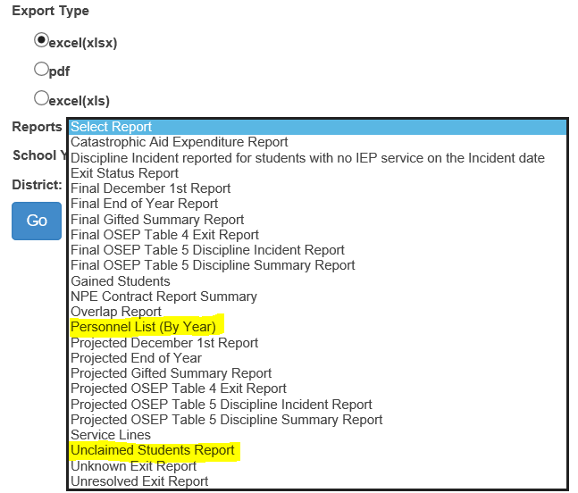
SPEDPro update
Report listing is alphabetical

Slide 11
SPEDPro Update
New Report – Unclaimed Students
Indicates which students are not included on projected or final reports due to “not claiming”.
Note: Students with “Not Claimed” on the profile but reported for NPE reimbursement are excluded from this report

Slide 12
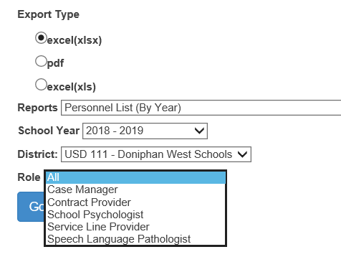
SPEDPro Update
New Report – Provider List
Default Export is .xlsx
Old Excel version is also available
Select any or all provider roles

Slide 13
SPEDPro Update
New Report – Provider List
Logs activity in the Personnel List

Slide 14
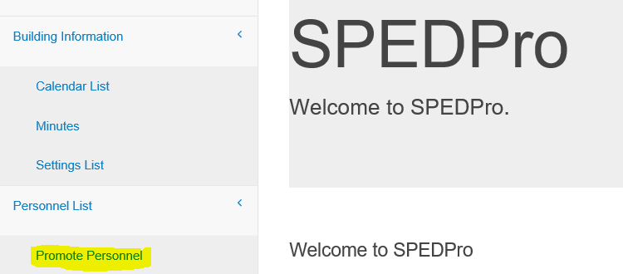
SPEDPro Update
Promote Providers – moving providers from prior to current year
Providers can also be imported or manually entered for the current school year.

Slide 15
SPEDPro Update
Promote Providers – moving providers from prior to current year
3
2
3
Choose current school year
Get Personnel
Select Providers to move
Promote Selected
4

Slide 16
SPEDPro Update
Verification Fixes
Verification 0053 – DD listed for 10 year old
Analysis applies to entire school year
Verification 0145 - entering student
Move in students not listed with entering status
Verification 0225 – Multiple Responsible schools
For the same period of time
Verification 0226 – SPED Transportation
ST service and Yes / No indicator do not align
Verification 0227 – Responsible school ≠ ACC
Most recent responsible school is not an Assign child count school on student profile

Slide 17
Verification Report
Report lists Profile ID, IEP ID, Service line ID or NPE ID
Use ID number as reference to find data triggering verification.

Slide 18
OSEP Data Quality Analysis change
LEA level data to begin OSEP year to year analysis in FY2019
20/20 analysis – Change of 20 or more students resulting in a 20% change
Child Count
Environment
Exiting?
Discipline?
KSDE will be required to provide explanation as to why the number and percent of students has changed.

Slide 19
OSEP Environment change
5 year old students will have environments calculated by Grade
5 year old preschoolers will continue to be counted in the early childhood environment categories.
Participation in a regular early childhood program 10 hours or less
5 year old Kindergartners will be counted in the school age environment categories.
Percentage of time receiving services outside of the regular class.
K time no longer applies to Kindergartners
Verification 0224 – will trigger if the grade level is changed from PR to KG or KG to PR after the December 1 report is finalized

Slide 20
Accurate reporting – Do Recommendations
Do contact KSDE with questions on how to resolve verifications
Do provide KSDE with evidence in cases when a verification is triggering falsely.
Do request false verifications be cleared from the list
Do create calendars accurately at the beginning of the school year.
Do create separate calendars for programs that do not follow the district level calendar.
Do discover what programs are offered in each school building.
Do following Data Dictionary guidance for SPED program buildings.

Slide 21
Accurate reporting – Don’t Recommendations
Do not copy school settings to next year with out discovery
Do not repeatedly import student records that do not contain updates
New problems are introduced that were not present before the import
Do not import batch files days before the collection closes
There may not be enough time to resolve verifications
Do not wait until days before the collection closes to ask how to resolve verifications, change a calendar, submit building setting
Do not fabricate data to cover up late information provided by agency staff

Slide 22
Importing Recommendations
Import batch files of all students once as an initial submissions.
Including all student in each import can cause new discrepancies that had been earlier resolved and / or new discrepancies that will need to be resolved.
Only Import students with data changes, New IEP, corrections to multiple service lines or both Profile and service lines changes
Do not import student records that have no data changes

Slide 23
Unresolved Exits – how to use the report
The Unresolved Exit report is a tool used in August and September of each school year. After September 15, the report has no functionality because the prior Fiscal year collection has closed.
Utilize multiple sources to discover exits from the prior school year
Local KIDS administrators, Primary Providers, Case Managers, Building Staff
First day of school exit warning –
Inaccurately reporting a student as exiting in the current school year to avoid listing on the unresolved exit report will have negative repercussions
Two point deduction for Timely and Accurately reporting.
LEA did not submit complete for the school year collection
LEA did not follow instructions by complying with the reporting standards.
Recommendation – Do not fabricate data

Slide 24
SPED Transportation
When is SPED Transportation reported
When the LEA provides transportation for a student for the provision of special education or other related services as specified in the student’s IEP.
How is SPED Transportation reported?
Like any other related service, with frequency, duration and location.
Which students are reported with SPED Transportation services?
Those students marked as Transportation = Yes on the student profile
Those students reported for Transportation reimbursement on KSDE form 308

Slide 25
SPED Transportation
What is not SPED Transportation?
Transportation provided to all students for daily attendance to and from schools
Transportation not provided or funded by the LEA
Extracurricular transportation not required on the student’s IEP
Any other Transportation provided not stipulated in the student’s IEP

Slide 26
Transportation Location
Using the destination building as the transportation service location
Examples
Destination – Job site - transportation setting = “D”
Destination – off Campus building - transportation setting = “D”
Destination – Day school - transportation setting = “J”
Destination – Alternative school - transportation setting = “H”
Other Transportation locations
Primary service location
Responsible school.
Transportation provider
Destination provider

Slide 27
Attendant Care service
Attendant care service is a service provided by a non-instructional para
Assists with supplementary aids and supports
Observes student activity in the classroom or lunch room
A bus para
Attendant care service could occur simultaneously with other direct IEP services, or delivered on its own.

Slide 28
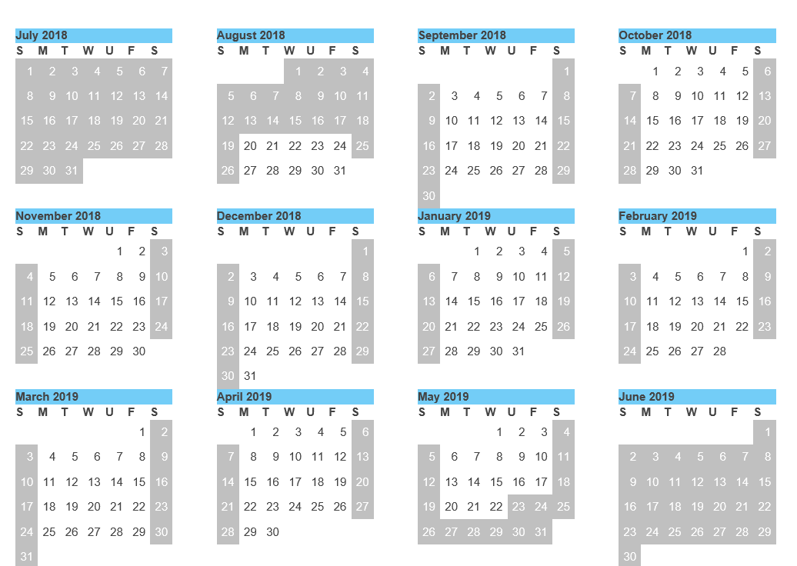
Avoiding Calendar Issues
Mark days classes are not in session from your calendar before student records are imported.
Correcting calendars late in the school year will trigger verifications on every service line for every student because total days of service between start and end dates have new values

Slide 29
Avoiding Directory Issues
Review the building information page.
Find and fix
10 Hour school day, Zero KG class time, 60 minutes sessions
Correcting class minutes in the Directory late in the school year will trigger verification 0224 because the Educational Environment calculation will change.

Slide 30
0176 Flag
Why is 0176 triggering?
Responsible school listed in SPEDPro is not found in the current year KIDS records
Why is the responsible school not found?
SPEDPro lists a different building – Last years school, the wrong building
KIDS records only list private / parochial schools
KIDS records have not been submitted
How to clear 0176?
Submit current year KIDS records listing an elementary, middle or high school of the organization providing special education support
SPED record type in KIDS resolves this issue

Slide 31
Incorrect Responsible School- 0176
Edit service line. Responsible school disappears.
Edit Responsible school, correct building is available for selection

Slide 32
Missing KIDS Records - 0176
Edit service line. No valid responsible school is available for selection

Slide 33
Fixing Gaps in Service
Gap is visible on the Student List Page
What caused the Gap?
Step 1
Where to look next?
Step 2

Slide 34
0224 - December 1 data change
The data from the December 1 final report has changed
Responsible school
Area of Disability
Educational Environment
Changing any data element that factors in the environment calculation will trigger 0224
20

Slide 35
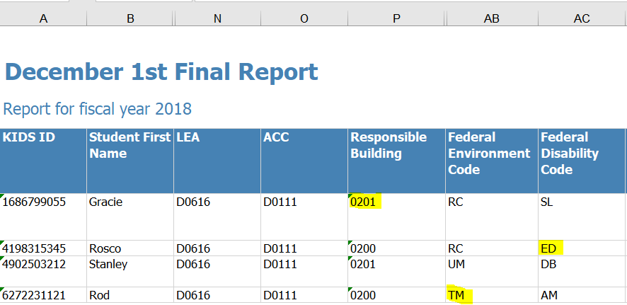
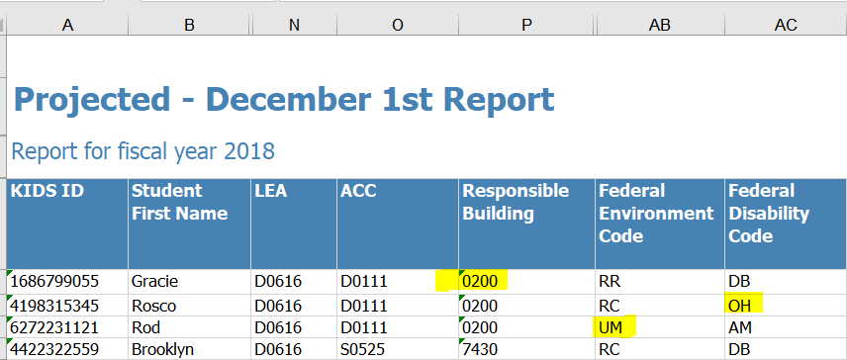
Where to find 0224 changes
Step 1 – Open the December 1 Final report
Step 2 – Create a projected December 1 report today
Step 3 – Search by KIDS ID in both reports and highlight the row
21

Slide 36
Where to find 0224 changes
Step 4 – Compare the values in each column
Responsible school – Column “P”
Federal Environment - Column “AB”
Federal Disability - Column “AC”
Step 5 – note the different values
Step 6 – Discover the cause of the change
Report or Verification?
Report – Listed by student. Old value new value
Verification – 3 verifications by area, no values
21

Slide 37
NPE Guidance
What students qualify?
Students who receive services from private, non-public school organizations
Heartspring
Prairie View
Milestones
Summit Achievement
Gillis
Ozanam
Children Center for the Visually Impaired
North Star
Students who participate in the Kansas School for the Deaf / Blind ESY program
March 2018, March 2019 - FAQ

Slide 38
NPE Guidance
Contract
Contracted services
Contracted Agency
IEP
Service
Hours
Start Date
End Date
Provider
License Area

Slide 39
Catastrophic Guidance
Where do the numbers go?
1000 - 320
Total expenses for services provided by outside agency
D.1 = 80% of Transportation cost
D.3 = Total IDEA VI-B funds / December 1 child count total
D.2 or D.6 = Total NPE reimbursement

Slide 40
Monthly FAQ are instructions
Avoid data accuracy point loss for not following instructions
Not following guidance in monthly FAQ can result in point loss

Slide 41
Report Analysis - Projected EOY
Avoid data accuracy point loss for not following instructions
Active students, services ending before last day of school

Slide 42
Report Analysis - Projected EOY
Avoid data accuracy point loss for not following instructions
No Grade level reported

Slide 43
Avoid data accuracy point loss for not following instructions
Report Analysis - Projected EOY
False verifications – applying preschool sessions to grade level student

Slide 44
Report Analysis - Projected EOY
Avoid data accuracy point loss for not following instructions
Invalid District because of invalid responsible school

Slide 45
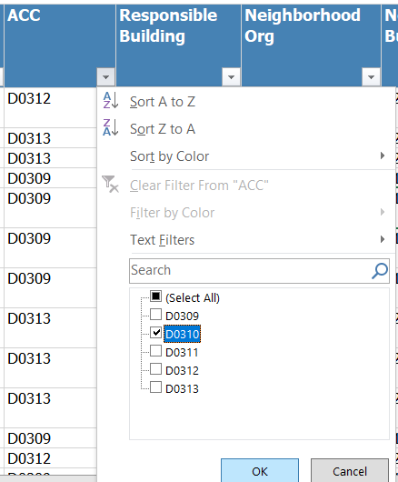
Avoid data accuracy point loss for Child Count
Report Analysis - Projected Dec 1
Confirming student population
Select district from ACC column
Click OK
Total record count is listed in lower left corner of Excel report

Slide 46
Report Analysis – Exit Status Report
Avoid data accuracy point loss for Inaccurate Exiting data
Evidence that reported basis of exit should be changed to “T”
Report should have no students listed by September 15

Slide 47
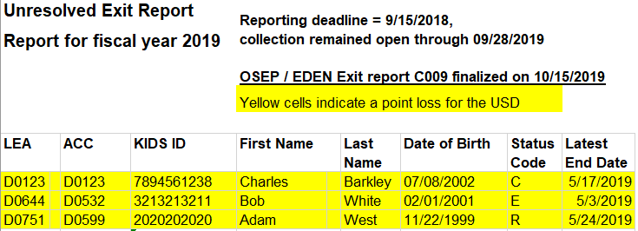
Report Analysis – Unresolved Exit Report
Avoid data accuracy point loss for Inaccurate Exiting data
Active students in end of school year, not found in current school year
USD 123 did not claim the student in KIDS Collection as enrolled or attending in the 2019-20 school year. 0176 present
USD 532 reports in KIDS batch 14485577 on 3/18/2019, student exited on 02/11/2019 - drop out
USD 599 reports in KIDS batch 1494039 on 5/30/2019, student exited on 05/24/2019 - Graduate with Diploma
Report should have no students listed by September 15

Slide 48
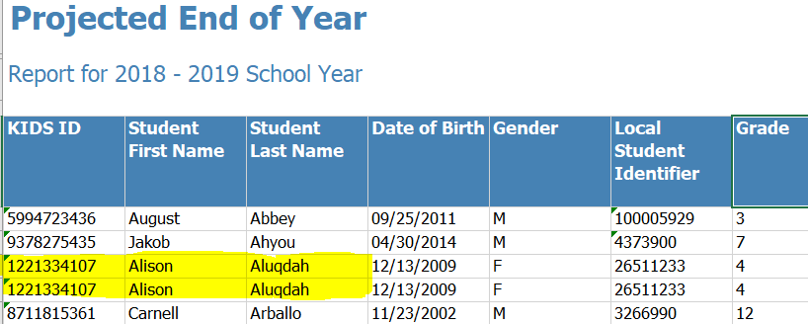
Report Analysis – Duplicate Records
Avoid data accuracy point loss for Duplicated records
Students reported multiple times in current school year
Use Guidance from FY 2019 workshop handbook to find and remove duplicates
Report should have no duplicates listed by September 15

Slide 49
Discipline Incident Report
Look for mis-classification in KIAS as IDEA student or missing IEP services.
Student reported in KIAS as IDEA, not found with IEP services on the date of the incident. KIAS identification may be in error, or MIS data is incomplete.
57

Slide 50
Mason Vosburgh, Data Coordinator
Kansas State Department of Education
900 SW Jackson St.
Suite 600
785-296-4945
mvosburgh@ksde.org
The Kansas State Department of Education does not discriminate on the basis of race, color, national origin, sex, disability, or age in its programs and activities and provides equal access to the Boy Scouts and other designated youth groups. The following person has been designated to handle inquiries regarding the nondiscrimination policies: KSDE General Counsel, Office of General Counsel, KSDE, Landon State Office Building, 900 S.W. Jackson, Suite 102, Topeka, KS 66612, (785) 296-3204

