Slide 1


Obtaining Feedback
Engaging All Families Series
Module 9 of 10
Notes:
Welcome
Welcome to the webinar on Obtaining Feedback.
My name is Jane Groff and I am the Ex. Director of the KS Parent Information Resource Center, and I will be your presenter for this family engagement series on Engaging All Families.

Slide 2
Welcoming
Environment
Recognizing
Diversity
Ongoing
Communication
Open House & Conferences
Sharing Family Resources
Encouraging Involvement
Acknowledging Concerns
Addressing
FAQs
Obtaining
Feedback
Additional
Resources
Engaging All Families Series:
Strategies & Tools to Strengthen Family Partnerships
1
2
3
4
5
6
7
8
9
10
Content for this series is derived from an analysis of research from the family engagement field
(i.e. Joyce Epstein, Anne Henderson), family support organizations, and state agencies that support family partnerships.
Notes:
Engaging All Families Series
This presentation is Module 9 of 10 in our Engaging All Families Series. Content for this series is derived from an analysis of research from the family engagement field, family support organizations, and state agencies that support family partnerships.

Slide 3



Icons Used in Presentation
Indicates files that can be saved to your computer from the FILES POD while watching the webinar
Indicates a website link that will be useful related to the content discussed
Indicates a webinar can be watched related to the content discussed
Notes:
Icons Used in Presentation
Prior to beginning the content of this webinar, there are a couple of things that you may find helpful.
First, there will be icons used throughout the series as visual prompts to additional resources.
When you see a:
• Green Download icon – this is to let you know that the document being discussed can be saved to your computer while watching the webinar. Documents to be downloaded can be found in the Included Resrouces on the webinar platform.
• Blue mouse icon – this will let you know that the slide contains a reference to a website that compliments the content that is being discussed. The link will be provided on that slide.
• Orange monitor icon – this will let you know that a webinar with related content is available for viewing.

Slide 4

This module addresses:
Methods of obtaining feedback
Utilizing feedback results
Notes:
This module addresses:
Several methods of obtaining feedback from families and how to use the feedback results once they are collected.

Slide 5
What is Feedback?
Feedback is information gained from families from a variety of sources
Notes:
Typically information is given TO families and less often is it received from families. It is valuable to collect feedback from families for multiple reasons. Collecting feedback provides parents an opportunity to express their thoughts and feelings. This shows you are interested in knowing their thoughts and opinions.
Feedback is information gained from families from a variety of sources. This may include Families’ personal reaction or opinion about a topic.
Feedback can be collected using formal or informal methods and allows for the development of two-way communication.

Slide 6

Why is Feedback Important?
Helps us to become better educators by identifying our strengths and areas of need
Fosters a relationship with all stakeholders involved
We can’t assume that our families/students have knowledge of everything we want them to know
Notes:
Collecting feedback helps us become better educators by identifying our strengths and areas of need.
IT also fosters a relationship with all stake holders involved because all meaningful communication is two-way.

Slide 7
Be Aware of:
Methods of Obtaining Feedback
Notes:
So it Is important to first become aware of the various methods we can use to obtain feedback from families.

Slide 8


Common Tools and Methods to Obtain Feedback
1. Surveys
2. Interviews
3. Focus Groups
Notes:
The three most common tools to use to gain feedback from families are:
Surveys
Interviews
And Focus groups

Slide 9

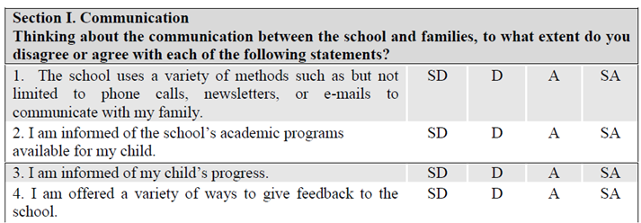
1. Surveys
A process of gathering information by asking questions
Points to determine…
  questions to ask
  target audience
  how to compile and share survey results
  if survey should be offered in other languages based on demographics
Notes:
Surveys are a “Process of gathering information by asking questions”
When designing a survey, it is important to determine:
Which questions to ask
Who is your target audience
How you would like to compile and share the results
And how you can accommodate any language barriers

Slide 10

Types of Surveys
Paper/pencil surveys
Informal testimonial/verbal
Email
Electronic surveys
*Example: www.surveymonkey.com
(free up to10 questions)
Notes:
Again, there are a variety of ways you can give a survey: A Paper/pencil survey still serve its purpose on occasion. Some testimonial or qualitative data can be collected and used for feedback. Survey questions can be sent and completed via email and surveys can be easily created and completed online using a program such Survey Monkey.
Regarding Survey Monkey, there is no cost for this service up to 10 questions. It can be a quick way to get output report graphs and reports.

Slide 11

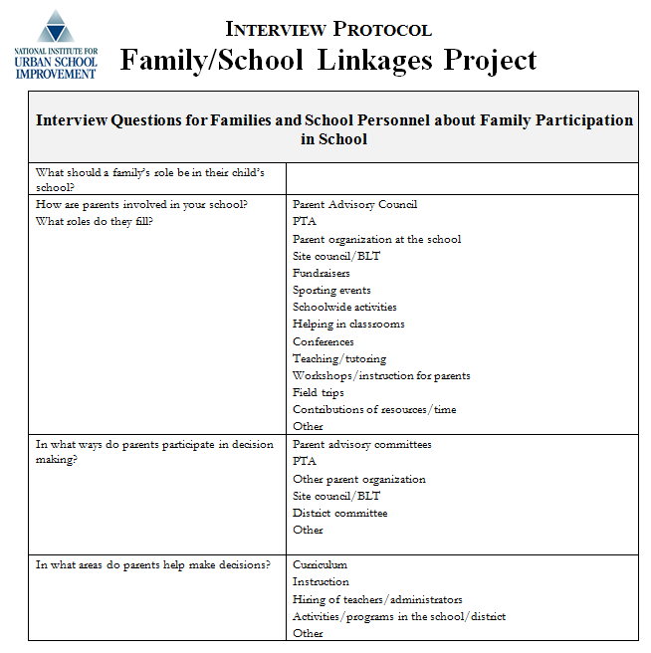
Ask Questions face-to-face and 1:1
2. Interviews
Pros
  More personable
  Read body language
  Ask probing questions
  Two-way communication
Cons
  Time consuming
  Scheduling issues
  Some people may
  not be as open
Tips to Interviews:
-Call person with plenty of advance times
-Tell interviewee the purpose of interview
-Give interviewee agenda (if appropriate)
-Pick a good interviewer for task
-Make sure questions are aligned with objectives
Notes:
We’ve talked about surveys as being one method of obtaining feedback from families….
Another approach to get family feedback is through an interview.
Like surveys, you are still gathering information by asking questions; however, interviews gives families an opportunity to be in a face to face environment.
There are some pros and cons with interviews.
The pros are:
It’s a personable way to get information
The administrator can read body language and ask probing questions
And it helps in making this a two-way process of communication
The cons are:
It is time consuming
With limited resources, there may be scheduling issue
And some family members may not be as open as others
It is a good idea to have a protocol for the questions already typed up so all that needs to be done is to quickly circle the answer.
Here are some quick tips to successful interview:
Tips to Interviews:
-Call the interviewee with plenty of advance times
-Tell the interviewee the purpose of interview
-Give interviewee an agenda (if appropriate)
-Pick a good interviewer to administer the survey
-Make sure questions are aligned with the surveyi objectives
And one other tip when conducting an interview, is would be best to avoid spending too much time writing the responses as it can be very intimidating to some families to see someone writing or taking notes prolifically.

Slide 12


3. Focus Groups
Ask questions face-to-face and group of people
Tips to Interviews:
-Tell interviewee the purpose of interview
-Give interviewee agenda (if appropriate)
-Pick a good interviewer for task
-Make sure questions are aligned with objectives
Pros
  More personable
  Read body language
  Ask probing questions
  Two-way communication
Cons
  Time consuming
  Scheduling issues
  Some people may
  not be as open
Notes:
The third practice of collecting feedback is by way of focus groups:
This technique is face to face but done generally with a small group of people.
This example is an invitation for families to meet with administrators and share their ideas during a coffee club event.
And as with the one on one interview, this method has pros and cons as well…..
Pros
It is More personable
The Interviewer can Read body language
The Interviewer can Ask probing questions
IT promotes Two-way communication and can obtain a variety of perspectives at one time
Cons
It may be Time consuming
You might encounter Scheduling issues
Some people may not be as open to talk in a group
However some quick tips to success would be:
Tips to Interviews:
-Call person with plenty of advance times
-Tell interviewee the purpose of interview
-Give interviewee agenda (if appropriate)
-Pick a good interviewer for task
-Make sure questions are aligned with objectives

Slide 13


Opportunities to Collect Feedback
Open House
Weekly folders/planners
Conferences
Office
Notes:
Timing for getting information feedback is just as important as what you decide to ask families.
Some suggested opportunities to seize information are:
During open house – of any school event/activity, open House tends to attract many families. Asking them to complete a quick survey as a ticket out the door is an efficient way to get their feedback while they are there.
On weekly folders/planners – these tend to go out regularly. A quick survey can be placed in the folder. For the younger students, parents/families are still checking their child’s backpack and it will be easily seen. For older students, including a feedback survey in their planner.
During parent teacher conferences- this would be a good opportunity to do a quick interview as a part of the conference process or a paper/pencil survey that parents could complete before leaving the building
In the office, there could be a drop box with a question prompt….. And families could submit their responses in the box.

Slide 14

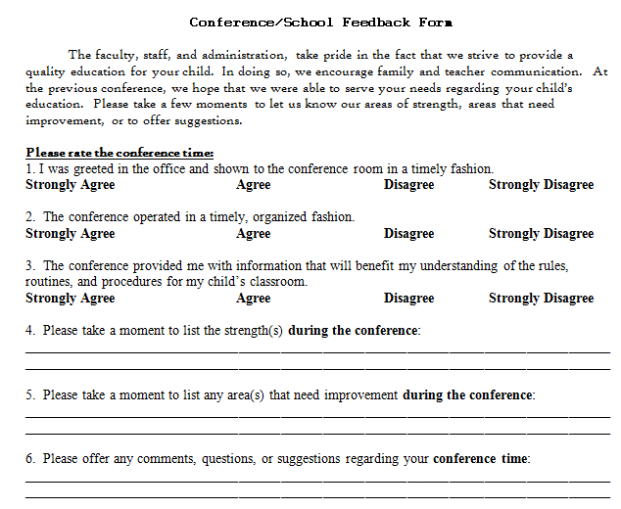
Build Feedback Process into Daily Activities
At a school conference
Notes:
Most families make a point to attend their child’s parent/teacher conferences which provides an opportunity to gain feedback from them. In this example, the school wanted a parents’ perspective about the effectiveness of the parent/teacher conferences and whether or not the families found them helpful or meaningful.
So, immediately following the conference the parents are prompted to complete the form and leave it in a designated drop zone.

Slide 15
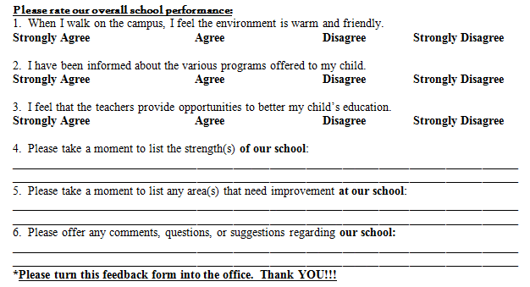
Visitors to Office
Build Feedback Process into Daily Events/Activities
Notes:
Another opportunity to collect feedback is when families are visiting the school’s office. It is likely that families will visit the school’s office more than visiting the classroom, to drop off something or sign their child in or out. And in this example the school is collecting parents opinions of the school’s overall performance. A designated drop zone in the school office would be a great place for families to leave their survey.

Slide 16
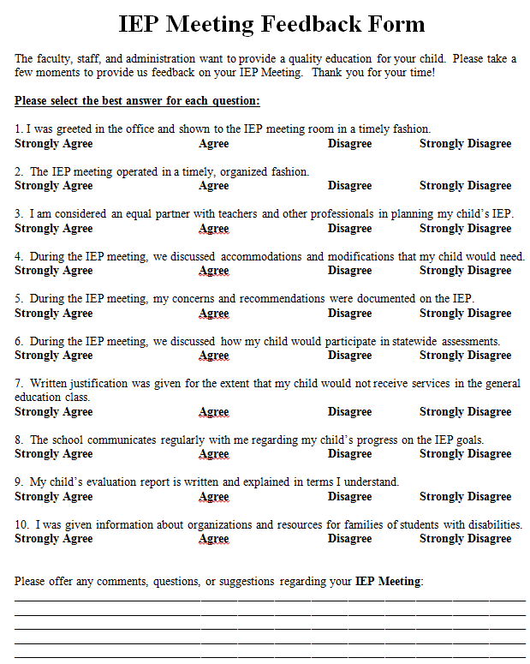
Build Feedback Process into IEP Meeting
Parent/Family Meetings
Notes:
A 3rd opportunity to gather feedback is when families are at the school for special meetings. In this example, the school collected family feedback on issues related to special education services.
Surveying as a part of the IEP process is a good opportunity to ensure that the voice of families of students with disabilities is being heard.

Slide 17
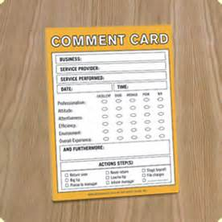
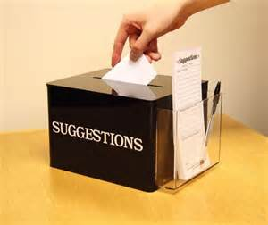

Other Ways to Collect Feedback
Notes:
We’ve talked about structured means of getting feedback, like surveys; however a less structured or informal way of obtaining feedback is by way of testimonial. This would be from a family’s phone call or email or when you see them face to face for example, when they are dropping their child off to school, etc. The advantage to this method is that it is not structured and the family member would be free to express his/her thoughts. The disadvantage is that these tend to be impromptu. If it’s by way of phone call or face to face, you would need to capture their thoughts in writing by taking notes.
Either way, particularly for the non-structured means of collecting feedback, it is important to find a way to compile and analyze the feedback so that you can make decisions on how to proceed with the information you have gathered.

Slide 18
Tips on Creating a
Feedback Form
Determine information you want to know
  Best time and method to communicate/meet
  Information related to academics or behavior
  Ask questions to see if families know about:
    Skills that will be tested during the year/curriculum
    Day to day activities
    Report card dates
    Communication from school
Keep it short
Use mostly “closed-ended” (list of answer choices) questions-the results are analyzed easier
  Do you have internet access in your home?
  A. Yes B. No C. Unsure
Include a few “open-ended” (unstructured response) questions
  Identify one topic that you would like more information on from the school.
Notes:
Creating a feedback form may be more challenging than you’d think. It requires a thoughtful and succinct presentation of the information you want to know. It is easy to ask questions that do not really get you the information you are interested in so it is important to narrow in on what you want to collect.
Make sure that you only ask a few questions. It should not take families very long to complete your surveys. Recent research says that after two minutes on a website, most people click away. You are more likely to get more families to return your form if it is quick and easy, rather than something that would require a great deal of time.
Also, using closed-ended questions help to families to complete the survey quicker, also it makes it easier to organize and analyze the results.
Also, using a couple of open ended questions will give families an opportunity to elaborate on their suggestions and put terminology and feedback in their own words.

Slide 19
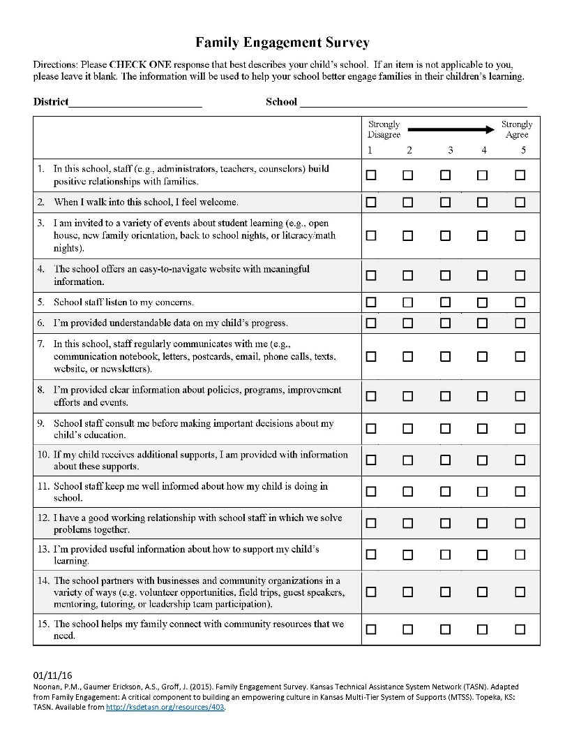
Notes:
The Kansas Parent Information Resource Center and the KSDE TASN Evaluation team recently collaborated to create a fifteen item statewide family engagement survey for districts/buildings to use to gather data on family engagement. The survey is available in English and Spanish. The survey is currently being translated into additional languages.
It is downloadable in the Included Resource Section of the Module 9 web platform.

Slide 20

Notes:
The new family Engagement survey is aligned with the six PTA National Family School Partnership Standards that were endorsed by the Kansas State Board of Education in 2008. The standards are: Welcoming All Families, Communicating Effectively, Supporting Student Success, Speaking UP for Every Child, Sharing Power and Collaborating with the Community. This survey has proven to be very reliable in measuring these six standards of family engagement.

Slide 21
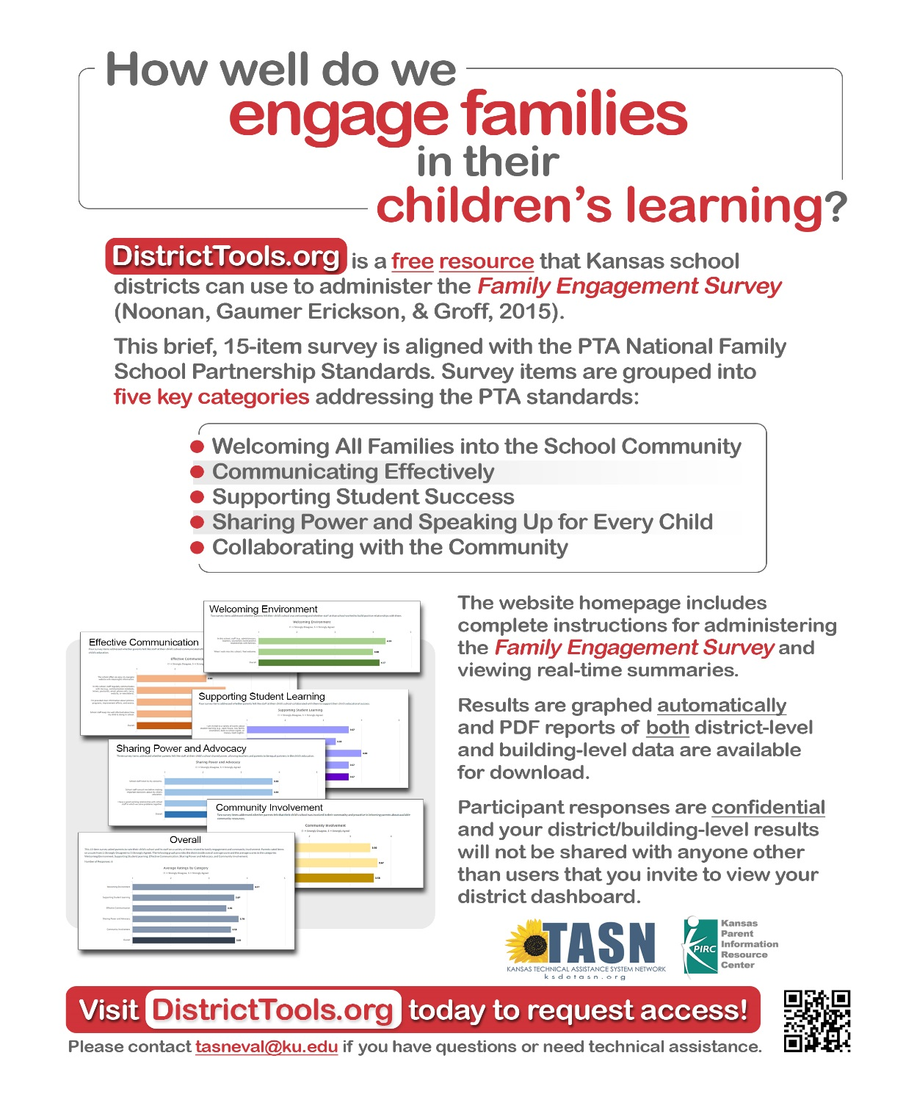
Notes:
Besides being downloaded from this module, the Kansas Family Engagement survey can also be found at DistrictTools.org. Districttools.org is a free resource that Kansas school districts can use to administer the Family Engagement Survey. A representative from a district or school can register and create a link to send to families to complete the survey. As families complete the survey, the data is gathered and results are graphed automatically and PDF reports of both district-level and building level data are available. Participant responses are confidential and results are not shared with anyone other than users that you invite to view your district dashboard.
This handout is available for download in the Included Resources section.

Slide 22

Notes:
Finally, KPIRC has compiled a packet of surveys for educators, school leaders, district leaders, families and the community. These surveys have been created by various organizations and we have gathered them together to be of help as you seek to find surveys that are most suitable for your needs.
This resource is available in the Included Resources section on the Module 9 web platform.

Slide 23
Be Aware of:
How to Use Feedback Results
Notes:
While it is important to carefully choose your method for obtaining feedback from families, it is also important that you determine how you will use the feedback results. For example, is the feedback going to be used to make changes or modifications? OR, is it to gather information to present to the school board? Etc.

Slide 24
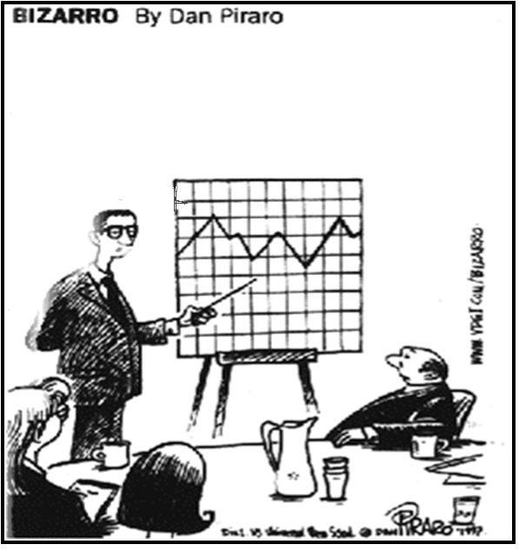
Make the Data Meaningful
…and here’s a chart that shows what you might see if you looked at a mountain range through a tennis racket
Notes:
I really like this cartoon. Take a moment and laugh ☺ We must be responsible with the data we collect. WE should ask ourselves if the data we collected is meaningful or did we collect something that doesn’t provide information that is valuable.
For example, in this cartoon they collected information but it was not meaningful and was used for a dual purpose………..to look at a mountain range through a tennis racket I’m sure was not the reason the data was collected ☺

Slide 25
Analyzing the Data
Notes:
Once the data is received, then it can be analyzed. Some programs such as Survey Monkey will compile the information and make charts for a report. The report can then be analyzed by the team to determine strengths and weaknesses as well as comparisons or growth over multiple years. Other times when we gather data, we may need to manually enter responses into an Excel format which can also provide reports from the data. Consider the manpower you have to collect and enter this data.

Slide 26

Plan Your Next Steps
Focus on a few things that need modification
Develop action steps with deadlines
Feedback is about growth; try not to focus on negative
Notes:
Your data may tell you many things but it is not possible to address everything. So, in order to plan your next steps focus on growth and identify goals. Under each goal develop action steps with deadlines and identify who will complete each action step.

Slide 27

Sharing Feedback
Families
  Open house
  Family meetings
  Newsletter/newspaper
  Website/Social media
  Letter/postcard
  Verbal
Faculty/Staff
  Faculty meetings
  Email
Notes:
Finally, it is important to share the feedback you received from the families. They will appreciate the fact that you took the time to analyze their data and consider their feedback. It is important to make them aware of any changes or modifications made because of their feedback. There are many opportunities to share the feedback as listed on the slide.
The feedback should also be share with the faculty/staff. This is valuable information that should be discussed thoroughly with the staff to provide them opportunities to share their insights from the feedback.

Slide 28
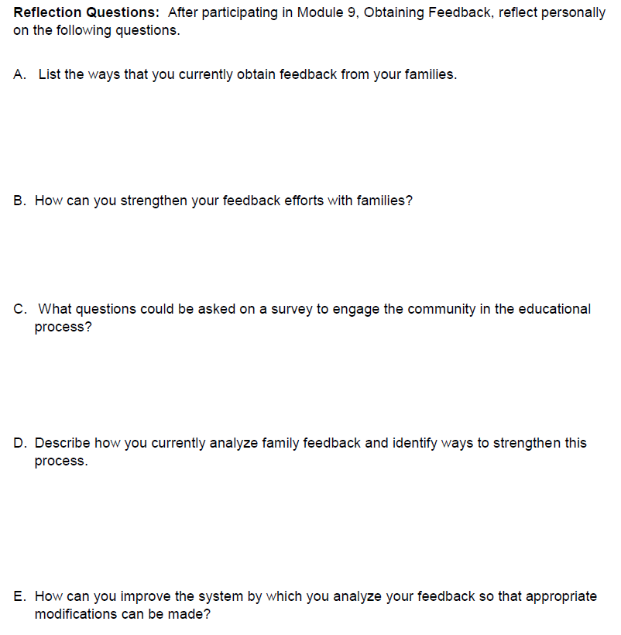

Notes:
Take 5
As a recap, when planning to Obtain Feedback from Families, you should be Aware of …… the various Methods to Collect Feedback from Families and How to Use the Feedback Results.
As a final consideration, I would like for you to Take 5…..that is take these 5 questions or statements and reflect on them:
List the ways that you currently obtain feedback from your families.
B. How can you strengthen your feedback efforts with families?
C. What questions could be asked on a survey to engage the community in the educational process?
D. Describe how and when you provide feedback to your families.
E. How can you improve the system by which you analyze your feedback so that appropriate modifications can be made?
And after you have “Taken 5”, you are ready to Obtain Feedback from Families.

Slide 29


www.ksdetasn.org/kpirc
Special thanks is given to the Louisiana Department of Education in the development of this module and additional resources.
Notes:
Closure
In closing, I encourage you to visit our website at the web address on your screen, where you can view the other webinars under the Family Engagement tab for the Engaging All Families Series as well as other resources.
Again, this is Jane Groff and on the behalf of the Kansas Parent Information Resource Center, a TASN project, I thank you for viewing this webinar.

