Slide 1


Addressing Frequently Asked Questions
Engaging All Families Series
Module 8 of 10
Notes:
Welcome
Welcome to the webinar on Addressing Frequently Asked Questions.
My name is Jane Groff, and I will be your presenter for this family engagement series on Engaging All Families.

Slide 2
Welcoming
Environment
Recognizing
Diversity
Ongoing
Communication
Open House & Conferences
Sharing Family Resources
Encouraging Involvement
Acknowledging Concerns
Addressing
FAQs
Obtaining
Feedback
Additional
Resources
Engaging All Families Series:
Strategies & Tools to Strengthen Family Partnerships
1
2
3
4
5
6
7
8
9
10
Content for this series is derived from an analysis of research from the family engagement field
(i.e. Joyce Epstein, Anne Henderson), family support organizations, and state agencies that support family partnerships.
Notes:
Engaging All Families Series
This presentation is Module 8 of 10 in our Engaging All Families Series. Content for this series is derived from an analysis of research from the family engagement field, family support organizations, and state agencies that support family partnerships.

Slide 3



Icons Used in Presentation
Indicates files that can be saved to your computer from the FILES POD while watching the webinar
Indicates a website link that will be useful related to the content discussed
Indicates a webinar can be watched related to the content discussed
Notes:
Icons Used in Presentation
Prior to beginning the content of this webinar, there are a couple of things that you may find helpful.
First, there will be icons used throughout the series as visual prompts to additional resources.
When you see a:
•Green Download icon – this is to let you know that the document being discussed can be saved to your computer while watching the webinar. Documents to be downloaded can be found in the Included Resource section on the right hand side of the webinar platform.
•Blue mouse icon – this will let you know that the slide contains a reference to a website that compliments the content that is being discussed. The link will be provided on that slide.
•Orange monitor icon – this will let you know that a webinar with related content is available for viewing.

Slide 4

This Module Addresses:
Common questions asked by families
Strategies to address frequently asked questions
Notes:
This Module Addresses
Some of the most Common questions asked by families
Strategies to address frequently asked questions

Slide 5
Why is This Topic Important?
If we know what families most commonly have questions about, we can tailor our communication efforts to meet their needs BEFORE they need help
We cannot assume that families already know this information discussed in this section
Notes:
Why is This Topic Important
If we know what families most commonly have questions about, we can tailor our communication efforts to meet their needs BEFORE they might need help. Families appreciate the information and it saves educators time and stress.
We cannot assume that families already know this information that will be discussed in this section. So it is important to think through these questions.

Slide 6

Notes:
What Families Want to Know
It is a myth and misconception to think that families do not want to be engaged.
Families do want to be engaged….In fact, there are things that families really want to know. As mentioned in the resource on your slide:
Families want to know that they belong
Families want information
Families want to able to have a way of contacting teachers
Families also want to help the classroom
And Families also want teachers to love their child and to have structure and appropriate discipline for their child.
Specific strategies are mentioned in each of the categories in this Working Together resource that are simple yet meaningful. For example, telling the families the philosophy of the school is something that families need to be reminded of at least annually if not at every P/T Conference so they are confident in the emphasis on their child’s learning.
This resource is available for download in the Included Resources section on the Module 8 webpage.

Slide 7


How Do I Contact
School Personnel?
Have you conveyed……
your contact information (listed in multiple locations)?
how to contact school for issues not relating to your classroom?
Notes:
One of the most frequently asked questions families have is How to Contact School Personnel? This should be conveyed to the families often and in multiple locations.
Your contact information or the school’s contact information should be included in your newsletters, emails, flyers, on schools’ website. It can also be put on magnets with other school information that families would keep and/post in the home to have easy access.
Families should also know how to contact the school with any general questions not relating to your classroom. For example, who they might contact to be part of a parent organization.

Slide 8

How Can I Check Grades?
Have you conveyed….
log in information if grades are online?
a statement/policy on how often grades are updated in the system?
what grades consist of… quiz, tests, projects, etc.?
Notes:
How Can I Check Grades?
Families may want to know if there is a way to monitor their children’s grades. If your school has an online system for reporting and tracking grades, this should be communicated to parents early in the school year. Too often, the website address is given out but there is no demonstration or actual training of how to access the website.
Log in information should be given to families and opportunities to practice would be helpful. A statement/policy from the teacher can inform families about how often grades are updated in the system and what the grades may consist of. For example, grades may consist of content knowledge as well as participation, effort, attendance, etc. If a statement or policy is given from the teacher on how often grades are updated, teachers need to heed the policy timelines to avoid student and family distress.

Slide 9

How Do I Check Attendance?
Have you conveyed….
the method of notification for student’s absence?
how to track number of absences (on-line systems)?
Notes:
How do I check attendance?
Families should be reminded and encouraged to oversee their child’s attendance. Information on Open House night or on the school’s website and in newsletters should remind and motivate families of the correlation between attendance and grades. Families interact most with teachers and attendance information that comes from teacher is meaningful to them.
Families should clearly understand what the system in place is for an absence. For example, are the parents notified for each absence? Also, if there is a website for parents to monitor attendance, families need to know this information and be reminded of its importance.

Slide 10

Notes:
This is a resource developed by the KS Parent Information Resource Center and a national organization called Attendance Works. It provides families with information on the importance of regular attendance beginning in preschool and elementary school. It also provides tips for parents on what they can do to promote regular attendance. It explains what chronic absence is as well as warning signs.
This resource is available in Spanish on the reverse side of the resource. It is available for download in the Included Resources section.

Slide 11
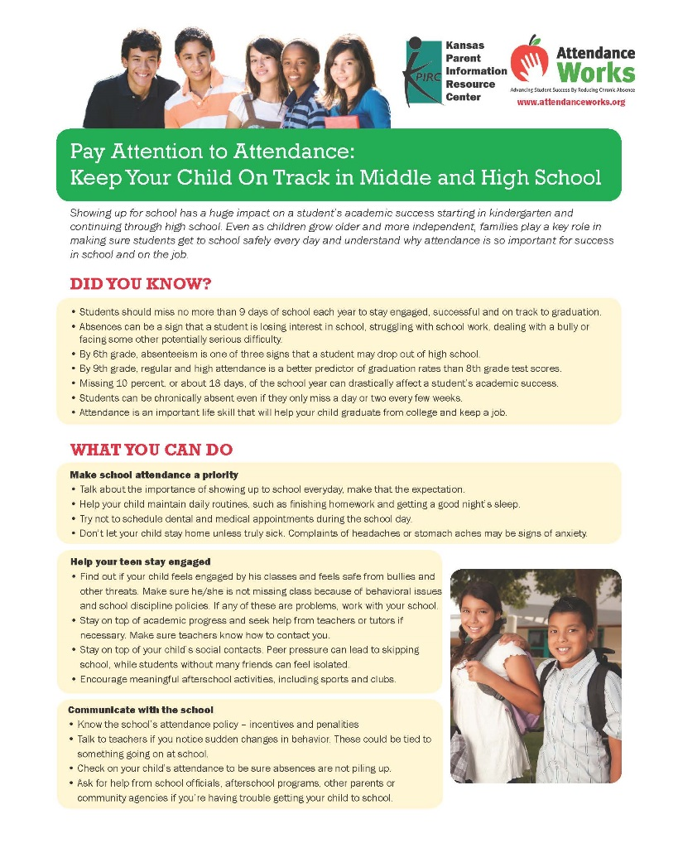
Notes:
A similar resource is available for middle and high school students and families. It provides families with information on the importance of regular attendance and its impact on academic success. It also provides tips for parents on what they can do to promote regular attendance and help their teen stay engaged in school.
This resource is available in Spanish on the reverse side of the resource. It is available for download in the Included Resources section.

Slide 12

What If My Child Has Make Up Work?
Have you conveyed….
the school and class policy on make-up work?
the process for completing make-up work?
how to access class activities online?
how to monitor grades and absences?
Notes:
A family friendly handbook is a good idea to welcome families and remind them of school policies and procedures. A parent handbook may convey policies on make-up work or homework in general. If a teacher posts information online from class activities, families should know how to access this information as well as monitor of grades and homework.
Remember to make the handbook in family friendly language and welcoming in its tone. It is an opportunity to provide information to families in one place. The handbook should be posted online also.

Slide 13

Where Can I Find School Meals Schedule?
Have you conveyed….
the location of current school menu?
the how to make payments?
the free and reduced forms?
Notes:
Meal planning is surprisingly very important, especially for parents who pack a lunch for their child. There may be certain meals their child will eat at the school if the menu is known and certain meals a child must avoid. Schools should convey other lunch information such as, how to make payments for lunch, what happens if payments are overlooked, explanations of free and reduced lunch access and, of course, the school menu.

Slide 14

What If I Need Help
With Homework?
Have you conveyed……
the types of resources that can be accessed at home?
clear instructions and due dates?
Refer to Module 5-Sharing Family Resources
Notes:
Homework can be a frustrating experience for families. Teachers can help relieve this frustration by explaining their view of homework and expectations as well as how families can find supports for homework. Generally, the frustration is due to a lack of clear instructions for the homework, due dates and clarity about the helpful resources that can be accessed at home.

Slide 15

Notes:
In the book Strengthening the Connection Between School & Home there is a Sample Parent Homework Help Tips sheet. It offers parents tips for establishing an environment conducive for homework and questions that they can ask their child to diminish frustration. This resource can be downloaded from the Included Resources section on the right hand side of the module webpage.

Slide 16

Notes:
The Working Together resource also contains a Homework Tip Page. It offers valuable tips on what families can do at the beginning of the year and throughout the year to help them stay engaged with the homework process.
This resource encourages teachers to talk with families about homework so they are able to give more support to their children’s efforts and reinforce the teacher’s goals. This resource is available in the Included Resource section on the right hand side of the module webpage.

Slide 17
Notes:
Families with children with disabilities will need additional information and support for their children. The websites provided in this slide at the national, regional and state level will provide families with additional support.

Slide 18

Notes:
Families with children with disabilities in Kansas would also benefit from being aware of the locations of the KS Parent Training and Information Centers. Staff at these centers can help families understand the complex systems of early intervention, special education and community services. This rack card contains locations and phone numbers of each of the Parent Training and Information Centers.
This resource is available in Spanish on the reverse side of the card and is available for download in Included Resources.

Slide 19

Notes:
Families with children with disabilities in Kansas are often challenged with finding the resources to provide and finance health care for their children because the health care needs are chronic and complex. Family to family staff members understand the issues and tap into a network of other families and professionals for support and information. This rack card provides information on the Family to Family Health Information Centers.
This resource is available in Spanish on the reverse side of the card and is available for download in Included Resources.

Slide 20

Notes:
Families with children with disabilities will be involved in designing their children’s Individual Education Program (IEP). This rack card provides information for families on the development of their child's IEP.
IT is available in the Included Resources section for download as IEP Page 1.

Slide 21
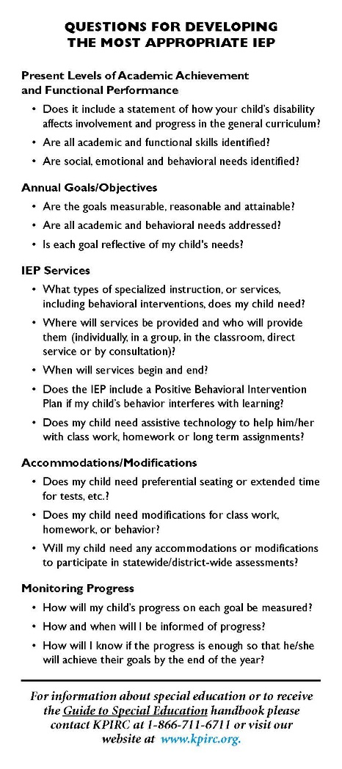
Notes:
On the reverse side of the previous IEP rack card are helpful tips for families for answering questions for developing the most appropriate IEP’s.
As mentioned earlier, the IEP rack card is available in Included Resources as IEP Page 2.

Slide 22

When Are Upcoming
School Events?
Have you conveyed…..
dates for family nights?
dates for testing?
information about sporting events?
information about extra-curricular activities?
deadlines for class requirements?
Notes:
Normally, schools post online a school calendar for the entire year with important dates in order that families can plan ahead. Posting these dates well ahead of time is considerate of family planning for vacations or doctor appointments. This may also help reduce absenteeism.
It is important to communicate dates for the first and last day of school, school breaks and other events such as family nights, testing, sporting events, other extracurricular activities and deadlines for class requirements.

Slide 23
How Do I Prepare for Parent-Teacher Conferences?
Have you conveyed….
the schedule for conferences?
the outcomes for conferences?
tools and resources to support families in preparing for conferences?
Refer to Module 6 – Open House and Conferences
Notes:
Preparation for Parent/Teacher Conferences should be thoroughly considered. Since some families only engage with the teacher and school at Parent Teacher Conferences, specific planning for the content of the conference should be well thought out. Well before the conference, the schedule, outcomes and tools and resources to support families in preparing for the conference should be distributed.

Slide 24

Notes:
Teachers may need additional support for planning and designing menaingful parent teacher conferences. This resource is helpful because it provides tip sheets for the principal, teachers and parents in planning for Parent Teacher Conferences. For example, it provides questions for the parents to ask of the teacher at the conference. It also provides insights to the principal and teachers as they plan for the conferences.
The resource is available in Included Resources and can be downloaded.

Slide 25

How Can I Volunteer at School?
Have you conveyed….
a list of activities/sign up for the year
opportunities to help in office (copies, bulletin boards, etc.)
activities to help students (i.e. reading to students, chaperone field trips, etc.)
Refer to Module 6: Encouraging Involvement
Notes:
Some families want to know how or if they can volunteer at their child’s school. This question is best addressed by providing this information either in a parent handbook, on the school website, in a newsletter or a discussion on Open House night. Suggestions can be offered to families for volunteerism through a list of activities that they may sign up for the school year. Opportunities for volunteerism can also be provided to the families to help students academically through becoming a reading buddy or mentor.

Slide 26

How Can I Collaborate
With The Community?
Have you conveyed…..
how families can participate on school committees?
how families can advocate for the school in the community?
Notes:
Schools benefit from community support. Invitations to families and community members to participate on school committees should include representatives that reflect the diversity of the community. Families can also advocate for the school in the community.

Slide 27
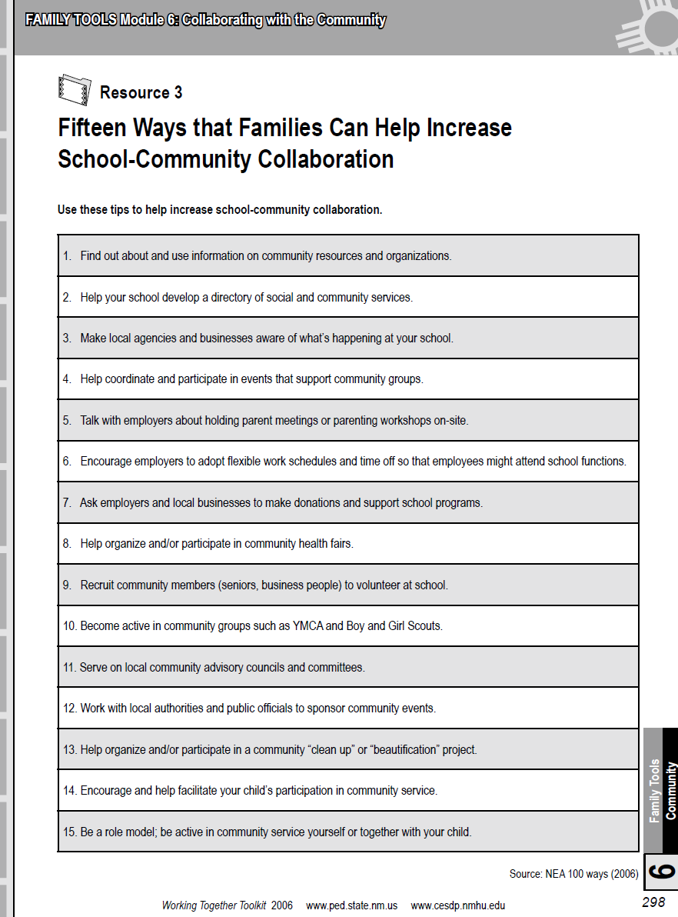
Notes:
Many times families are unaware of the services their community may offer them and their children. The school can Serve to bridge this gap between the community and families. Some schools create a community resource list that is available in the office for families or distributed to families at parent teacher Conferences.
This resource, Fifteen Ways that Families Can Help Increase School-Community Collaboration is available for download in the Included Resources Section on the module webpage. It is a tool that is helpful for educators to examine how to better engage their community.

Slide 28
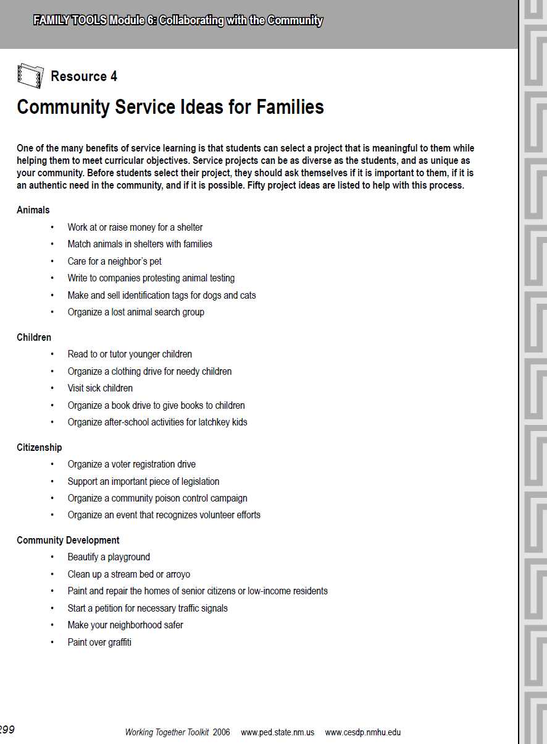
Notes:
Service learning projects are a great opportunity for families and schools to work together to engage with the community and for community service. This resource helps us to think about areas such as Animals, Children, Citizenship or Community Development for service learning projects. It is available for download in the Included Resources section.

Slide 29
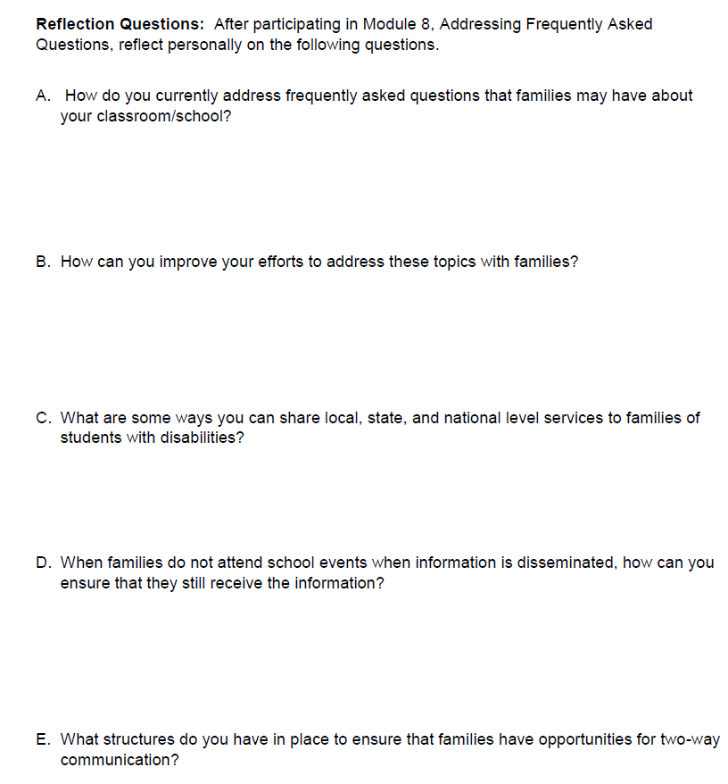

Notes:
Take 5
As a recap, when planning to Address Frequently Asked Questions, you should be Aware of ……
The most common questions asked by families
strategies to address frequently asked questions
As a final consideration, I would like for you to Take 5…..that is take these 5 questions or statements and reflect on them:
How do you currently address frequently asked questions that families may have?
How can you improve your efforts to address these topics with families?
What are some ways you can share local, state, and national level services to families of students with disabilities?
When families do not attend school events when information is disseminated, how can you ensure that they will receive the information?
What structures do you have in place to ensure that families have opportunities for two way communication?
And after you have “Taken 5”, you are ready to Address Frequently Asked Questions.

Slide 30


www.ksdetasn.org/kpirc
Special thanks is given to the Louisiana Department of Education in the development of this module and additional resources.
Notes:
Closure
In closing, I encourage you to visit our website at the web address on your screen, where you can view the other webinars under the Family Engagement tab for the Engaging All Families Series as well as other resources.
Again, this is Jane Groff and on the behalf of the Kansas Parent Information Resource Center, a TASN project, I thank you for viewing this webinar.

