Slide 1


Additional Resources
Engaging All Families
Module 10 of 10
Notes:
Welcome
Hello and Welcome to the webinar on Additional Resources.
My name is Jane Groff and I am the Ex. Director of the KS Parent Information Resource Center, and I will be your presenter for this family engagement series on Engaging All Families.

Slide 2
Welcoming
Environment
Recognizing
Diversity
Ongoing
Communication
Open House & Conferences
Sharing Family Resources
Encouraging Involvement
Acknowledging Concerns
Addressing
FAQs
Obtaining
Feedback
Additional
Resources
Engaging All Families Series:
Strategies & Tools to Strengthen Family Partnerships
1
2
3
4
5
6
7
8
9
10
Content for this series is derived from an analysis of research from the family engagement field
(i.e. Joyce Epstein, Anne Henderson), family support organizations, and state agencies that support family partnerships.
Notes:
Engaging All Families Series
This presentation is Module 10 of 10 in our Engaging All Families Series. Content for this series is derived from an analysis of research from the family engagement field, family support organizations, and state agencies that support family partnerships.

Slide 3



Icons Used in Presentation
Indicates files that can be saved to your computer from the FILES POD while watching the webinar
Indicates a website link that will be useful related to the content discussed
Indicates a webinar can be watched related to the content discussed
Notes:
Icons Used in Presentation
Prior to beginning the content of this webinar, there are a couple of things that you may find helpful.
First, there will be icons used throughout the series as visual prompts to additional resources.
When you see a:
• Green Download icon – this is to let you know that the document being discussed can be saved to your computer while watching the webinar. Documents to be downloaded can be found in the Included Resources on the webinar platform.
• Blue mouse icon – this will let you know that the slide contains a reference to a website that compliments the content that is being discussed. The link will be provided on that slide.
• Orange monitor icon – this will let you know that a webinar with related content is available for viewing.

Slide 4

This module addresses:
Family Engagement
Resources & Tools
Notes:
This module includes Additional Family Engagement Resources and Tools that were not included in the other 9 modules in this series.
There have been many tools, resources, tips that have been shared throughout the other 9 modules of the series but there are still some valuable supports we would like you to become aware of. I would also like to encourage you to begin to grow your library of either online books or hard copy books that you have access to which provide evidenced based practices in engaging families. I will give you titles of some of the most inspiring and practical books for building family-school-community partnerships.
So, here we go.

Slide 5
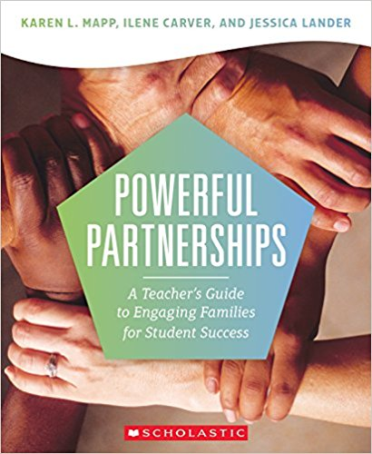
Powerful Partnerships
Newest book (2017) released by Mapp, Carver and Lander.
Teachers and administrators will learn how to create the respectful, trusting relationships with families necessary to build the educational partnerships that best support children’s learning.
The book will cover the mindset and core beliefs required to bond with families.
The book provides guidance on how to plan engagement opportunities and events throughout the school year that undergird effective partnerships between families and schools.
Notes:
One of the newest books released in the summer of 2017, is Powerful Partnerships by Karen Mapp, Ilene Carver and Jessica Lander. Dr. Mapp has been a leading researcher in family engagement for decades. This book helps teachers and administrators learn how to create respectful, trusting relationships with families. It will introduce you to Core Beliefs on family engagement and provide guidance on how to plan engagement opportunities.

Slide 6
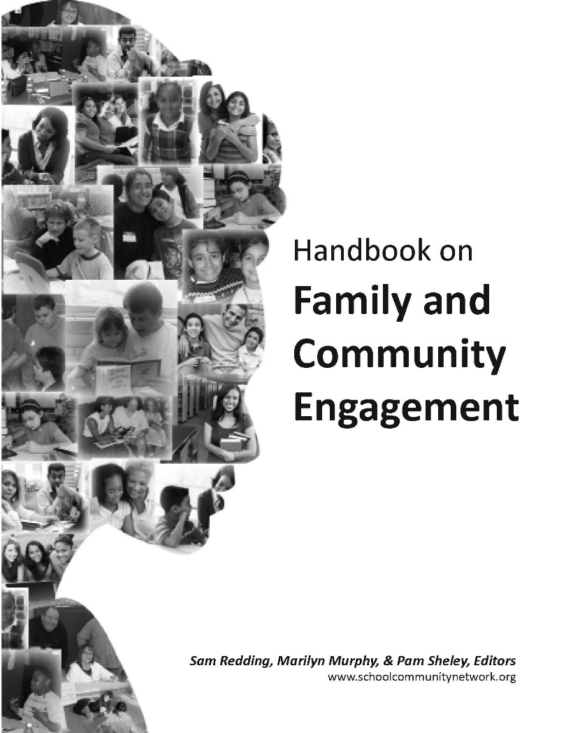
Handbook on: Family and Community Engagement
Thirty-six of the best thinkers on family and community engagement were assembled to produce this Handbook, and they come to the task with varied backgrounds and lines of endeavor. (2011)
The authors tell us what they know in plain language, succinctly presented in short chapters with practical suggestions for states, districts, and schools.
The vignettes in the Handbook give us vivid pictures of the real life of parents, teachers, and kids.
In all, their portrayal is one of optimism and celebration of the goodness that encompasses the diversity of families, schools, and communities across our nation.
Available for free download at: http://www.schoolcommunitynetwork.org/downloads/FACEHandbook.pdf
Notes:
The Handbook on: Family and Community Engagement is a compilation of 36 of the best thinkers on family engagement. The unique feature of this resource is that it provides clear guidance for states, districts and programs individually at the end of each chapter on what steps to take to develop partnerships. IT also includes vignettes of some best practices for engaging families. This handbook is available for free download at: http://www.schoolcommunitynetwork.org/downloads/FACEHandbook.pdf

Slide 7

Organizing Schools for Improvement
In 1988, the Chicago public school system decentralized, granting parents and communities significant resources and authority to reform their schools in dramatic ways.
To track the effects of this bold experiment, the authors of Organizing Schools for Improvement collected a wealth of data on elementary schools in Chicago.
Over a seven-year period they identified one hundred elementary schools that had substantially improved-and one hundred that had not. What did the successful schools do to accelerate student learning?
The authors of this illuminating book (2010) identify a comprehensive set of practices and conditions that were key factors for improvement, including school leadership, the professional capacity of the faculty and staff, parent and family ties, and a student-centered learning climate.
In addition, they analyze the impact of social dynamics, including crime, critically examining the inextricable link between schools and their communities.
Notes:
Organizing Schools for Improvement has become a favorite of mine for using research to support family engagement. Written in 2010, this book lays out the research on 200 failing schools in Chicago and how 100 of them improved and 100 of them did not. The University of Chicago examined all data collected and determined there were a list of five comprehensive practices that were key factors for improvement and family and community ties were one of the five.
I believe this book helps to make sense out of school improvement and identifies family engagement as a key factor in the process.

Slide 8
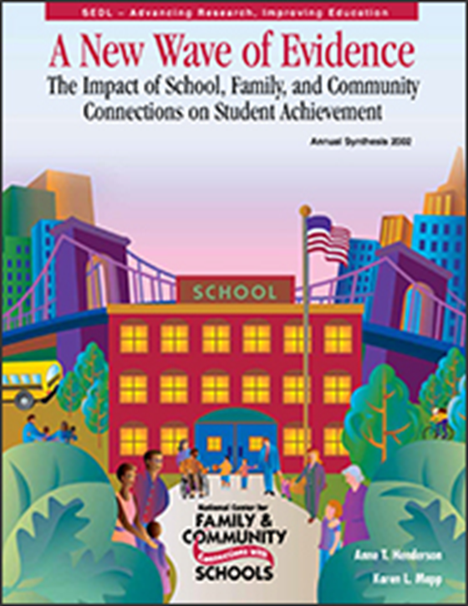
A New Wave of Evidence
Annual synthesis (2002)
In 2000 the U.S. Department of Education’s Office of Educational Research and Improvement charged the Southwest Educational Development Laboratory’s new National Center for Family and Community Connections with Schools (the Center) with doing an annual review and synthesis of current research about family and community connections.
In early 2001 the Center’s staff and steering committee began making plans to document the growing evidence that family and community connections with schools make a difference in student achievement and success.
Notes:
A New Wave of Evidence is an updated version of a synthesis of research that discusses how family engagement is directly linked to student learning and outcomes.
The findings in this research has shaped the direction in which family engagement is headed….which encourages educators to engage families in their children’s learning.
This document is available for your download.

Slide 9

Beyond the Bake Sale
Countless studies demonstrate that students with parents actively involved in their education at home and school are more likely to earn higher grades and test scores, enroll in higher-level programs, graduate from high school, and go on to post-secondary education.
Beyond the Bake Sale (2007) shows how to form these essential partnerships and how to make them work.
Notes:
Beyond the Bake Sale is defined by its title. It encourages school leaders and educators to engage families in strategies beyond a bake sale. Beyond The Bake Sale is based on the New Wave of Evidence synthesis and is a practitioners guide to understanding how to form essential partnerships and how to make them work. IT is full of surveys, sample letters, rubrics and many other practical resources for educators. This book has become a favorite of many educators.

Slide 10

School, Family, and Community Partnerships
Based on 25 years of research, this updated edition of a bestseller details a framework that enables school, district, and state leaders to develop more effective programs for family and community involvement.
A team of well-known experts shows how to create Action Teams for Partnerships and train team members in planning and implementing partnership activities to reach school goals.
New examples of successful partnership activities
Increased attention to connecting family/community involvement to goals for student success
A CD-ROM with forms and a PowerPoint presentation for workshops, with Spanish translations of selected reproducibles
Notes:
The School Family and Community Partnerships shows how to create action teams for partnerships and train team members in planning and implementing partnership activities. IT includes a CD Rom with forms and a PowerPoint presentation for workshops, with Spanish translation of reproducibles.

Slide 11
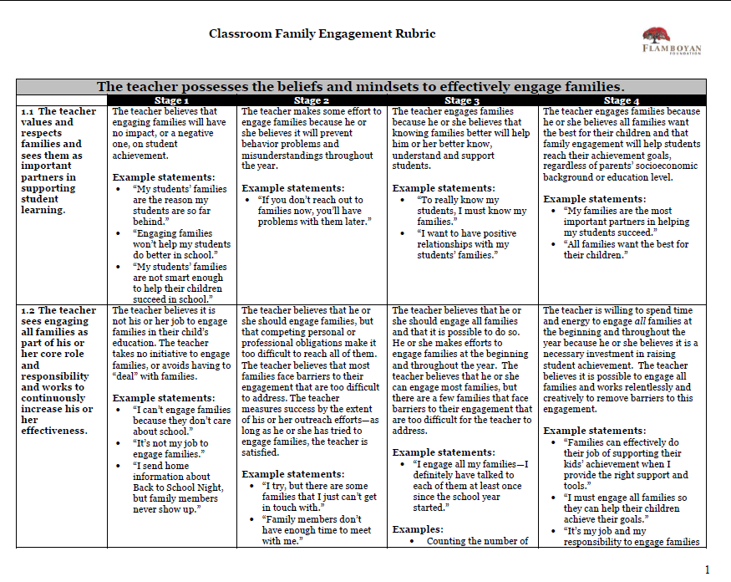
Notes:
Other than books, there are also other valuable resources that I would like to introduce to you in this final module to support your development of engaging all families.
This resource is a Classroom FE rubric. It addresses the teachers beliefs and mindsets to effectively engage families and gives a vision of what a classroom may look like that seeks to engage families. One of the strengths of this resource is that it addresses each topic area with evidenced based practices for the elementary school, middle school and high school.
This tool can be helpful for teachers and it can be used as a tool to inspire conversation for professional learning in family engagement used as discussion points for school leaders during classroom walkthroughs.
It is available in the Included Resource section on the Module 10 webinar platform.

Slide 12

Notes:
A good FE program may take three to five years to establish, so it takes time and effort but keep moving ahead. The Working Together booklet is full of practical strategies that can be supportive of your efforts as your grow and change.
This download shares 50 ideas to boost Family and community engagement and is available in the Included Resources section on the Module 10 web platform. These ideas would be good discussion starters for a staff in-service or a workshop on improving teacher-family communication.

Slide 13
Notes:
This Checklist for Schools can be used as a reflective tool schools and districts can use to encourage family and community support of children’s learning. These programs and practices are meant to be advisory and should be adapted to each school or district’s needs. These topics will bring to mind strategies you may not have thought about such as developing a family center or regular training for staff in reaching out to families. IT is available for download in the Included Resources section on the Module 10 webinar platform.

Slide 14
Notes:
This is a list of web resources for teachers on family-school-community partnerships that contain some of the most current research and information on family engagement. I would encourage you to spend some time exploring the websites and discovering what strategies or programs each resource may hold for you and your school or classroom.

Slide 15
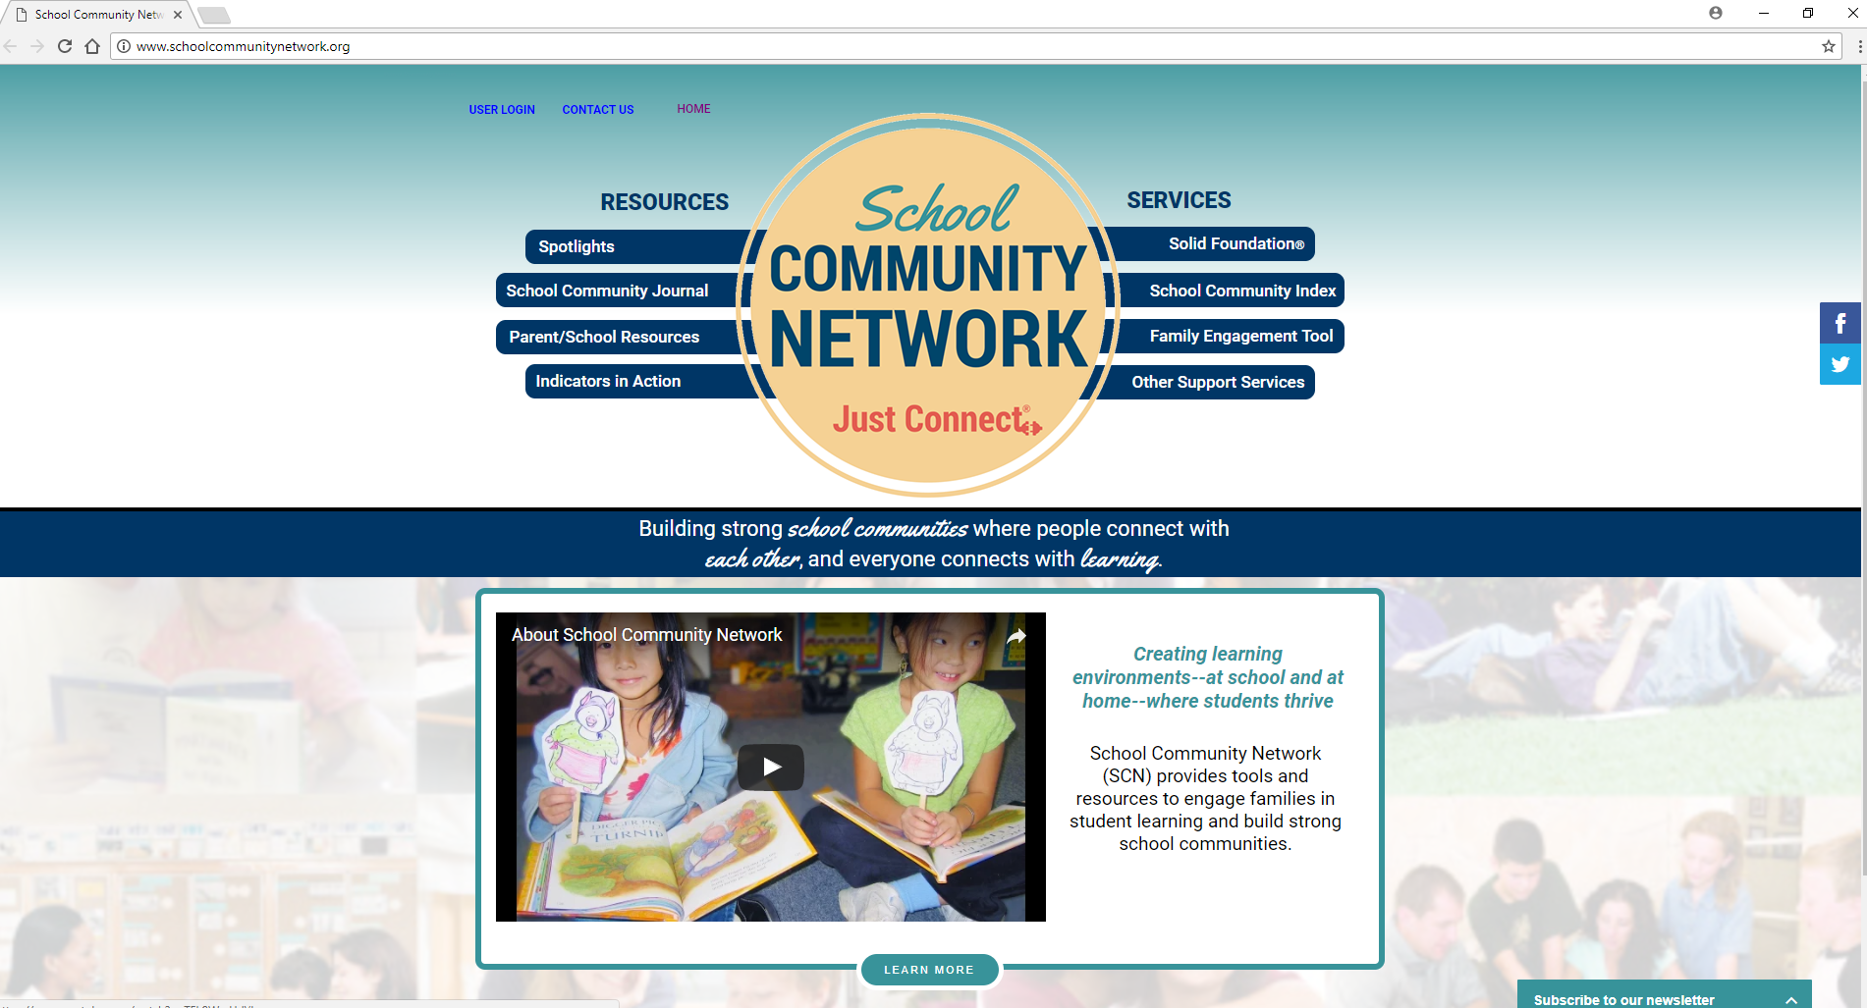
Notes:
There are several valuable websites that I would like to introduce to you in the following slides. The School Community Network (SCN) website provides tools and resources to engage families in student learning and build strong school communities. Their website includes The School Community Journal which is a journal that includes research and field reports related to the school as a community of teachers, students, parents, and staff. The website also helps parents in the education of their children and schools in their work with families by providing resources in which you can search the databases by age group, topic or key word for free activities, articles and resources. This website is located at: http://www.schoolcommunitynetwork.org

Slide 16
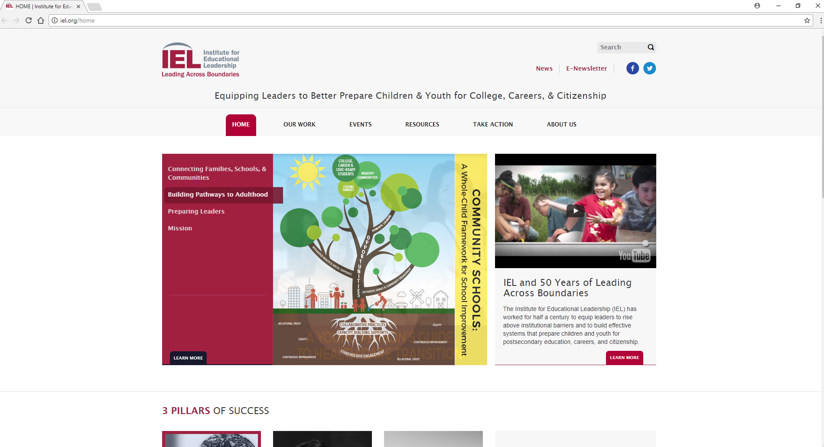
Notes:
The Institute for Educational Leadership (IEL) focuses on three pillars required for young people and their communities to succeed. One of the three pillars is Connecting Families, Schools, and Communities.
IEL strives to involve the broader community with public education to support the learning and development of young people. This means helping bring families, schools, and community resources together as partners for the common good. IEL hosts an annual family engagement conference in which practitioners gather to share their expertise and resources.
The website is: www.iel.org

Slide 17
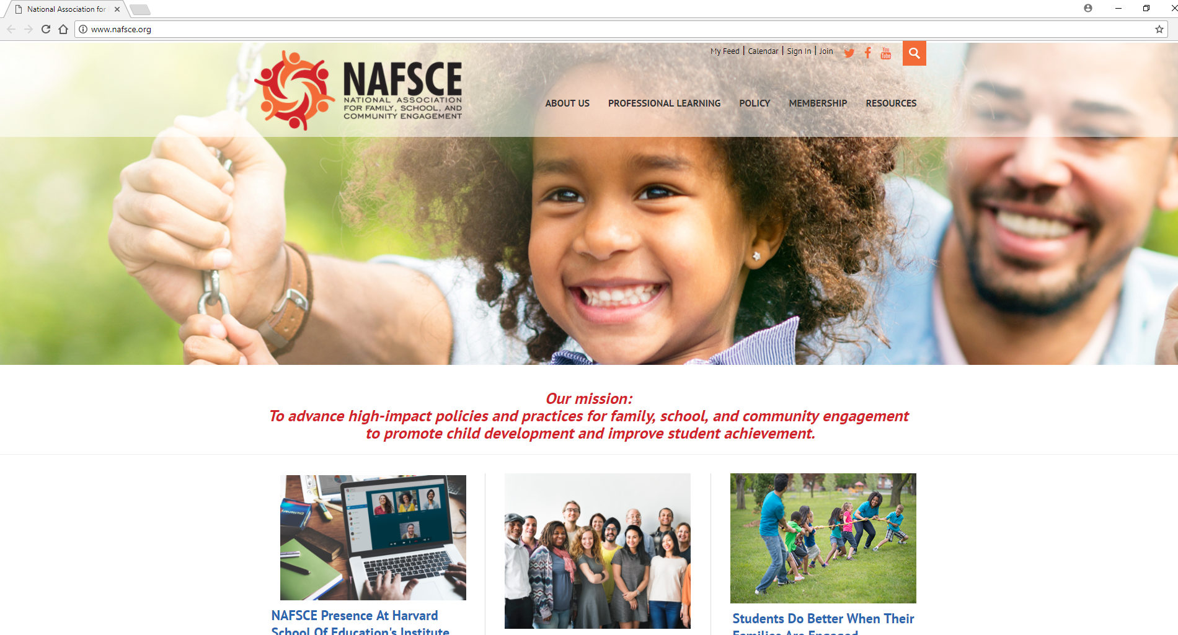
Notes:
The National Family Association for Family, School, and Community Engagement (NAFSCE) is the leading organization for family-school-community partnership memberships. Their mission is to advance high-impact policies and practices for family, school, and community engagement to promote child development and improve student achievement.
NAFSCE Members have full access to professional learning programs, a resource library, online communities, career center and other opportunities. The website is www.nafsce.org

Slide 18
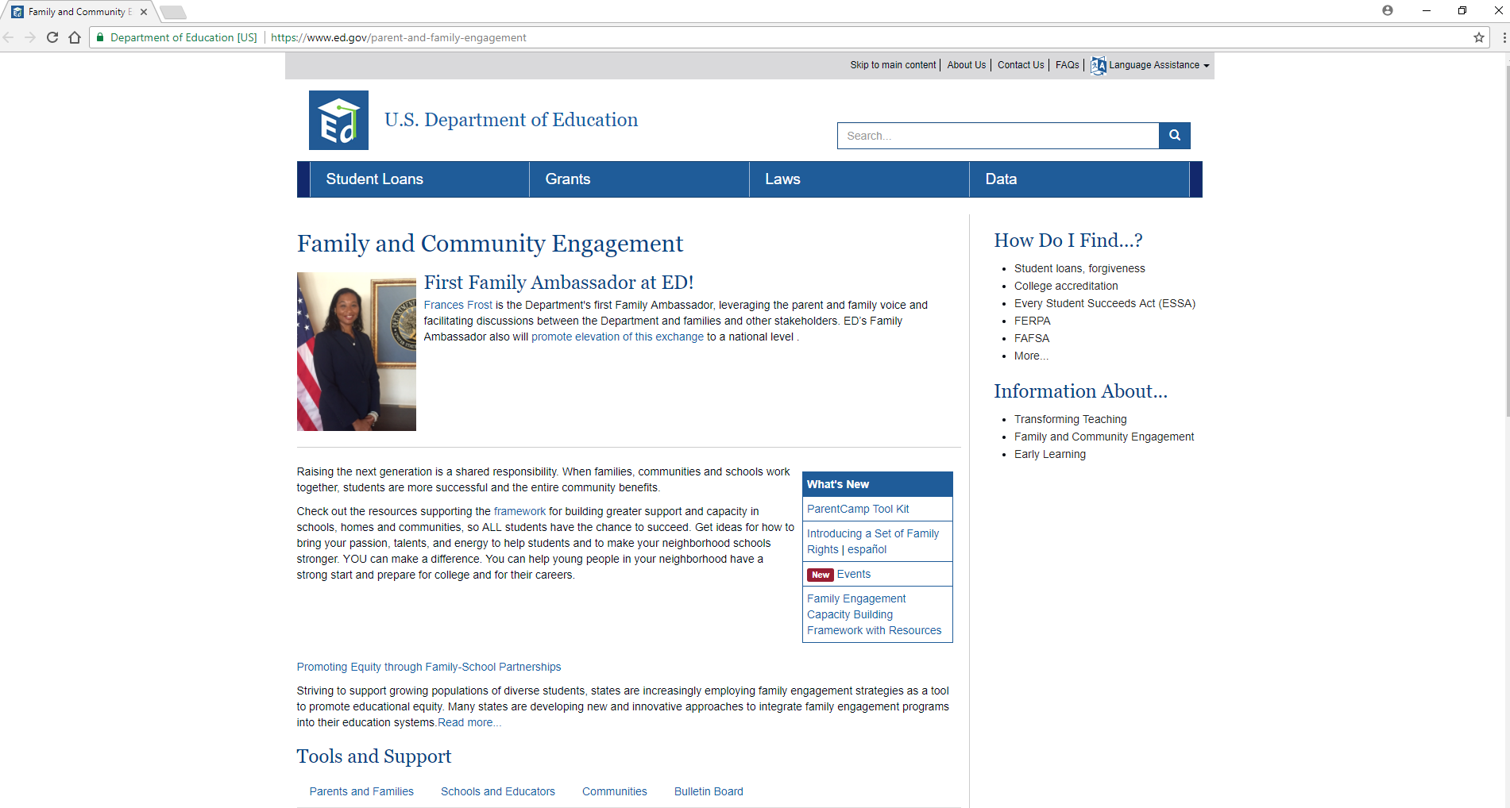
Notes:
The U.S. Department of Education Family and Community webpage is located at: https://www.ed.gov/parent-and-family-engagement This webpage contains current topics on family engagement that the federal government posts. For example, a new family engagement ambassador has recently been appointed to leverage the parent and family voice and facilitate discussions between the Department and families and other stakeholders.

Slide 19
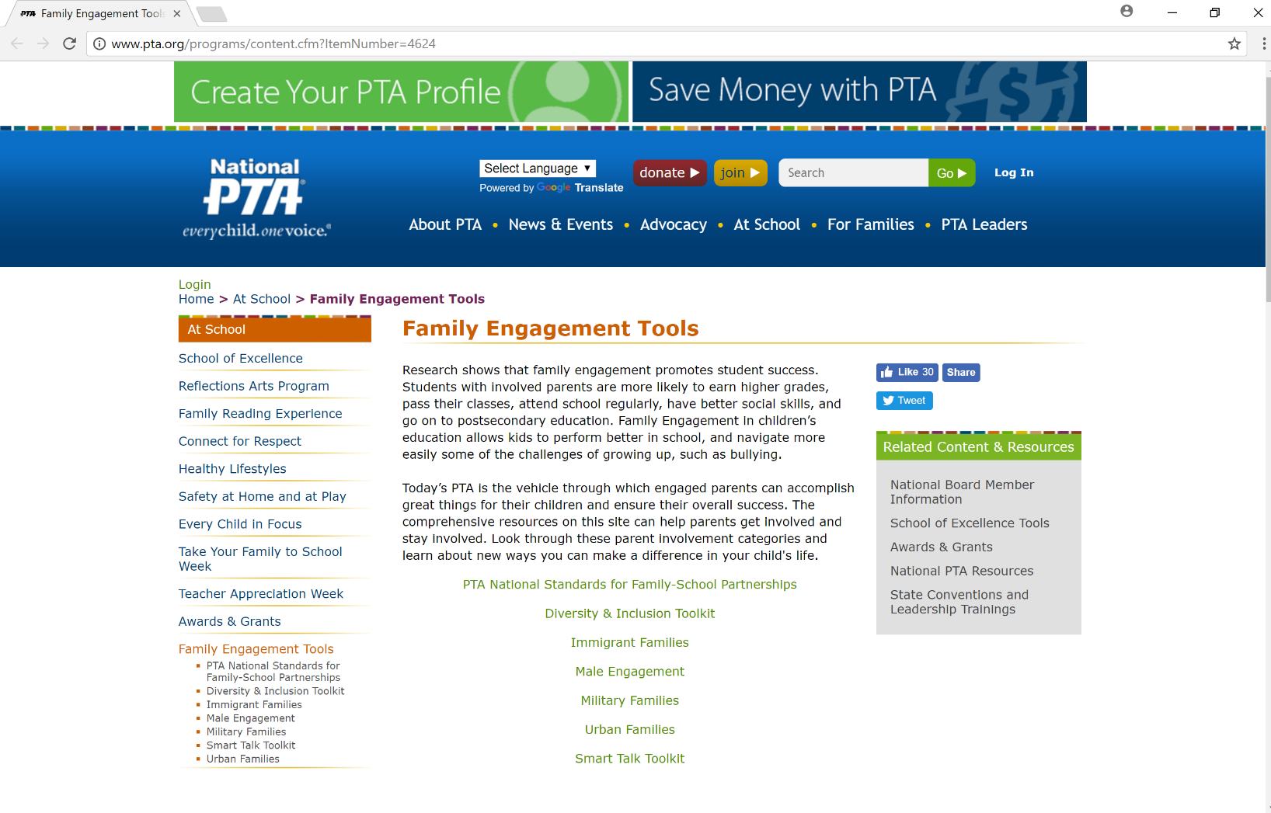
Notes:
The National Parent Teacher Association (PTA) is the vehicle through which engaged parents can accomplish great things for their children and ensure their overall success. The comprehensive resources on this site can help parents get involved and stay involved. Look through these parent involvement categories and learn about resources that can be copied, distributed, texted or tweeted to your children's families.
The website is: http://www.pta.org/programs/content.cfm?ItemNumber=4624

Slide 20
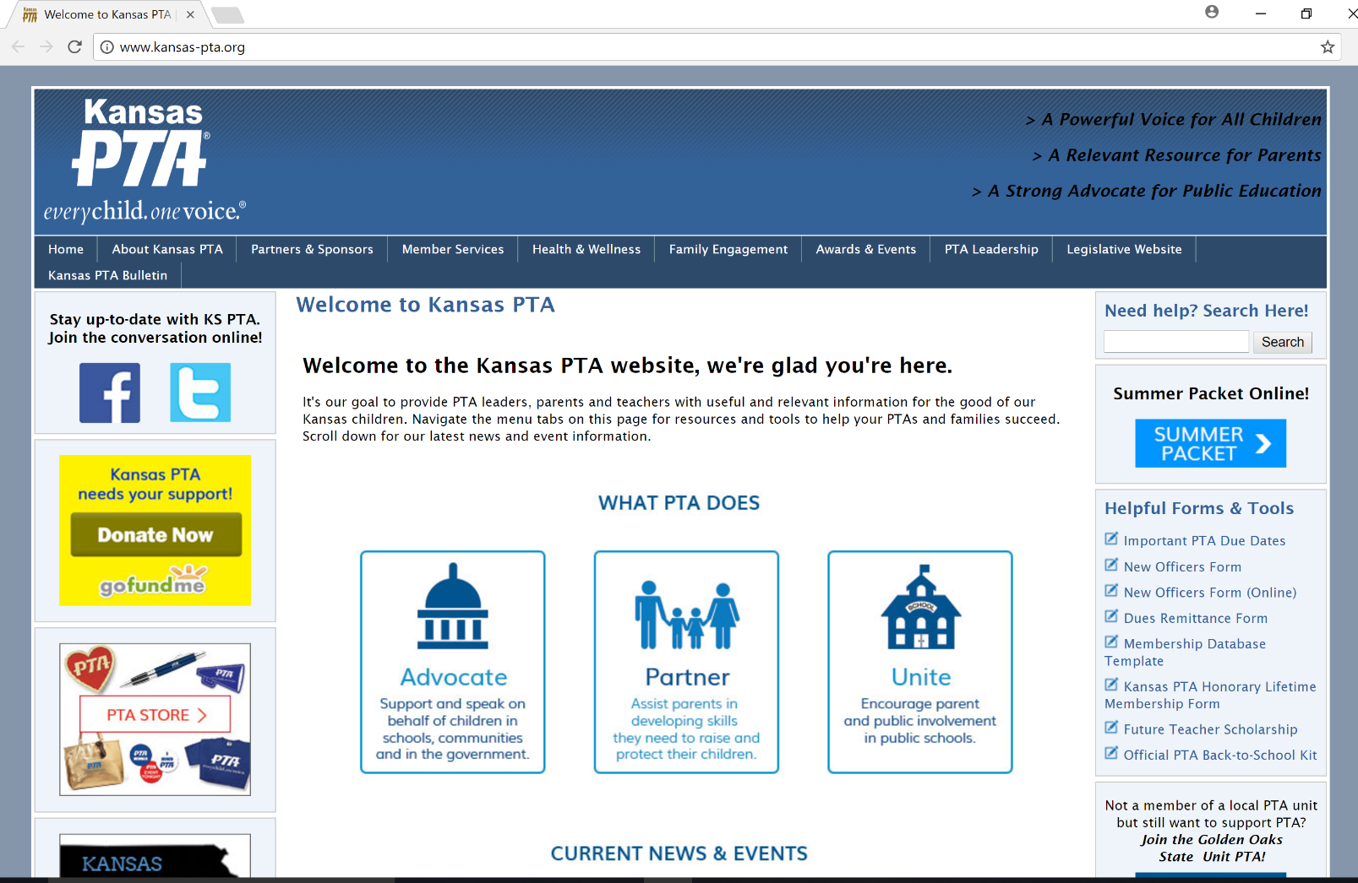
Notes:
It is the goal of KS PTA to provide leaders, parents and teachers with useful and relevant information for the good of our Kansas children. Current information on the Every Student Succeeds Act (ESSA) is provided on the KS PTA website for KS families and educators as well as other issues concerning education in the state of KS.
It is PTA’s goal to provide PTA leaders, parents and teachers with useful and relevant information for the good of Kansas children. The website is: www.Kansas-pta.org

Slide 21
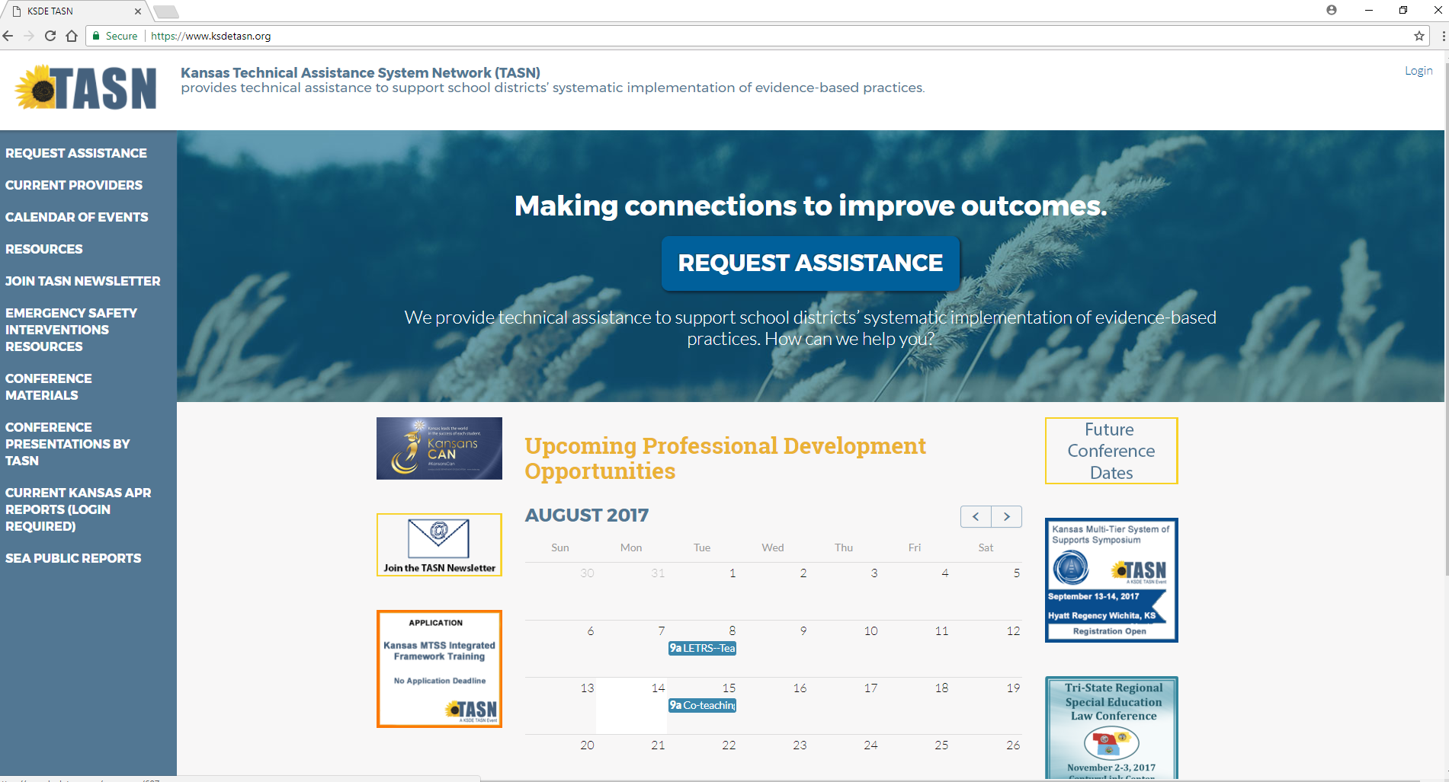
Notes:
The KS Technical Assistance System Network (TASN) is an online resource for KS educators. TASN provides technical assistance to support school districts’ systematic implementation of evidence-based practices. On the left hand side of the homepage is a Current Provider link. If you click on this link you will see a list of the providers available to you through TASN. The KS Parent Information Resource Center is among this list. For any needs pertaining to family engagement or other topics click the Request Assistance blue button on the homepage and submit your request for support. You will receive a prompt reply with how the TASN network can support you. The website is https://www.ksdetasn.org

Slide 22

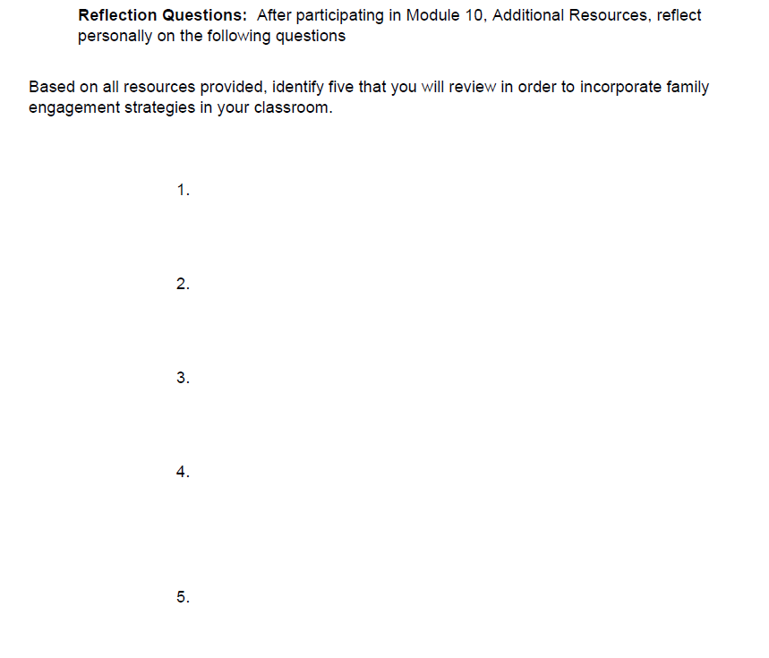
Notes:
Take 5
As a recap, when planning to use additional resources, you should be Aware of ……The variety of resources, tools, tips, supports that are available to you. As a final consideration, I would like for you to Take 5….. That is…Based on all the resources provided identify 5 that you will review in order to expand your knowledge and incorporate family engagement strategies in your classroom.
And after you have “Taken 5”, you will have knowledge of and are ready to use a variety of resources to help you engage families and establish partnerships with them. Included with your Take 5 is a Certificate of Completion.

Slide 23


www.ksdetasn.org/kpirc
Special thanks is given to the Louisiana Department of Education in the development of this module and additional resources.
Notes:
Closure
In closing, I encourage you to visit our website at the web address on your screen, where you can view the other webinars under the Family Engagement tab for the Engaging All Families Series as well as other resources.
Again, this is Jane Groff and on the behalf of the Kansas Parent Information Resource Center, a TASN project, I thank you for viewing this webinar.

