Slide 1
MIS Workshop
FY2018

Slide 2
Topics
Data Dictionary Updates
Submission Schedule
Verifications
How to use MIS reports
Directory Review
Provider List change
Tips and Reminders
1

Slide 3
Data Dictionary Updates
Reporting Standard - Each LEA is required to keep the data as up to date and current as possible. Student records are reported at a minimum of monthly updates. Active and exiting students are reported together.
Which students need to be submitted and when?
Exiting students, as soon as the exit is discovered
Active students, New IEP is reported as soon as possible
New students, shortly after they begin services.

Slide 4
Data Dictionary Updates
Submission Schedule is redefined
Because of limitations of older MIS systems, school year records were collected in fractions. These limitations have been resolved with web-based MIS applications.
Concept of Separate collections - December 1 collection, June collection is no more.
One Collection – School year collection. Data is relevant to the school year, not parts of a school year. KSDE is able to extract snap shot data.

Slide 5
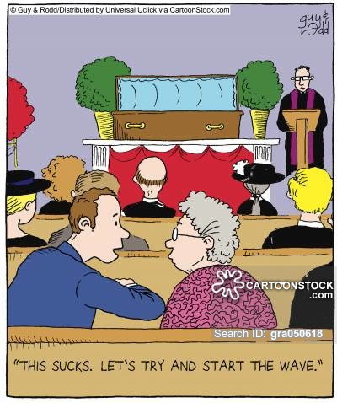
December 1 Collection Window
4

Slide 6
Data Dictionary Updates
Submission Schedule is redefined
Why the change?
The change happened in 2011 when KSDE introduced a web-based MIS application. Data should be submitted in real time.
Intent – To address data request (legislative or fiscal) with current information
Ease workloads by instantaneous correction of data, avoiding potential bottlenecks and logjams up against Federal due dates.
KIAS system pulls data directly from SPEDPro. If data entry has been neglected for a period of time, then KIAS data could be unreliable with inaccurate results.

Slide 7
Data Dictionary Updates
Submission Schedule is redefined
How does this effect Verification deadlines?
Verification deadlines are met if student data is submitted timely and verifications are addressed when data is submitted, verifications never overlap with data pulls.
Projected December 1 and End of Year, Discipline and Exiting reports provide indicators that unresolved verifications are causing discrepancies in these reports.
6

Slide 8
Questions related to the reporting standard
Q.
A.
Does MIS data entry stop in preparation to the December 1 data pull?
Will inactive status codes and exit dates keep students from counting on December 1?
No, Data entry is a continuous process throughout the school year.
No, inactive status codes and exit dates are factored in determining the December 1 population. These data fields are ignored.

Slide 9
Questions related to the reporting standard
Q.
A.
How do Private / Parochial school students get factored in our OSEP reports?
Do I list the Responsible school as Private / Parochial since the student gets general education at the Private / Parochial school ?
By listing the neighborhood school as the Private / Parochial School, they are removed from Discipline and Exiting reports. Private / Parochial is an OSEP environment category.
No, Responsible schools are always a public or state school. No exceptions. Since the IEP acts as an enrollment form, these students are dually enrolled. KIDS records make the association to the public school.

Slide 10
Questions related to the reporting standard
Q
A.
A student moved 5 times this year all between member districts in my Coop. Then finished as active in the first USD.
How many inactive profiles do I create to show these many exits?
Zero, no profiles list an exit date or inactive status. This student does not qualify as an exiter because the student never left the catchment and finished the school year as active. The student’s status does not change from the beginning of school year.

Slide 11
Move between Member Districts
Buildings align by corresponding dates
10

Slide 12
Questions related to the reporting standard
Q
A.
There are 2 Catholic and 1 Lutheran schools my LEA that our teachers go to provide services. Who enters the District level calendars as the organization is outside of my catchment?
No one creates District level calendars for private / parochial schools. Private / parochial schools follow building level calendars. You enter the building calendars, settings and assign the providers the X0 and Z0 organizations because the schools are within your catchment boundaries.

Slide 13
Questions related to the reporting standard
Q
A.
I have a student that attends two different schools. How can I determine which one is the responsible school?
You cannot determine the responsible school based on where the student attends. The student’s accountability school listed in the their KIDS record is considered the responsible for MIS reporting. This building may be different from the attendance building.

Slide 14
Data Dictionary Updates
Responsible school –
Clarification made on determination of Responsible school
The school building identified by the LEA in terms of Accountability and / or funding. These buildings are identified in the KIDS Collection Record in the Accountability School field (KIDS D2) or the Funding School field (KIDS D15). The Accountability School identifies the building for which the student’s average daily attendance and assessment scores are assigned and reported to KSDE. No other factor determines responsible school
In-Service topic

Slide 15
Data Dictionary Updates
K time data range parameters –
Clarification made on K time data range parameters
Note: K time must be within the same service date range as the IEP services. K time cannot start before or end after the IEP services. K time participation outside the range of IEP services is not applicable in the Indicator 6 calculations.
Applies to “Assigning Correct Buildings”, examples 17-19 in the Data Dictionary
Checked by Verification 0212
In-Service topic

Slide 16
Data Dictionary Updates
OSEP Clarification–
Dear Colleague: Preschool LRE, January 9, 2017
Q - Are informal settings such as weekly school-based or neighborhood playgroups, or home settings considered Regular Early childhood programs?
A - No, because they generally are not required to comply with the State’s early learning program standards or curricula
Result – participation in these informal settings / programs do not qualify as K time.
In-Service topic

Slide 17
Data Dictionary Updates
Dual-program kindergarteners – Kindergarten students who participate in both Kindergarten class and other early childhood programs or preschool programs. IEP support in each program is reported separately by program type / setting and session minutes.
Dual-program kindergarteners clarification has been added to all preschool program types
Verification 0058 allows for grade KG and preschool settings (B, R, W) with no verification flag.

Slide 18
How might the MIS look for a Dual-program kindergartener?
KG
KG
KG
PR

Slide 19
Data Dictionary Updates
Security – Personally identifiable information (PII) – Including PII (student name), attached to or embedded in E-mail correspondences to KSDE, is a violation of the KSDE security policy.
Infractions of this policy will result in a point deduction from the LEA Timely and Accurate report. Q4 as non-compliant for failing to follow the reporting standards and guidance.

Slide 20
Data Dictionary Updates
M - Residential: Placement in Residential setting means a facility where students receive IEP services in educational programs and live at the facility during the school week. Includes any facility, which provides living accommodations and is considered the domicile or temporary sojourn of the students attending and receiving services at the facility.
Qualification of educational facility and treatment facility was removed.
Focus is on living at the facility during the school week
J - Day School: Examples include but are not limited to: buildings or programs exclusively for IEP students only, transitional programs for 18-21 year old IEP students, other programs for non-residential IEP students

Slide 21
Data Dictionary Updates
T - Extracurricular: Past examples of extracurricular settings only listed locations of non-academic activities.
Examples were added to include music programs and theatrical presentations which may be part of a student’s general education curriculum.

Slide 22
Data Dictionary Updates
Student Profiles–
Student profiles – A student profile represents the student’s current organization association. A student would have only 1 profile per school year per LEA. Students who move within a Coop or Interlocal during the school year, only list one profile, new profiles are not created. A profile with exit information from a prior organization within the LEA catchment is not valid and not reported.
Tip – Students who move between Coop or Interlocal member districts, - Delete the original profile first before entering the new profile to avoid duplicate records.

Slide 23
Data Dictionary Updates
Promotion of Grade and Status
Students must be reported with current year grade level and current year status starting with initial submission (Import or keyboard entry) of records for the school year. All students with current status of B, E, I, N, & R are promoted to C – continuing on July 1 of each school year.
Clarification – The student’s IEP, IEP origin, IEP meeting and / or the IEP date are not factors in determining a student’ annual or current status. July 1 is the only factor that establishes a student’s annual status.
In-Service topic

Slide 24
Data Dictionary Updates
Removal of old data elements
These data elements were last collected in the MIS in the 2011 school year and have been removed from the Data Dictionary.
Local ID
Race / Ethnicity
Student First Name, Middle Initial
Student Language

Slide 25
Data Dictionary Updates
Data Codes used in MIS reports
Discipline data codes: - Key to the codes found in the MIS discipline data table
Basis of removal codes:
D | Drug offense | H | Due Process Hearing Officer Determination
S | Serious Bodily Injury | V | Violation of a school’s code of conduct
W | Weapon offense
Discipline records include numeric values for the number of days of removal by incident date and incident type.

Slide 26
Data Dictionary Updates
OSEP Environment Codes for LRE and Indicators 5 & 6
10-hour test is based on the student’s participation in a qualified regular early childhood program per week
Early Childhood Environments |  | School age Environments
 | Age 3-5 |  | Age 6-21
TM | 10 hours or more & Services50% > in regular EC programs | RC | Less than 21 % outside reg. class
UM | less than 10 hours & Services 50% > in regular EC programs | RR | 21 % - 60 % outside reg. class
TL | 10 hours or more & Services < 50% in regular EC programs | SC | More than 60 % outside reg. class
UL | less than 10 hours & Services < 50% in regular EC programs | SS | Separate School
SP | Separate Class | RF | Residential Facility
SS | Separate School | HH | Homebound / Hospital
HO | Home | PP | Private Parochial Student
PL | Service Provider Location | CF | Correctional Facility

Slide 27
Data Dictionary Updates
Data Codes used in MIS reports
OSEP Race / Ethnicity
Category | Code | Category | Code
American Indian or Alaska Native | A | Native Hawaiian or Other Pacific Islander | P
Asian | S | Two or more races | M
Black or African American | B | White | W
Hispanic | H

Slide 28
Data Dictionary Updates
Directory Updates
Preschool program associations, verification 0214
Program Type | Directory value | Setting Code |  | Program Type | Directory value | Setting Code
Headstart | 6 | B, K |  | SPED Reverse Mainstream | 9 | W
4 Year Old At-Risk | 7 | B, K |  | All other Reg / Gen Ed Preschool | 10 | B, K
Integrated SPED | 8 | R |  | Itinerant Services – All other | 10 | G

Slide 29
Data Dictionary Updates
Directory Updates - Special Education Program Types, Settings and Examples
Default Settings underlined, Possible settings [bracketed] based on program
Program Name | Settings | Program Name | Settings
Non-public - Off campus | D, E, U, T, X | Home | A, O, P, U, T, X
Public off campus | T, X [G, H, J, U,] | After school K time building | K
Community based preschools | B, G, K, T, X | Incarceration | I, T, X
Public off site preschools | G, T, X [B, K, R, W] | Hospital | L, T, X
In-Service Topic

Slide 30
Verifications
There a no new Verifications
IT has not been able to resolve logic issues related to time, these have been turned off. Too much time in the session or school day, too much K time, AC / IN, NU time.
Verification logic is also contained in report form. Updated Reports Page is planned.
Reports will be separated into two sets.
Final / child count and OSEP and Gifted reports
Verification reports. Overlap, projected, moved reports, etc.
Verifications 0203 and 0210 were prevalent in FY2016. These indicate subsequent changes to your final December 1 child count population and factor in the Organization’s level of determination.

Slide 31
Verifications
Verification 0123 & 0124 (overlapping service start and end dates) have been retired because of redundancy. The Overlap report completes the same task and provides the information as to the overlapping organization.
Verification 147 continuing status and services start later than 10 days from the first day of school
Verification 148 active status and service end before 10 days from the last day of school.
Are being retired and moving to a report

Slide 32
L.O.D.
Levels of Determination
Timely and Accurate Data
What tools can I use to avoid point deductions for timely and accurate data?
Projected Reports
Unresolved Exit Report
Verification 0203
Verification 0210

Slide 33
L.O.D.
Levels of Determination
Timely and Accurate Data
What do these verifications and reports indicate?
Projected Reports – The current status of your data
Unresolved Exit Report – Student active at the end of the current school year, not found next school year
Verification 0203 – Data reports December 1 services, student not counted on the final report
Verification 0210 – Data reports no December 1 services, student did count on the final report

Slide 34
Why am I getting verification 0203?
Student was not counted on the Final December 1 report. Subsequently the data was changed to include the student on the report after the report was finalized
Service start or end dates changed to cover December 1
Original record not Claimed, new record marked Claimed.
Area of disability added to December 1 service lines.
New record has a different KIDS ID
What changes could trigger 0203?

Slide 35
Why am I getting verification 0210?
Student was counted on the Final December 1 report. Subsequently the data was changed to exclude the student on the report after the report was finalized
What changes could trigger 0210?
Service start, end or exit dates modified to remove December 1 services
Original record was Claimed, new record marked not Claimed.
New Import does not include IEP in place on December 1

Slide 36
How do I fix a 0203 or 0210 Verification?
In most cases you cannot. The verifications are after the fact and act as an alert.
The December 1 child count is final. The data is finalized before the OSEP deadline
The opportunity to submit or change December 1 data ends when the report is final.
0203 and 0210 are indications the data was changed after the report was finalized.
0203 and 0210 are notifications that a discrepancy exists in your student population

Slide 37
Report Descriptions
December 1 Only IDEA students with services intersecting December 1 | End of Year All students served at any time during the school year | Gifted Summery Students with GI marked as Yes on service lines intersecting December 1 | Overlap Report All students by ID with the same service dates on different profiles | Unknown Exit Report Students reported as “T”, In-State transfer, but is not found elsewhere. Reported basis of exit is in question
December 1 12-1 EOY 12-1 EOY EOY

Slide 38
Report Descriptions
Unresolved Exit Report Student reported as active at the end of the year, not found in the beginning of the year. | Gained Student Report Students with a profile exit date and KIDS records starting after the exit date, but not found in the MIS. | Exit Status Report Inactive student found with new records showing that reported basis of exit needs to be changed | Discipline Report All incidences of disciplinary removal by date
EOY December 1 EOY EOY

Slide 39
Do Quality Checks
1
2
Unequal end dates may trigger Verification 0210
Active record and services stop before end of the year
2
What can the report tell us?

Slide 40
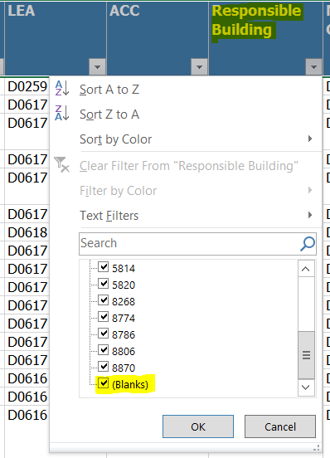
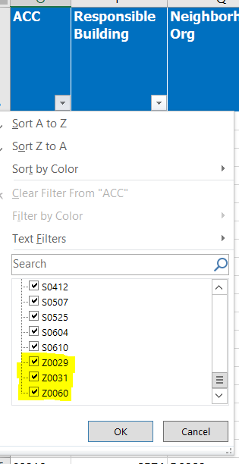
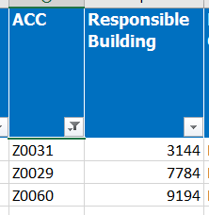
Do Quality Checks
Responsible building on December 1, determines responsible organization on December 1
Result of invalid responsible buildings

Slide 41
Do Quality Checks
Is basis of exit “S” a valid exit code?
Is the student on the Exit Status report?

Slide 42
Do Quality Checks
Triangulation Analysis
Is basis of exit valid for this age?
Is area of Disability valid for this age?

Slide 43
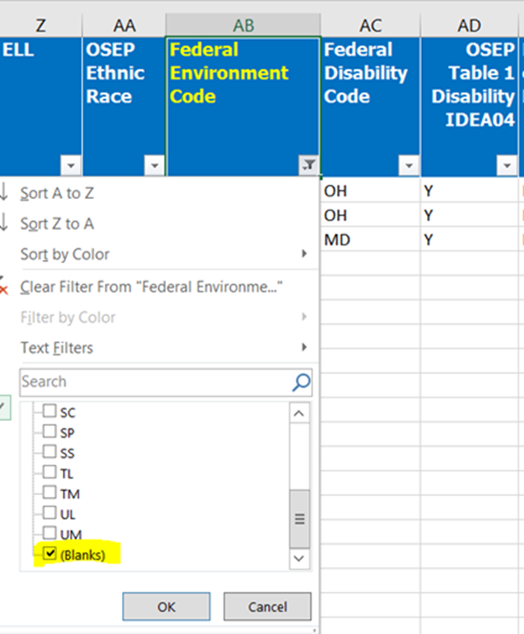
Why would OSEP Environment be blank?
Several Possibilities
Zero Days of service
Zero minutes
Invalid settings
No Calendar
Closed building

Slide 44
EOY Check
Different USD in the same Organization
Multiple records for the same student
What is the probable cause of this issue?
43

Slide 45
Discipline Check
Check Service lines to Incident date
Look for Long Term Removals
What should we expect to see on the service lines ?
44

Slide 46
Discipline Check
Starting around 10/05/16 for 80 school days
Services should be in the “U” setting
Was the incident reported in error or are the service lines in error?
45

Slide 47
Unresolved Exit Report
18 year old, possibly Graduation status missing
No Service lines in FY2017
21 year old in current school year. Exit status is required
Active student and services stopping in December.
What can the report tell us?
46

Slide 48
How do I address the Unresolved Exit report?
Identify the student and discover why the student is not reported in the current year
Share Unresolved Exit report with providers
Check with KIDS administrator to see if EXIT records were submitted
Check for current year enrollment status and days of attendance
Based on found information:
Enter Exit Date and basis of Exit status code in prior school year record, or
Enter Active status record in the current year MIS
47

Slide 49
Quality Check Cycle
1
Enter Student
2
Check Profile
IEP
3
Run Verifications
4
Check Overlaps
5
Projected Report
48

Slide 50
But, I submitted the “R” setting
Why am I getting Verification 0214?
The preschool program (setting) code on the service line is not found in the directory.
The verification triggered because something is wrong. Either the settings are in error or the Directory is in error. The settings, Directory and service lines must align
49

Slide 51
Knowing All about your buildings
Which Building is correct?
In-Service Topic
50

Slide 52
Which building houses the headstart program?
Be prepared to answer provider questions related to buildings
Is there a building titled with headstart?
Is the program in an elementary school?
Is there a generic program that represents headstart?
None of these, a new building needs to be opened in the directory
51

Slide 53
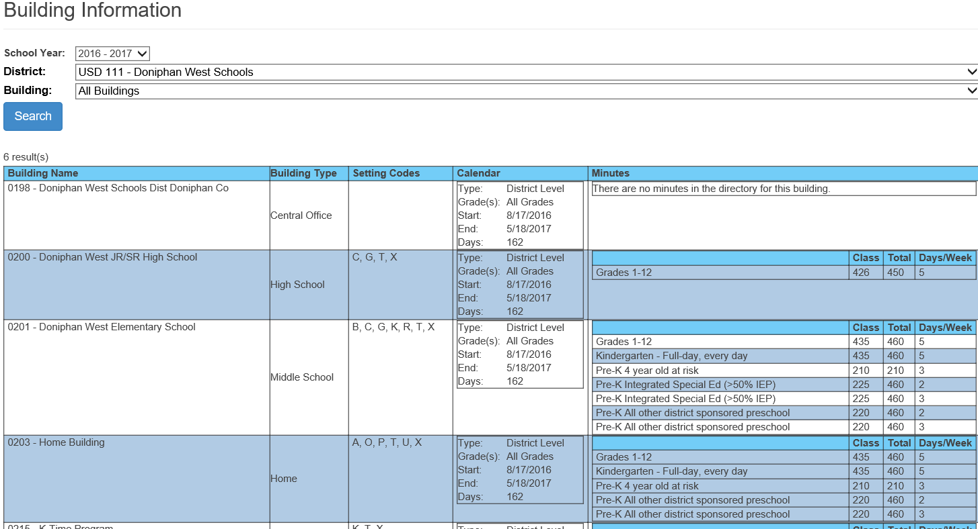
How do I know what programs are present in the Directory?
The Building Information page in SPEDPro lists all buildings, programs and session minutes
52

Slide 54
Does the Directory data look correct?
Check building data prior to entering calendars
What is a noticeable inconsistency?
Setting “B” is in Question. If “B” is true, then are the Programs (All RMS) & Calendar types correct?
53

Slide 55
Do the calendars and days per week match?
Apply calendars based on their organization association
District level preschool calendar associated to a private school.
54

Slide 56
Which Directory program types are in error? Which Directory program type is missing?
Contact the board clerk when the program types are missing or incorrect
Home
Program type / Missing or in Error
Head Start / In Error
4 year old at Risk / In Error
Kindergarten / Missing
Integrated SPED / In Error
Reverse Mainstream / In Error
All other preschool / Missing
55

Slide 57
Aligning preschool programs and setting codes
Directory Program
Which Setting codes pass 0214 test?
Headstart
SPED Reverse Mainstream
4 Year Old At-Risk
All other Reg / Gen Ed Preschool
Integrated SPED
Itinerant Services – All other
B, G, K, T, X
W, G, T, X
B, G, K, T, X
B, G, K, T, X
R, G, T, X
G, T, X
56

Slide 58
Aligning the program by name to Settings
Program Name
Which Setting codes pass 0004 test?
Madison Alternative / Day School
Community Based Preschool
Off-Site Non-Public
Jefferson High School
Home
Topeka Dist. Shawnee Co
H, J, T, X
B, G, K, T, X
D, E, U, T, X
C, G, T, X
A, O, P, U, T, X
57

Slide 59
Which settings are in error? Which settings are missing?
Apply logic before listing settings. Do not automatically copy from last year.
Trump Elementary School
Setting / Missing or in Error
A = Home / In Error
B = Head Start / Missing
E = Community Based Location / In Error
G = Pullout class / Missing
H = Alternative School / In Error
K = Regular Early Childhood Program / Missing
M = Residential Facility / In Error
58

Slide 60
Why am I getting Verification 0215?
Student was originally submitted as one active status, but the active status changed during the school year.
Can I fix this by importing in a new record?
No, that does not work. 0215 required a fix on the KSDE end
59

Slide 61
Data Central
60

Slide 62
Data Central
61

Slide 63
Data Central
62

Slide 64
Data Central
63

Slide 65
Data Central
64

Slide 66
Tips and Reminders
Use the projected reports as Verification checks.
Look for blank / null values and make corrections
Check for invalid values, X0 or Z0 assign child count organizations, then change responsible school
Missing race, gender, date of birth means KIDS records are likely missing.
Verify the child count, are the number of students correct. Some students may be missing.
Missing or blank data fields can indicate other data elements are causing the issue
Invalid building
Missing KIDS record
Students not included on reports
65

Slide 67
Tips and Reminders
What data is triggering this verification?
Use the action items on the verification list to jump directly to the place that is triggering the verification
66

Slide 68
Tips and Reminders
Service line does not save.
Settings are not available for selection
Check settings list for Approval status
Check validity of service building. Is it closed?
67

Slide 69
Tips and Reminders
Responsible building has no values listed to choose
Contact local KIDS administrator to discover status of KIDS records
68

Slide 70
Students are missing from expected reports
Check the claiming status
Is Value 1 = Yes displaying?
69

Slide 71
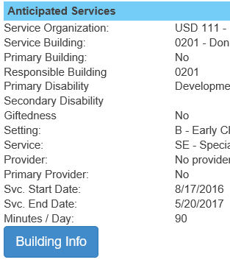
Tips and Reminders
Where do I look to find why the student has zero days of service?
The building Info button pops up the information associated to the service building
70

Slide 72
What does the building Info pop-up tell me?
1
2
4
3
1
For the Building and the student’s Grade level
Session Minutes are missing from the Directory = N/A
Days per week is missing from the Directory = N/A
Settings have not been approved = N/A
Calendar is missing = N/A
1
4
2
3
4
4
71

Slide 73
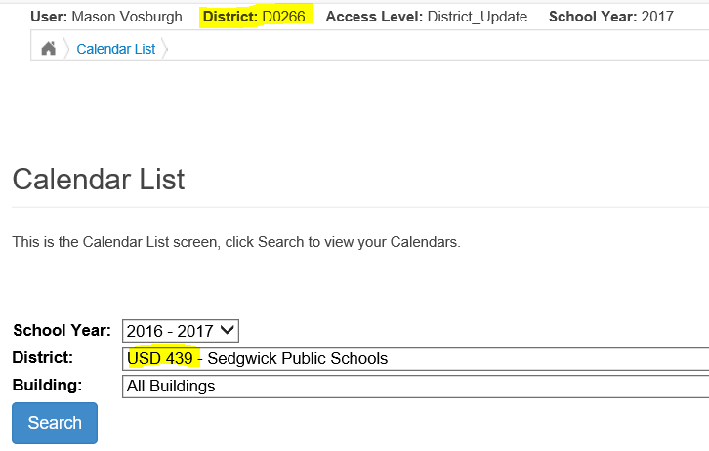
Tips and Reminders
Why doesn’t the application let me work on Calendars or settings?
Check the access level selected in the page header.
A USD 266 user cannot work on USD 439 data.
It would work if the access was at the Coop or Interlocal level
72

Slide 74
Tips and Reminders
Why does the data in SPEDPro look different that what I see in my IEP program?
The template has 21 cells of header fields and goes up to 25 service lines. Differences can be compared.
Bad data such as dates in the wrong school year may fail to import.
Use the Import template to see what data was exported from your IEP program. What you see may be different than what exported out.
73

Slide 75
Tips and Reminders
Gifted students who exit IDEA services must have and exit date and exit status
In-service topic
Student is no longer a child with a disability. Do not miss students who qualify for OSEP Table 4 Exits
SE services end indicates Exit date needed
Student List
Student Profile
74

Slide 76
Tips and Reminders
Gifted students who exit IDEA services must have and exit date and exit status
In-service topic
Student is no longer a child with a disability. Do not miss students who qualify for OSEP Table 4 Exits
SE services end indicates Exit date needed
75

Slide 77
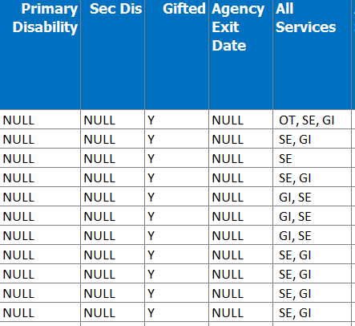
Tips and Reminders
Gifted students who exit IDEA services must have and exit date and exit status
Look in your projected EOY report for students missing Exit data
No Disability at end of year and no exit date, but SE and related services were provided
76

Slide 78
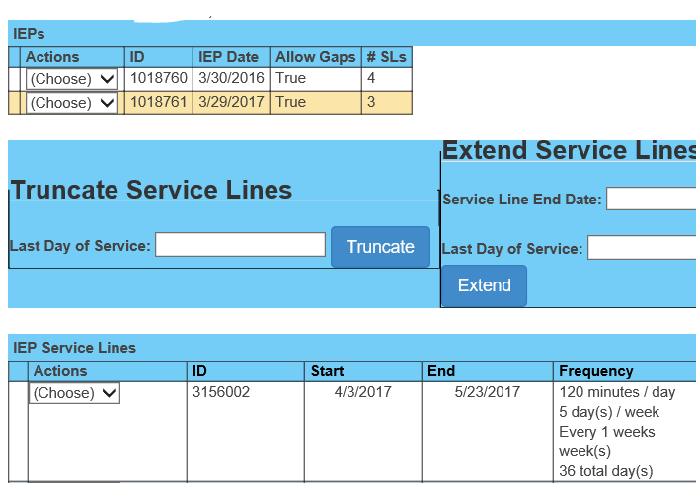
Tips and Reminders
IEP Date
IEP date = date IEP was finalized. Meeting date is not always the IEP date
In-Service Topic
77

Slide 79
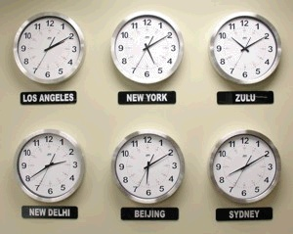
Tips and Reminders
KIAS is now pulling data directly from SPEDPro into the KIAS system. KIAS needs the data to be as current and up to date as possible. Please keep the MIS updated close to
MIS Data is being pulled into the KIAS system
78

Slide 80
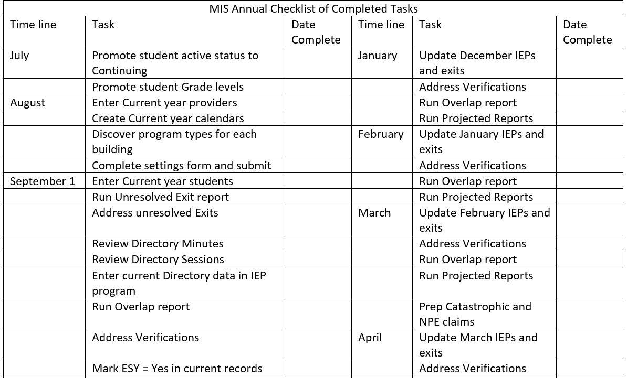
7/21/17
7/21/17
79

Slide 81
Moving Projected Data Sets to a “Ready” Stage for Finalization
Background – Organization reported half of their students with incorrect service location / setting codes. This resulted in a significant shift in the SEA, LEA and building level OSEP Environment categories. The organization was required to correct their data and the OSEP reports were resubmitted.
Problem - KSDE only needed to resubmit data for 1 organization, but complete data from all organizations is required. SPEDPro only has the ability to create a single inclusive Final OSEP report. The task of deleting and reinserting a single organization into a new final report created a number of challenges for the IT programmers.
Solution – Starting in FY2018, each LEA may mark in SPEDPro their data sets for the December and End of School year MIS reports are ready to pull into the OSEP Final report. The system will save this data set unchanged for initial or subsequent OSEP submissions
Result – Identifying the student population as “Ready for Finalization” will help to improve LOD for timely and accurate submission because changes to the population can be flagged early, before KSDE submits SEA, LEA and building level OSEP reports
80

Slide 82
Thank You
Class Dismissed

Slide 83
SpedPro Reports, Timely & Accurate Data, and the Level of Determination
August 2017 MIS Workshops
Tim L. Berens
KSDE TASN GSTAD Project Coordinator

Slide 84
Sped Pro Reports
Mason’s presentation contained information about how to use the
Unresolved Exit Report
Verification 0203
Verification 0210
Connection between the reports and Timely and Accurate Data Point Deductions
Magnitude of the Timely and Accurate Data Point Deductions
Effect of Timely and Accurate Data Point Deductions on the district Level of Determination

Slide 85
Report Data and the Timely and Accurate Data Scoresheet
Verification 0203
Verification 0210
Unreported Discipline data
Unresolved Exit Report
Timely and Accurate Data
Q1 Dec
Timely and Accurate Data
Q1 KAN DIS TABLE 7 IDEA
Timely and Accurate Data
Q2 Jun

Slide 86
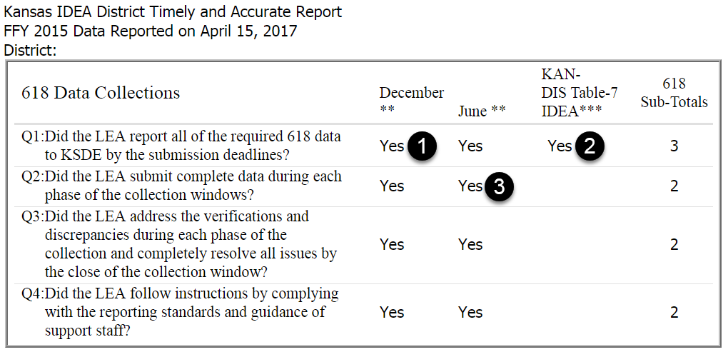
Timely and Accurate Scoresheet
The KS APR web site Timely and Accurate Data Score Sheet is used to calculate whether a district is substantially compliant.
Q1 December
No students with a
Verification 0203 or a
Verification 0210
1
2
Q1 KAN DIS Table 7 IDEA
Did not have Unreported Discipline data
Q2 June
Did not have students on the Unresolved Exit Report
3

Slide 87
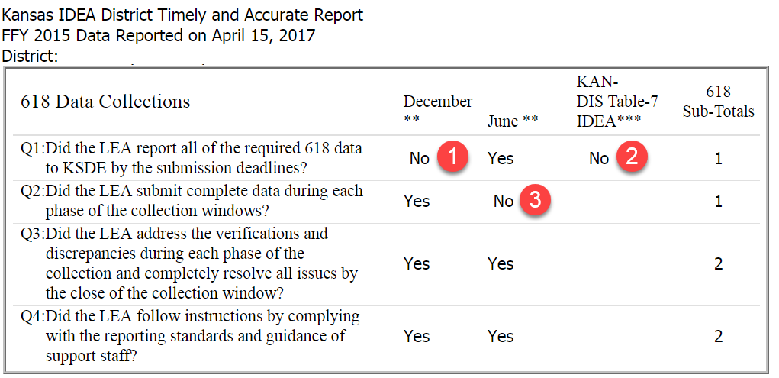
Timely and Accurate Scoresheet
A total of 15 or 16 points is Substantially Compliant. Anything below 15 is Not Substantially Compliant. A “No” on any two these three is 14 and Not Substantially Compliant.
Q1 December
One or more students with a Verification 0203 or a
Verification 0210
1
2
Q1 KAN DIS Table 7 IDEA
Unreported Discipline data
Q2 June
One or more students on the Unresolved Exit Report
3

Slide 88
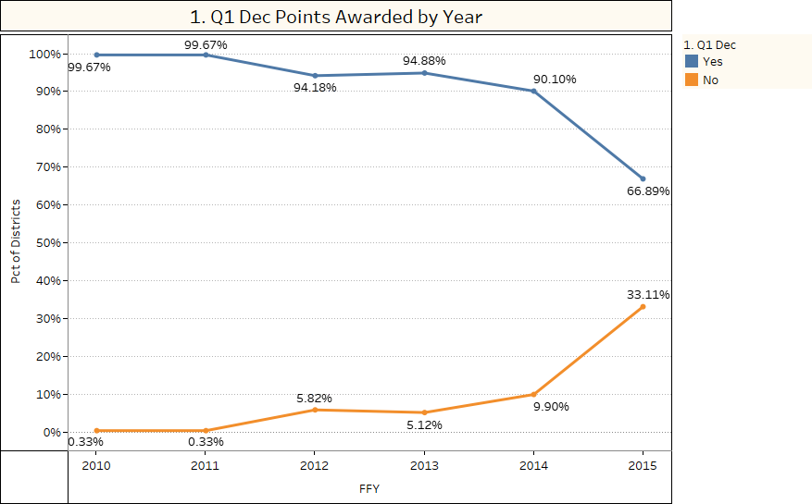

Slide 89
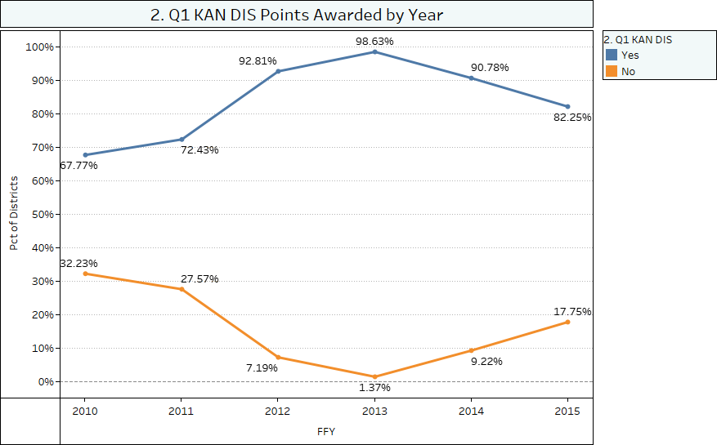

Slide 90
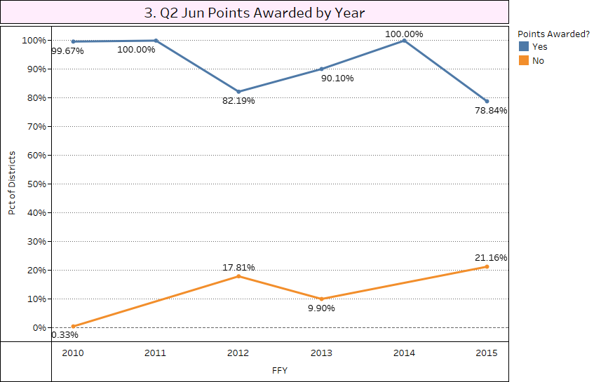

Slide 91
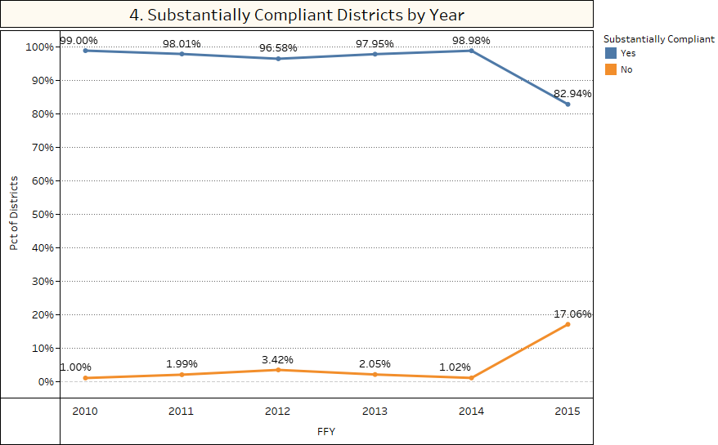

Slide 92
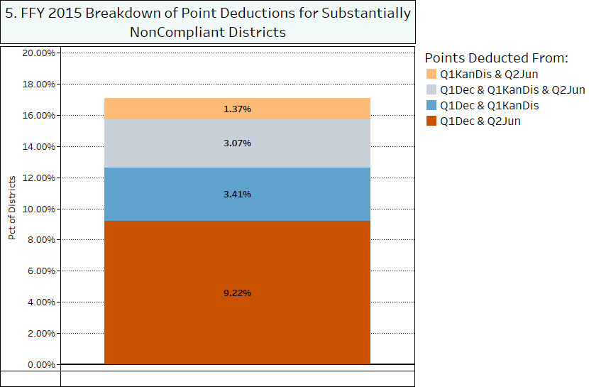

Slide 93
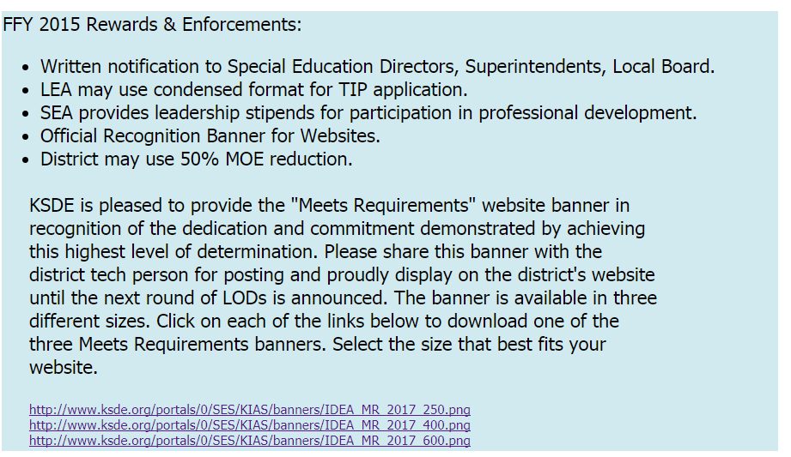
Rewards and Enforcements
When LOD is Meets Requirements, the Rewards and Enforcements are:
KSDE may customize the Rewards and Enforcements.

Slide 94
Level of Determination
When all LOD factors are Substantially Compliant, the LOD is Meets Requirements

Slide 95
Level of Determination and Rewards and Enforcements
When one or more LOD factors are Not Substantially Compliant, the LOD is Needs Assistance, Needs Intervention or Needs Substantial Intervention.
When LOD is Needs Assistance, the Rewards and Enforcements are:
KSDE may customize the Rewards and Enforcements.

Slide 96
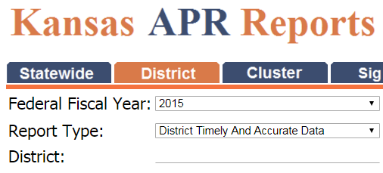
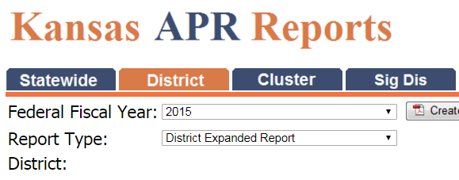
Timely and Accurate Data Score Sheet Level of Determination
Can be found on the KS APR Web by clicking on the Current Kansas APR Reports link on the left.
District Timely and Accurate Data report
District Expanded Report contains Level of Determination and Rewards and Enforcements

Slide 97
Questions? Comments?
Please feel free to contact me at
Tim Berens
913.538.7250
tberens@keystonelearning.org

