Slide 1
MIS FY2013
Leadership –
Training –
Workshops
1

Slide 2
Agenda
KAN_Service updates
New Features
Application Changes
Clarifications
Advice
On the Horizon
Reminders
Data Dictionary
2

Slide 3
KAN_Service Updates
New Features
Application Changes
3

Slide 4
New Importing option
Validation mode
Validation tests the import file for correct length, sequence, field format (date, number, text) etc. and returns details of any errors without submitting the student population
4

Slide 5
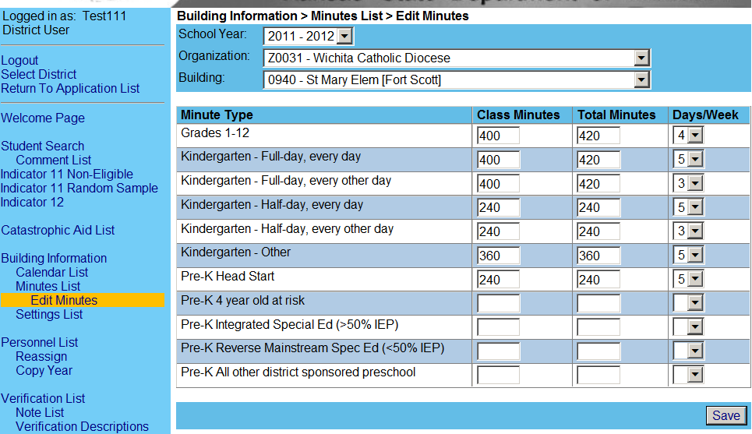
Edit Parochial Minutes
User enters session & building minutes
And days per week
5
5

Slide 6
Change in data reporting methodology
Old method
Only report active students on December 1
Only include exit records in June.
New method
Report all students in real time
Minimum of monthly updates
6

Slide 7
Gained Student report
For students who have exited another LEA without exiting special education
And your LEA has claimed the student in KIDS after the exit from the prior LEA
Serves as notification that an IEP student has entered your agency and may still have an active IEP

Slide 8
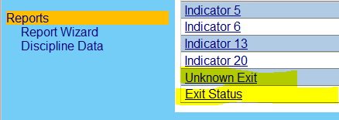
New Reports for EOY collection
Unknown exit – students reported as In-state transfers “T” but not found in another agency
Fixed by entering new agency in evidence box
8

Slide 9
New Reports for EOY collection
Exit status– students reported as Drop out, Left state, revoked consent, action initiation exit, but found in another agency
Fixed by changing exit status to “T”
9

Slide 10
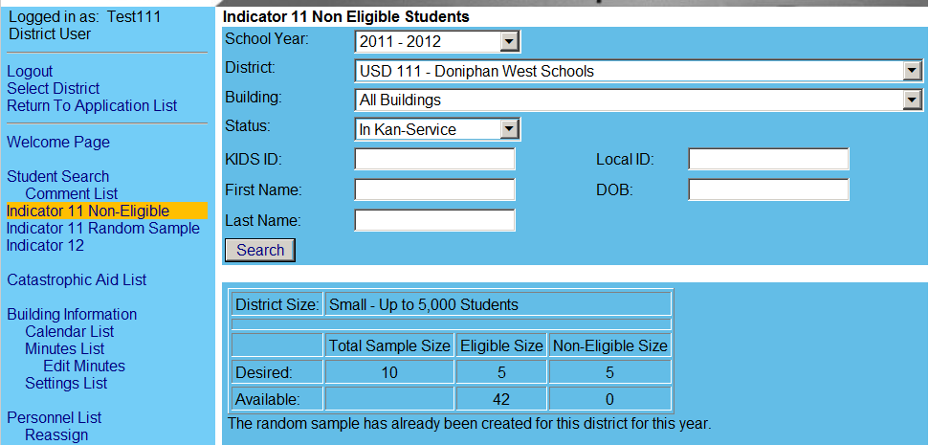
Indicator 11
10

Slide 11
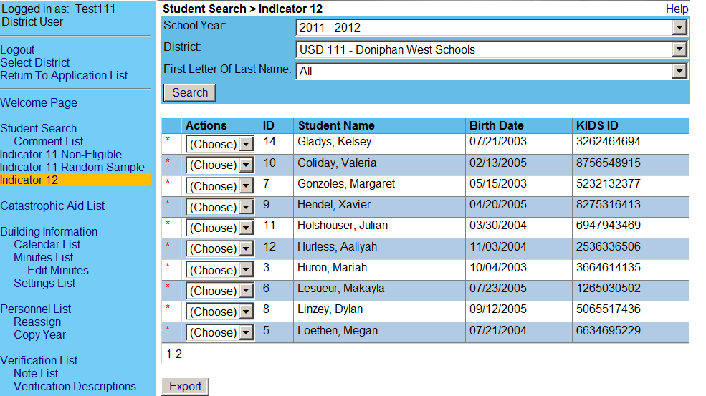
Indicator 12
11

Slide 12
Data Management
Clarifications

Slide 13
New Student Associations
New to the LEA
KIDS collection record is required for All
KIDS record determines the responsible school
If KIDS only lists USD central office, then MIS clerk may pick a responsible school in K_S
Preschooler / parochial student
KIDS collection record is required for All
Excluding students from KIDS submissions is not permitted
If the parochial school put a USD building as the funding school field, this works for USD association.

Slide 14
MIS Import to KIDS records relationship
MIS Building
KIDS Building
Responsible
Elementary
Middle
High
AYP
Funding
Attendance
MIS clerk selection
Responsible
KIDS contains only
Dist. Office with:
Program bldg.
Program code
0002, 0003
File rejected if:
KIDS has no association to the reporting agency by building

Slide 15
Other Student Associations
Bad data in KIDS
KIDS collection record may contain inaccurate information
KIDS administrators submit new records
Student moves within catchment
Responsible school needs to change
What to do?
Select new KIDS record in the “Student” field to make correction. (Note: different DOB in KIDS 2005 / 2008)

Slide 16
Provider Data
Contract Provider Role
Only assign for NPE providers
Role allows for selection in NPE contract section
Not a USD provider
Not reported on Personnel for categorical Aid
Does not have a USD assignment
Provider Role
Role allows for selection on IEP service lines
Organization of service location determines selection availability
Provider Assignment
Only assign Coop (7xx) or Interlocal (6xx) numbers
only if the attendance building is associated to (listed under) the coop or interlocal in the directory

Slide 17
FY 2013 Building Information
Advice

Slide 18
Directory Updates
New buildings or programs
Request to have opened in the directory
Permissions for data entry
Board clerk
Superintendent or designee
Private Parochial schools
Open for schedule information.
Schedules and sessions will be pulled into K_S
If information missing from P / P schools,
MIS clerks have tool to enter minutes
Edit minutes

Slide 19
Directory Updates
Coop / Interlocal
Member districts
Permissions granted to SPED Director
Update in July
Remove past member districts
Add new member districts
Update address and contact information for printed directory
Incorrect Associations
MIS clerks loose access to USD data
Cannot enter calendars
Cannot enter program setting codes
Cannot set provider assignments
Student records cannot be accessed
Student records may disappear

Slide 20
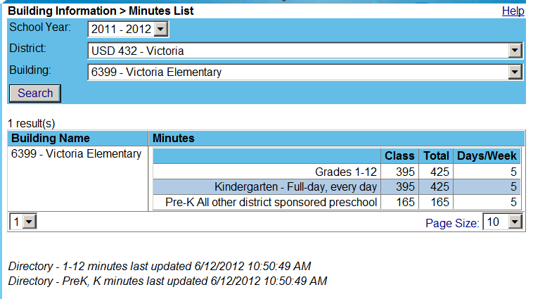
Directory Updates
Sync to directory

Slide 21
Preschool Programs in the Directory
Rank order determines session minutes
Integrated SPED
Reverse mainstream
All other
Head start
4 year old at risk
Focus on w/ board clerk
total program minutes
Most days per week
Rank order may bring a short session to the top and cause verifications for students in longer sessions.
Its OK to not report or delete specific programs if the longest program is not accounted for

Slide 22
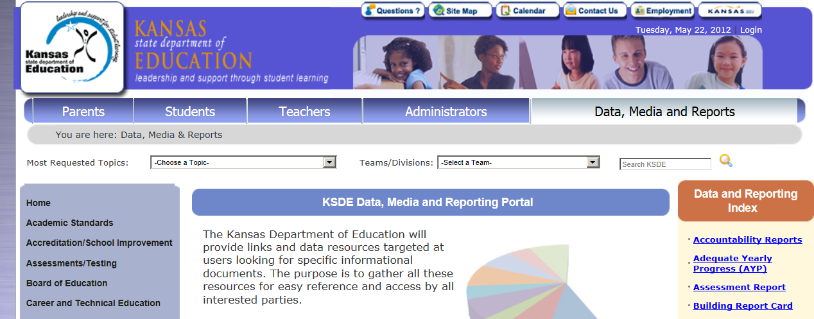
Directory data for IEP programs
Complete KSDE data request form
Include
Data needed
All buildings
File format
Field sequence

Slide 23
Advice
Providers

Slide 24
Contract Providers
Only identify as contract provider if employed by a NPE agency
Only list assignment organization as the NPE agency
Heartspring
Prairie View
Milestones
Do not list any USD as assignment organization
Required provider roles
Provider
Contract provider

Slide 25
Inactive Providers
If a provider leaves during the current school year
On make inactive if provider is not hired by another agency
Avoid using the inactivate provider feature
Remove all assignments (Origination #)
Simply do not select
If a provider retires or does not return in the next school year,
Do not import or enter on the Provider list

Slide 26
Active Providers
Do not enter a coop or interlocal assignment if there are no buildings associated to the coop or Interlocal
Do 600-D0637, D0700-D0726
Do not list assignment of a private parochial school if the teacher does not serve students in private parochial schools.

Slide 27
Correctly Reporting providers
Advice

Slide 28
Correct Providers
There is an increasing number of phony / dummy providers being set up in personnel table the MIS and are listed on IEP service lines as legitimate teachers of record.
The have phony names and fake ID numbers. Some real examples:
Substitute Teacher
Regular Ed Teacher
Anticipated Provider
Past Teacher
“ School Name”

Slide 29
Correct Providers
What is problematic -
This may be considered a fabrication of data, as it is inaccurate and unreliable.
What may be the consequences?
Indicator 20 may come into play
Auditors have read only access to the MIS
Auditors may check to verify the number of IEP students in a preschool program for calculations of the 50 / 50 ratio.
If the real provider is not used, the ratio may be skewed negatively resulting in a proration / reduction of categorical aid based on this evidence.

Slide 30
Other Advice
Advice

Slide 31
Comprehensive Evaluations
Entering students.
Enter the most recent date on students entering, dates are visible to the receiving MIS clerk

Slide 32
Verification fixes
On the Horizon

Slide 33
Verifications
0176 no match to KIDS records
Responsible building
Responsible building in MIS is not in KIDS
Fix – Toggle on Responsible building field and pick one found in the KIDS record
Fix – Toggle on Student field and pick the KIDS record that has the MIS building
Tip – if USD central office is only present in KIDS record, the MIS clerk gets to choose responsible building.
Grade level
Grade level in MIS is not in KIDS is no longer a condition
Verifications displaying falsely should go away on their own and no longer display under false conditions.

Slide 34
Next years MIS data
On the Horizon

Slide 35
Next years MIS data
3 options for entering data for next year
Keyboard entry
Import from another source
Roll current year data into next year
Item 3 is a new feature that will be addressed during MIS workshops
All 3 options require setup before process can be completed
1. Set up calendars
2. Enter providers
3. Update building settings

Slide 36
Provider roll over
Under provider list go to: Copy Year
Select Source year and target year
Select all providers and unmark all providers not continuing
Copy marked providers into target school year

Slide 37
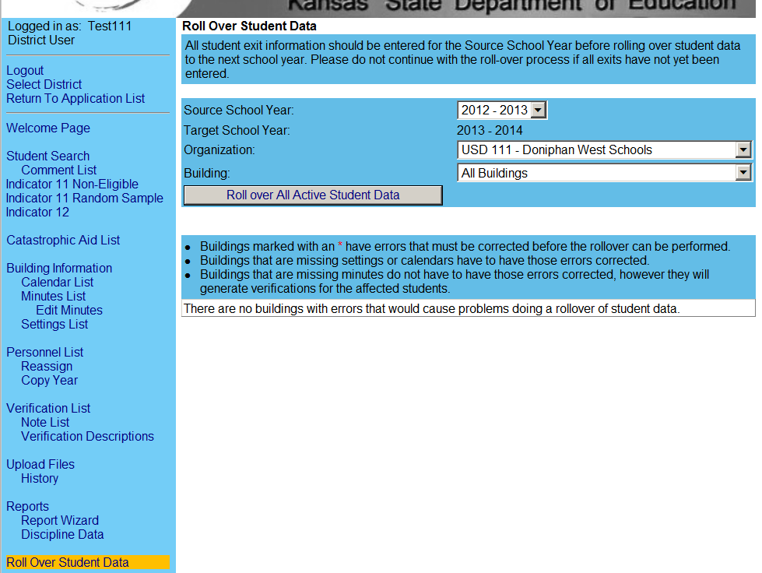
Student roll over
Go to: Roll over student data.
Select Source year and target year
Select Student’s organization and buildings
Move selected organizations and buildings

Slide 38
FY 2012 Discipline Data
On the Horizon

Slide 39
FY 2012 Discipline Tasks
Starting When?
August 2012
Ending When?
September 2012
What students?
Students identified as IDEA in KAN_DIS
What's going to happen?
Students with disciplinary removals will be pulled in KAN_Service for OSEP reporting

Slide 40
FY 2012 Discipline Tasks
What tasks are required?
Data clerks will “filter out” students who are not applicable to the OSEP report.
What students would be filtered out?
No match in KAN_Service
Improperly identified as IDEA by the building submitting the data
Gifted only
Those with incidences outside of IDEA services
How is the clerk to know whom to filter?
A series of verifications / alerts will give notification to the user

Slide 41
FY 2012 Discipline Tasks
Can you give an example?
Homer is listed in the report.
Homer got a 5 days suspension for bringing a shopping bag of Ganja to school on 4/11/12.
Homer was on an IEP but completed objectives on 2/15/2012
This incident occurred when Homer was in general education.
Homer exited from IDEA services on 2/15/2012
This incident does not qualify for OSEP reporting and would be removed by the user
Do incidences prior to the IDEA services also get removed?
Yes

Slide 42
FY 2012 Discipline Tasks
Why can’t Mason do this for us, he did it in past years?
Mason is restricted in KAN_Service.
Mason does not have permissions to add, delete, modify or alter LEA data in any way.
Can Mason tell me directly what I need to do so my OSEP report is accurate?
Why yes, he would love to do that and is more than willing to assist in any way.

Slide 43
OSEP analysis of data changes
SPED data changed from Year to Year
A jump up or down in the number by category
Race, age, gender, LEP, etc.
Disability category
Education environment
Suspensions / expulsions
Basis of exit
Old method looked only state wide
New method looks at organization
USD or special purpose school
Organization would provide explanation.

Slide 44
Future Considerations

Slide 45
Redesign of Application
Feedback from MIS clerks
There are some inherent flaws in the basic structure and design of K-S.
Resulting in:
Additional verifications
False verifications
numerous overrides
Confusing reports
Duplicate student records
Inactive IEPs
Disconnected Info
Area of disability to IEP
Grade levels
Exit data for non-exits

Slide 46
Redesign of Application
New structure is needed
Intent
To align disconnected data
New data element associations
Reduce verifications
Reduce overrides
Improve reports
Employ lessons learned in LEAMIS
How ?
Revised Import specifications
Rearranging page layouts
When ?
FY2013-14
Why then ?
Many fixes are in the works for FY2013
Recourses and staff turnover.

Slide 47
Reminder
Catastrophic
Non-public Equevalency

Slide 48
Forms and submission
Catastrophic Forms
NPE funding formula and contracts
Follow the funding link on the SPED page at KSDE.org
Qualified NPE programs (Heartspring, etc.)
Require only fully licensed providers have contact with your students
File both NPE and Catastrophic
USD comes out 25% ahead on NPE with both claims

Slide 49
NPE Estimated Entitlement
Hours of each service
Times
Rate per hour (from formula memo)
Example
750 hours of Autism service at AM rate
750 X .000149 = .11175
Sum all contracted services
.11175 + .0952 + .1002 + .2593 = .566
Multiply sum by per teacher entitlement
.566 x $28,900 = $16,357
Enter under all other deductions (line D.6)

Slide 50
NPE Estimated Entitlement
 | Do not
 | Claim NPE | Claim NPE
Catastrophic
Cost | $ 60,000 | $ 60,000
NPE
Deduction | $ - | $ (2,500)
Net
Catastrophic | $ 60,000 | $ 57,500
75%
Grant | $ 45,000 | $ 43,125
NPE
Payment | $ - | $ 2,500
Total
Reimbursement | $ 45,000 | $ 45,625

Slide 51
NPE / Catastrophic Tips
File on behalf of the agency that accrued the cost.
If a coop or interlocal member district was billed and paid for all expenses, make the claim for the member USD.
The coop or interlocal may submit the claim, but identify the USD as the agency to receive reimbursement. Auditors will be looking for invoices and payment vouchers related to the USD

Slide 52
NPE / Catastrophic Tips
Splitting cost – when a USD and Coop / Interlocal share costs on the same student
If both agencies have net cost above the minimum threshold, both may make claim
If one or both agencies have less than the minimum threshold, the all costs may be absorbed by a single agency to make claim
For example
Agency “X” has $60,000 in expenditures
Agency “Y” has $15,000 in expenditures
Agency “X” absorbs the expenditures of agency “Y”.
Agency “Y” bills Agency “X” for $15,000, Agency “X” pays the $15,000 and makes a claim for $75,000

Slide 53
Data Dictionary Updates

Slide 54
Revised Terminology
Disability categories
MR – is no longer a valid category
Grade level
Clarified KIDS values are used in file imports, not values users see on screen
User sees KG, file imports value 05
Return to special education services
Used in the school year the student returns to special education.
54

Slide 55
Revised Terminology
Location = Settings
Consistent with K_S terminology to include classrooms and other places collectively
Regular Ed = General Ed
Consistent with OSEP terminology addressing “time outside of the regular classroom”.
Included “typically developing peers”
Intended to be the location of general education curriculum designed for all students to meet state standards
55

Slide 56
Game Time
Myths and Legend's
Is it a myth or a legend ?

Slide 57
Myths and Legend's
Issue
A transfer student must be exited in KIDS by the prior agency before I can enter the student in Kan-Service ?
Myth or Legend ?
Myth
The receiving agency can put the student in K_S once a KIDS record is submitted by the receiving agency. The prior agency KIDS record is not a factor

Slide 58
Myths and Legend's
Myth or Legend ?
Myth
MIS clerks can connect to any student in KIDS as any students may go on IEP at any time. There is no cross check on disability between MIS and KIDS.
Issue
KIDS records must be marked with a disability code first before the student can be entered in KAN-Service

Slide 59
Myths and Legend's
Issue
Entering exit dates and exit status for a student who moved out on December 5th, has no effect on the December 1 child count
Myth or Legend ?
Legend
Only students with service lines “touching” December 1 total in the child count. December 1 is still covered on the service lines with an exit date of December 5th

Slide 60
Myths and Legend's
Issue
Searching by student name brings up the student twice. This is an indication the student has more than 1 KIDS ID number.
Myth or Legend ?
Legend
Yes a good indication
Call the KIDS help desk and they can let you know witch one is active and which one has been retired.

Slide 61
Myths and Legend's
Issue
KIDS records contain the district central office number as AYP and funding schools. I can import the MIS with any elementary, middle or high school as responsible school and the record gets in.
Myth or Legend ?
Legend
Yes and you get an expanded responsible school list to pick any other responsible school if desired

Slide 62
Myths and Legend's
Issue
KIDS records contain the district central office number as AYP and funding schools and a SPED program as attendance. I can import the MIS with district central office number as responsible school and the record gets in.
Myth or Legend ?
Myth
The district central office and SPED programs are not valid responsible schools. This format will fail to import.

Slide 63
Myths and Legend's
Issue
KIDS records only contains a private / parochial school number. I can import the MIS with any elementary, middle or high school as responsible school and the record gets in.
Myth or Legend ?
Myth
There is no association with the USD and this student. Fix –
The USD should claim the student for funding
Contact the private / parochial school to add the USD office

Slide 64
Myths and Legend's
Issue
Student moves within a coop or interlocal during the December 1 collection window and the assign child is changed. The student will count in the new USD, even though he was not there on December 1.
Myth or Legend ?
Legend
This is true.
The application picks up the USD present in the student profile when KSDE finalizes the data.
No effect on federal funding.

Slide 65
Myths and Legend's
Issue
To exit a student the student must have exit status in KIDS and the basis of exit must be the same as the KIDS record.
Myth or Legend ?
Double Myth
The MIS does not pull any exit information from the KIDS records.
There are 2 different exit cycles and only some exits align.

Slide 66
Myths and Legend's
Issue
I can’t open or get into KAN_Service. The application seems to be down.
I need to call Mason or Tim
Myth or Legend ?
Triple Myth
Don’t call or notify Mason or Tim, there is nothing we can do about it
Call the KIDS help desk
785-296-7935

Slide 67
Questions

