Slide 1
FY 2021
MIS Workshop

Slide 2
Preparation Step 1 -
Go to > TASN website
https://ksdetasn.org/gstad/preleadership-and-mis-workshop-presentations
Print the PowerPoint
Use the printed PowerPoint as a workbook for note taking
2

Slide 3
Preparation Step 2 -
Log into SPEDPro and select the 2019-2020 school year
Go to the reports page and create a projected 2020 End of Year Report
Save the report as it can be used during the presentation
3

Slide 4
Agenda
Workshop History
2021 Updates & Data Dictionary Requirements
Data Quality & Timely and Accurate
Tips & Reminders
4

Slide 5
Workshop History
FY 2016 – FY2021
5
Notes:
Amanda

Slide 6
My car doesn't start
FY 2017
OK, Tell my why
6

Slide 7
My car doesn't start
FY 2017
What are the details, can you send a screenshot?
I got a server error!!
On which page, which student? What did you click, select or type?
I got an import alert!
What does the Import alert message say ?
My buildings are not showing up!
Which building doesn’t show up where ?
Neighborhood School – on the student profile?
Responsible school – on a service line?
Service location building – on the building information page?
Total Days are showing zero days!
7

Slide 8
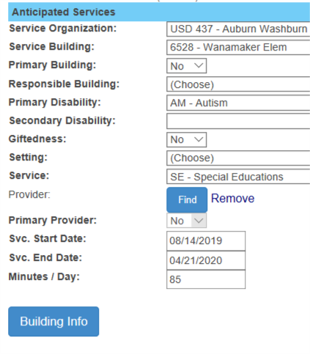
My car doesn't start
FY2017
The service line has zero total days?
(1)
Select the service line.
(2)
Click Building info button.
8

Slide 9
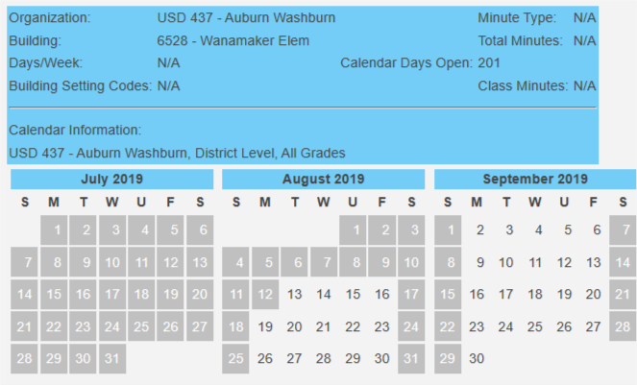
My car doesn't start
FY2017
Building Info shows why are there zero days
Information is not present in the Directory = N/A
Note the information both present and missing
Setting codes are missing
Building information page displays the same details
9

Slide 10
My car doesn't start
FY2017
How to fix zero days
(2)
Building Info data is complete. Calendars, settings and Directory
Application automatically calculates total days. Click Save.
Select the service line in Edit mode.
(1)
(3)
10

Slide 11
My car doesn't start
FY2017
Students are missing from December 1 & EOY reports
Are you claiming the student ?
Look on the student profile
Review the Unclaimed student report.
11

Slide 12
Import Alerts
What does the message mean ?
The line length is not correct for this type of file
Student record has either to few or to many fields – copy file text, paste in SPEDPro template
Fields in record imported do not match selected record type
Provider file format selected, student records imported.
Unable to match student information to a KIDS record
Last name is misspelled or different – student should import in.
Gender does not match – student should import in.
Date of Birth is incorrect – student should import in.
No student / district association in KIDS
Could be several causes. If import failed, Re-Import minutes later. Contact KSDE
Invalid KIDS ID
ID number is not valid in the system – will fail to import
12

Slide 13
Import Alerts
What does the message mean ?
Import file format is in error or out of sequence.
The value 'D0123' is invalid for the field 'Assign Child Count Organization
Imported record child count does not align with Selected “GO” organization
The value '' is invalid for the field 'Responsible Building Identifier‘, Service Location (Attend Building), etc.
Responsible building, Service Location (Attend Building), etc., reported is closed building, invalid number, blank or null value.
13

Slide 14
Import Alerts
What does the message mean ?
Import file format is in error or out of sequence.
The line length is not correct for this type of file \?U???}3??????d6?4h??}}h?)?[?;?R?8???0??sK6?m?/?T$>??Mv!???9??/
You imported in something other than a text file. Excel, Word, PDF
The value ‘11/08/2021' is invalid for the field 'Service Start Date'.
The Service start or end date is in a different school year
The value '11/02/2020' is invalid for the field 'IEP Date‘
The IEP date is tomorrow or somewhere in the future.
14

Slide 15
Import Alerts
What does the message mean ?
Import file format is in error or out of sequence.
The value '2044' is invalid for the field 'Staff ID'.
Building number present in the Provider ID field
The value O is not an active status code. Annual status cannot be determined.
First record submitted cannot have an Exit status. Students must start the school year as Active, then exit after services were received.
The INSERT statement conflicted with the FOREIGN KEY constraint
Happens when the a batch file is re-imported and the preceding files have not completed processing. – Take time between imports
15

Slide 16
Know the Directory Information
FY2018
Program Buildings
Program buildings list the same schedules as local elementary school
16

Slide 17
Know the Directory Information
FY2018
Review the building information page early in the school year.
Find and request to fix – local board clerk has permissions
10 Hour school day, Zero KG class time, 60 minutes sessions
Correcting class minutes in the Directory late in the school year will impact verification 0224 because variables in the Educational Environment calculation will change.
17

Slide 18
Reporting Preschoolers in Special Education Classrooms
FY2018
18

Slide 19
Requirements & Data Dictionary
19
Notes:
Amanda

Slide 20
3 year old C to B Transitions
Situation -
FY2020 – Parents may choose not to transition their child from Part C to Part B.
FY2020 – Organization reporting under Option 2
FY2021 data - Verification 0170 - Student's Current Status is "B" and student's third birthday was in the prior school year.
Solution – Report as active status as New Referral in FY2021
20

Slide 21
Parent Language
Language categories and codes used in SPEDPro are inconsistent with the Common Educational Data Standards (CEDS)
FY2021 is a transition year to update local IEP systems to the new standards
Complete list of all languages is found in
K I D S 2020-2021 Collection System File Specifications
Appendix D: First Language Codes
MIS Data Dictionary lists the most common languages with the new code
Both old and new languages will be valid for FY2021. Only CEDS codes will be valid beginning in FY2022
21

Slide 22
Data Dictionary Clarifications
Neighborhood School – Any Private / Parochial school Neighborhood School results in the OSEP Environment category of Private / Parochial
K time – removal of Kindergarten grade from guidance
K time – only applies to services that intersect the December 1 date
Entering status - can be reported for students entering from another state or another country
Action initiated Withdrawn from Special Education – Transfer to a GED program does not qualify as an Action initiated Withdrawn from Special Education
5 year old Kindergartners included in the school age OSEP environment categories
Public off campus building – central office added
22

Slide 23
Catastrophic Aid
Problem with the import routine was discovered by IT
The Import specifications have been removed from the Data Dictionary
Catastrophic Aid file selection has been removed from the Import page in SPEDPro
Catastrophic Aid applications must be typed into SPEDPro in FY2021
23

Slide 24
Promote Providers
1. At the select organization page, select the target organization click GO
2. Navigate to the Promote Personnel link in SPEDPro
24

Slide 25
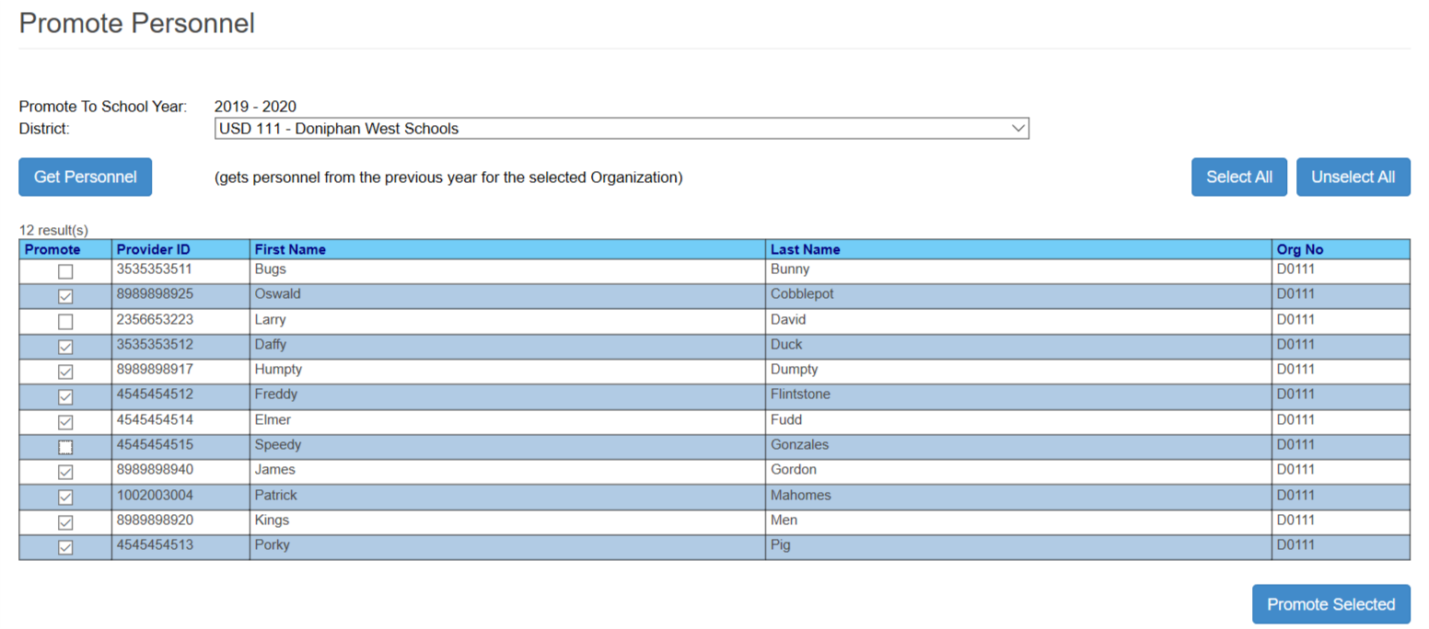
Promote Providers
3. Click – Get Personnel
4. Select all providers to move to the current school year.
5. Select all providers to move to the current school year
25

Slide 26
Service location for student served in Out of school Suspension or Expulsion
FY2006
U: Under Suspension / Under Expulsion: Includes locations for students who receive special education or related services in non-school locations or Interim Alternative Educational Settings (IAES) due a disciplinary removal by district administrators
Do not report students served in Out of school Suspension or Expulsion settings as “Homebound”
Homebound location on December 1 will result in an inaccurate OSEP Environment and potential point loss for accurate reporting.
Address during Teacher In-Service training
26

Slide 27
Calendars
D0 Organizations
District Level
X0 / Z0 Organizations
Building level calendars only
Do not create a District level calendar for a school in the X0 / Z0 organization
S0 Organizations
District calendars
Unless individual buildings follow different calendars
Grades
All Grades
All Kindergarten
All Pre-K
Individual program types (Headstart, Integrated, etc.) are not required.
27

Slide 28
Closed buildings
Opened buildings
Home buildings
D0609 – Project Alternative
-0503 – Home
D0609 – Project Plus
- 0504 – Home
S0604 – KS School for the Blind
8437 – Home
S0610 – KS School for the Deaf
0930 – Home
X0015 – Prairie View School
– 0509 – Home
X0758 – Heartspring
- 2134 – Home
Z0032 – Lakemary Center
- 4731 - Home
X0440 –
0001 – V Lindsay
0002 - Gillis center
0003 – Horizon Academy
0351 – Emporia Christian
X0330 – Emporia Christian
- 9719 - Emporia Christian school
X0440 –
– V Lindsay - 0508
- Gillis center - 0505
Z0061 - Horizon Academy
- 9708 – Horizon Academy Elem
- 9711 - Horizon Academy Jr / Sr High
New buildings
Contact KSDE for new
X0440 Programs
“Home” building for special purpose schools
28

Slide 29
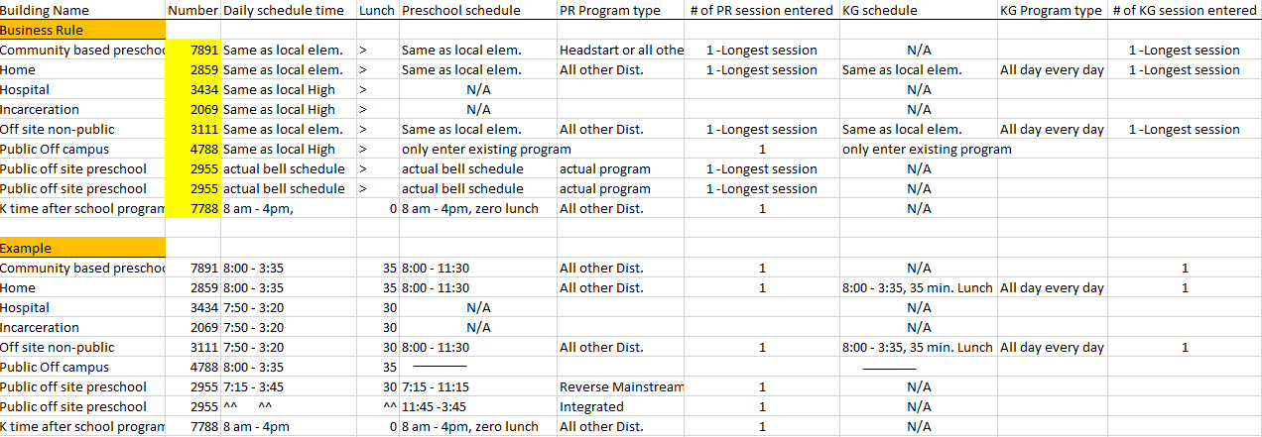
Directory Session Chart
29

Slide 30
Data Quality & Timely and Accurate
FY 2016 – FY2021
30
Notes:
Amanda

Slide 31
When to run SPEDPro reports?
Unresolved exit report – run from your initial submission of the school year up to September 15. August – September 15
Exit status report & Unknown exit report – run from last day of school to September 15
Discipline Incident report, Projected discipline reports, projected table 4 exit report - run from last day of school to September 15
Projected December 1 report & projected gifted summery report – run from first day of school to February 28
Verification report, Projected end of year report, overlap report, unclaimed student report, & gained student report – run continuously for 13 months beginning August of current year to September 15 of next year
31

Slide 32
FY2018
Data Quality Checks
Avoiding Accuracy & Complete issues
1
2
Unequal end dates
2
Active record, no exit date
Service end date is in question
May trigger Verification 0210
Indicates incomplete data
Services stop before end of the year
32

Slide 33
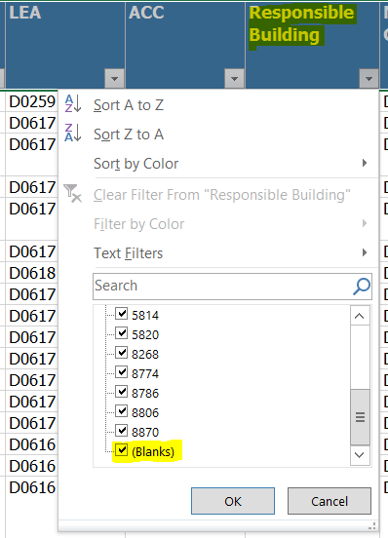
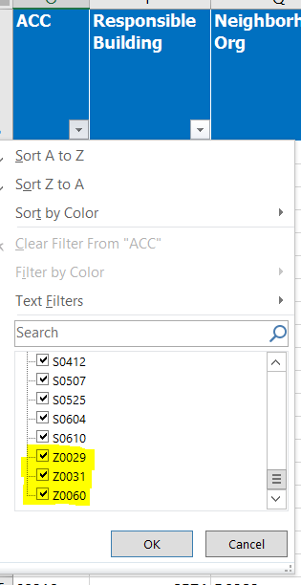
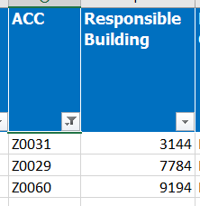
FY2018
Data Quality Checks
Projected Dec 1 & EOY Report
ACC
Check responsible school using ACC values
Responsible building
should not be blank, or X0 / Z0 organization.
33

Slide 34
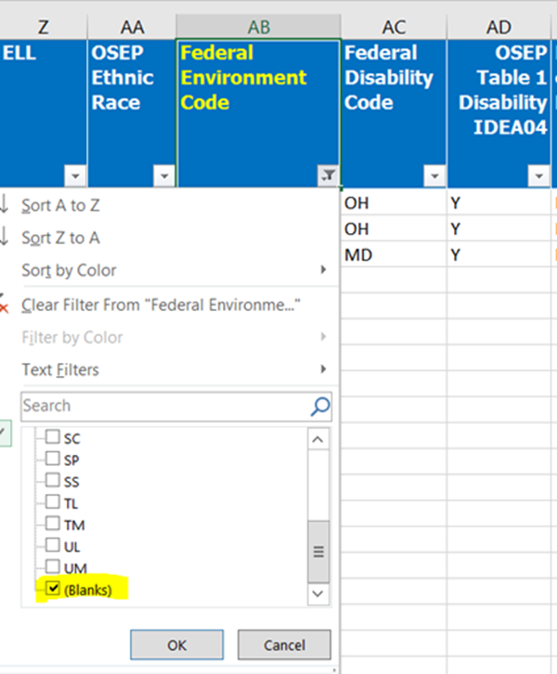
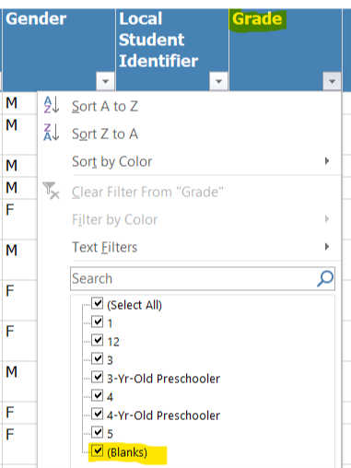
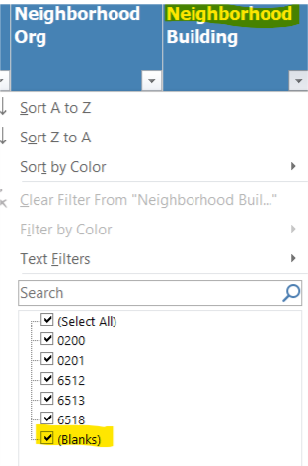
FY2018
Data Quality Checks
Projected Dec 1
Environments
Projected Reports
Look for unexpected blank values
Neighborhood school
Grade
34

Slide 35
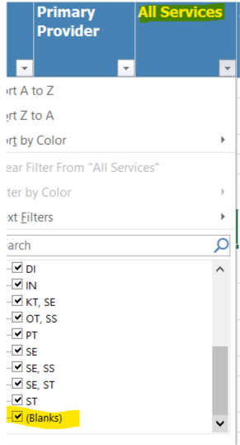
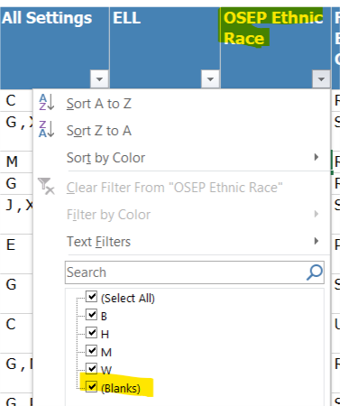
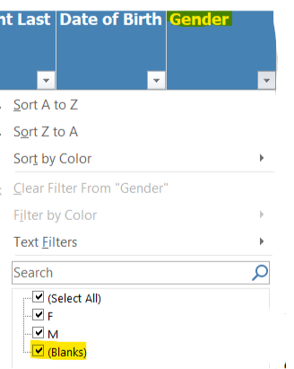
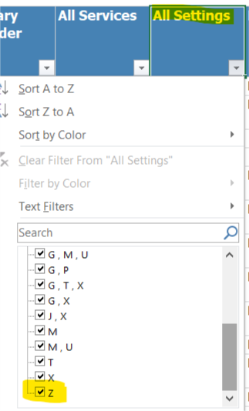
FY2018
Data Quality Checks
Projected Reports
Look for unexpected blank values
All Services
Race Ethnicity
Invalid settings “Z”
Gender
35

Slide 36
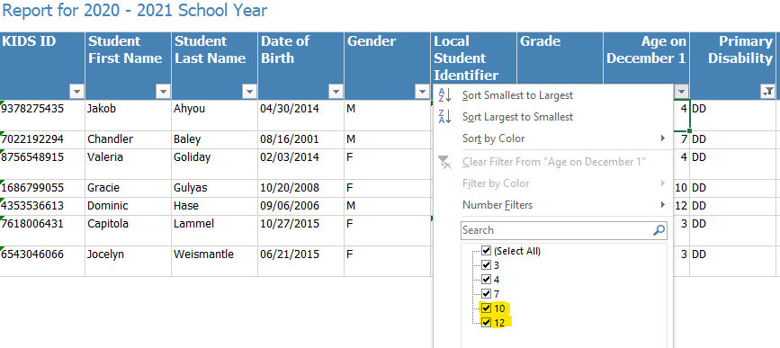
FY2018
Data Quality Checks
Projected December 1 Report
Look for DD students older than age 9
Disability = DD
December 1 age
36

Slide 37
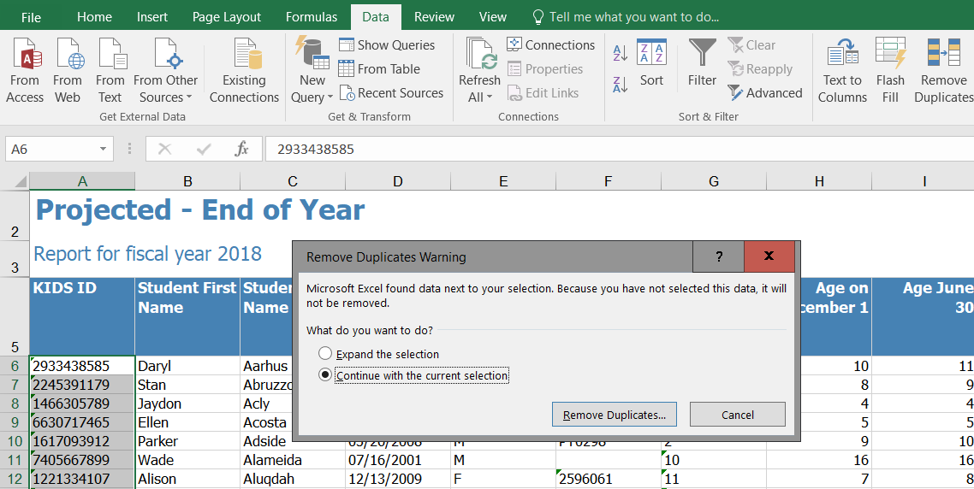
Check for Duplicate records
FY2019
Find Duplicates
3
2
Highlight KIDS ID numbers
Select Data Tab
Remove Duplicates, Warning Box
Keep Current Selection
Click Remove Duplicates
1
4
5
37

Slide 38
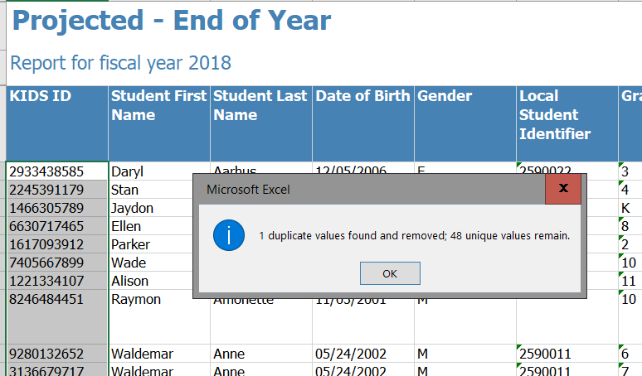
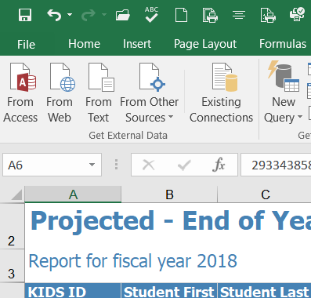
Check for Duplicate records
FY2019
Reverse the Remove Duplicate Action and put the Duplicates back in the report
Pop-Up Alert identifies the number of Duplicates, if any
38

Slide 39
Find Duplicate records
FY2019
2
1
3
39

Slide 40
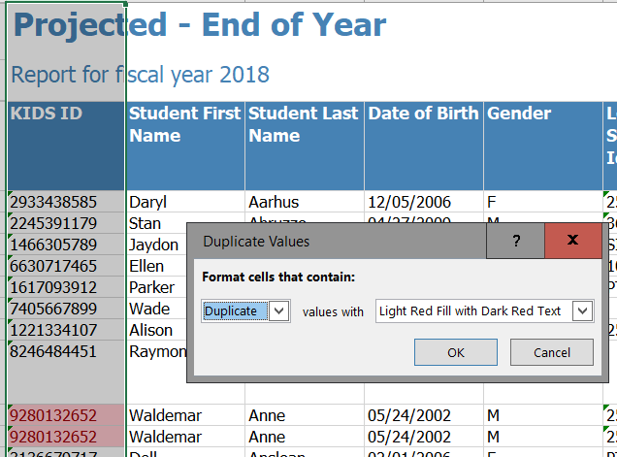
Duplicate records are Highlighted
FY2019
Remove Duplicate records found
Note: Active Records & Inactive Records for the same student represents a duplicate
Delete Duplicates and retain a single record
5
40

Slide 41
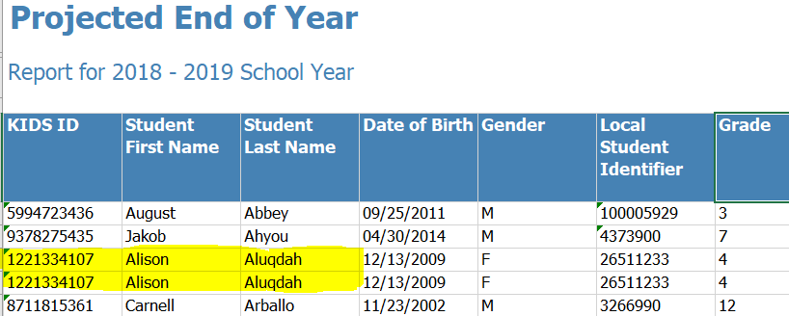
Report Review
Find Duplicates
41

Slide 42
Report Review
Exit Status Report
Evidence that reported basis of exit should be changed to “T”
42

Slide 43
Report Review
Pre-Finalization Notice
43

Slide 44
Report Review
FY2020
Discipline Incident Report – No Service
Discipline incidences do not align with service line data
No services on incident date
No Disability on incident date
44

Slide 45
FY2019
Data Quality
What MIS factors in Timely & Accurate reporting
Verification 0203 – Qualified student excluded from December 1 count
Verification 0210 - Unqualified student included in December 1 count
Verification 0220 – Contradicting Disabilities
Verification 0221 – Contradicting Responsible schools
Verification 0224 – Changed December 1 / OSEP data
Unresolved Exit Report – Missing student exits
Unresolved Exit Status Report – Exiting Status needs updating
Verification 0148 – Incomplete data
OSS / Expulsions services not reported on 12-1 service lines – Incorrect Service Location
45

Slide 46
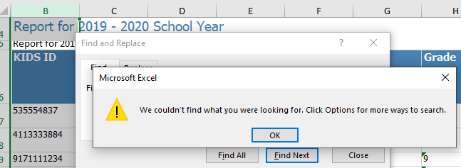
Data Quality
What MIS factors in Timely & Accurate reporting
a) 0203 - Qualified student excluded from December 1 count
b) 0210 - Unqualified student included in December 1 count
46

Slide 47
FY2019
Data Quality
What MIS factors in Timely & Accurate reporting
c) Disability flags
Multiple Disability for same period of time – 0220
December 1 disability changes – 0224
d) Responsible school flags
Triggers verification 0176
Multiple Responsible Schools for same period of time - 0221
December 1 responsible school changes
e) Verification 0224 report
47

Slide 48
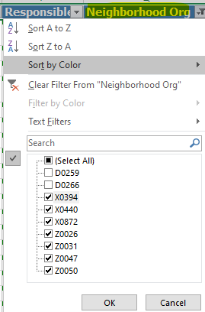
Private / Parochial Status
Found on Projected reports under Neighborhood organization
Student Profile – Identified by Neighborhood school
Solution - Keep Private / Parochial status all school year
Educational environment = PP
Exits not reported to OSEP
Discipline removals not reported to OSEP
48

Slide 49
Grade level status
Student Profile – Identified by SPED Grade Indicator
Preschool Grade listed when December 1 data finalized. Preschool environment = TM
Grade level changed before the end of the school year. School age environment = RR
Solution – Keep the same grade level all school year
49

Slide 50
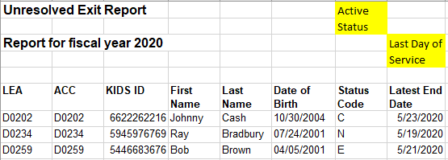
FY2019
Data Quality
What MIS factors in Timely & Accurate reporting
f) Unresolved Exit Report
Exit status is missing
g) Exit Status report
Evidence of in-state transfer “T”
50

Slide 51
FY2019
Data Quality
What factors in Timely & Accurate reporting
h) Incomplete school year data
Services stop before the end of school
Projected EOY report
No Exit Date / Active status
51

Slide 52
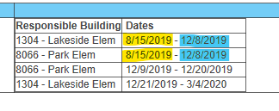
FY2019
Data Quality
What MIS factors in Timely & Accurate reporting
Incorrect building triggering 0176
View on the Student List page
Multiple Disability for same period of time - 0221
December responsible school changes – 0224
52

Slide 53
Data Quality
What MIS factors in Timely & Accurate reporting
Service location for Disciplinary removals
January - Crosscheck fall incidences of long term removals
The length (days) of removed impact the December 1 service location
53

Slide 54
Data Quality
What MIS factors in Timely & Accurate reporting
Service location for Disciplinary removals
Out of school location
Out of school location
In school location
54

Slide 55
FY2019
Data Quality
Timely Submissions
Initial Submission
September 1 = Target date for Initial submission
Begin Year set up complete
September 15
Calendars
Settings
Providers
Students
Indicator 11
September 15
Indicator 12
September 23
Indicator 13
June 1
Discipline
June 30
55

Slide 56
FY2019
Data Quality
What MIS does not factor in Timely & Accurate reporting
Non-public Equivalency Data
Catastrophic Aid data
Gifted only Student data
56

Slide 57
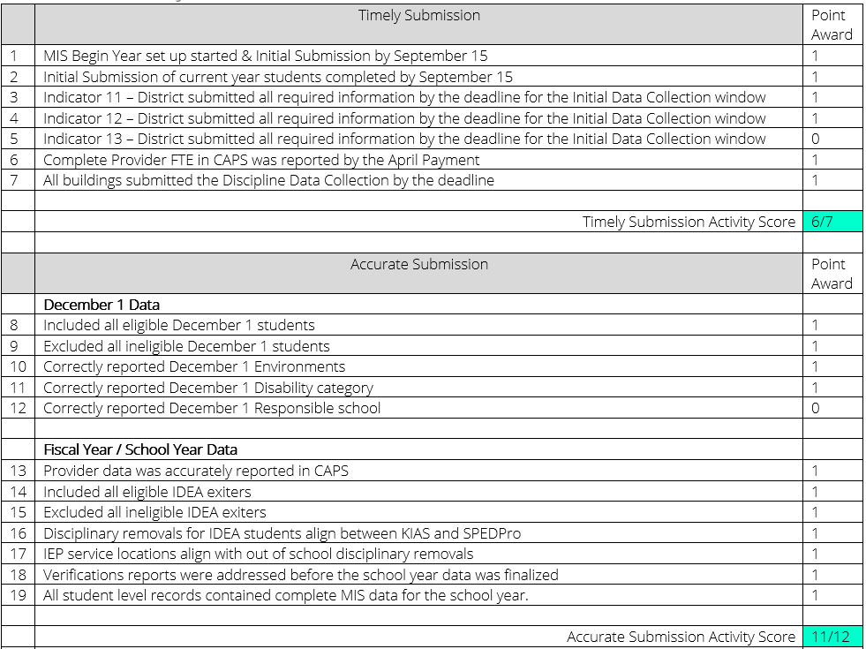
Timely and Accurate Data Quality Scoresheet
57

Slide 58
Timely and Accurate Data Quality Scoresheet
Stakeholder Input
Send Questions and Feedback to KSDE
Submit input in writing
Input collected through -
September 4, 2020
Noon Deadline
Final Version will be introduced in September 2020
Data Quality to be measured beginning in FY2021 under new format
58

Slide 59
Tips & Reminders
59
Notes:
Amanda

Slide 60
How to avoid Duplicate records resulting from Importing
FY2018
Students with existing SPEDPro records
Change in responsible schools
Students who move between Coop member districts
Change in Assign Child count organization
Students who exit and return
Solution –
Delete original student profile before importing new student record
60

Slide 61
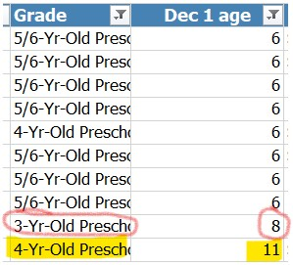
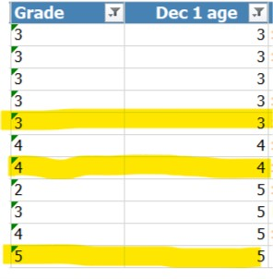
FY2020
Projected Dec 1 & EOY
Check grade level for unexpected age
Check age for unexpected grade
Correcting later can trigger verification 0224
61

Slide 62
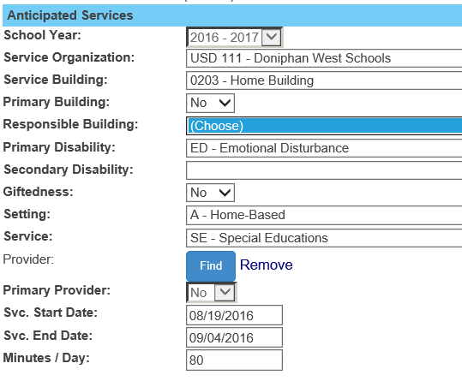
FY2018
Verification 0176
Responsible building has no values listed to choose
Contact local KIDS administrator to request submission of KIDS records
62

Slide 63
FY2018
Gifted students who exit IDEA services must have and exit date and exit status
In-service topic
Student is no longer a child with a disability. Do not miss students who qualify for OSEP Table 4 Exits
SE services ended on 03/04/2017
Verification 0018 means your data is entered correctly
Student Profile
63

Slide 64
FY2019
Save Imported files
If questions arise regarding data changes between Preliminary, Final and Subsequent data,
It helps to keep a history of records submitted to troubleshoot changes in data over time
Develop a file naming convention and organized system to find and retrieve files easily
64

Slide 65
Knowing KIDS Data
FY2018
KIDS Collection
KIDS Assignment
Stores a history of KIDS records
Stores KIDS records by school year
Stores all KIDS record types
Used by SPEDPro’s Student Search “in KIDS” criteria to find student if claimed in current school year
Determines demographics populated in SPEDPro
Determines student’s responsible school
Identifies the KIDS ID Number associated to a student.
65

Slide 66
Time Line Graph
FY 2016
66

Slide 67
Updated Browser Support
67

Slide 68
MIS Exercise
Multiple choice reminder questions
Scavenger Hunt
Exercise review in August
68

Slide 69
Other Data Presentations
Discipline Data Reporting
Emergency Safety Interventions (ESI)Early Childhood data
Indicator 5
Indicator 6
Indicator 7
Indicator 11
Indicator 12
Significant Disproportionality
Special Education Categorical Aid
Document Updates
2021 Data Dictionary
SPEDPro User Guide
Index of Support Documents
Directory Session chart
www.KSDE.org
MIS and student data page
Please participate
69

Slide 70
Follow Up
Zoom Meeting
August 12, 2020, 1:00 PM
Zoom Agenda
Address Workshop Questions
MIS Exercise review
FY2021 Questions
Email Zoom questions and feedback to:
mvosburgh@ksde.org
70

Slide 71
Mason Vosburgh Data Coordinator SETS (785) 296-4945 mvosburgh@ksde.org

