Slide 1
FY 2019
MIS Workshop

Slide 2
Data Dictionary
UPDATES
2

Slide 3
Revised format
Forward, Definition and Appendix sections merged into a single document.
3

Slide 4
Data Dictionary Clarification
Service initiation dates removed as invalid IEP date. The ignition date can be designated by the team as the IEP date
Setting “U”, Under Suspension / Under Expulsion: - Interim Alternative Educational Settings (IAES) added to definition. Students reported in KIAS as removed to Interim Alternative Educational Settings would be reported with a service location setting of “U” for the time served in the IAES.
4

Slide 5
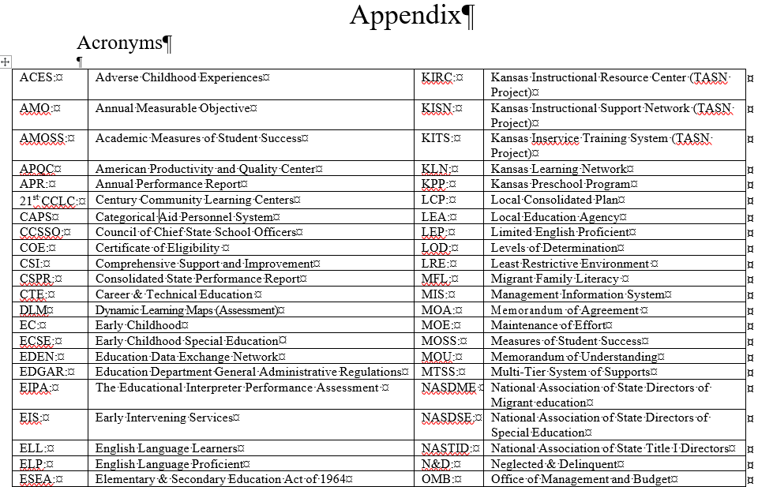
Acronyms
List of common acronyms added
5

Slide 6
Initial Submission
Begin Year Set Up
Complete and enter calendars
Including private schools in your catchment area
Review building information
Session minutes, days per week, preschool types (V-0214)
Discover current year program types and submit settings
Update current year providers
6

Slide 7
Initial Submission
September 1, target Initial submission data
Meets monthly update requirement
Finds unresolved exits from prior school year
Populates projected December 1 and EOY reports
7

Slide 8
Continuous Activity
Guidance for Timely Reporting
Updating student records close to “real time”.
Review projected reports.
Finding expected and unexpected results
Indicator data may be skewed negatively
8

Slide 9
Grade Level
Clarification – Grade level functionality SPEDPro
Grade level reported determines the calendar and class session to apply to the service line
Preschool calendars, preschool session minutes program comparisons do not differentiate from 3, 4, & 5 year old preschool grades listed on the student profile.
SPED grade levels reported in SPEDPro are not compared to grade levels reported in KIDS records. KIDS grade does not change, KIDS has grades not applicable in SPEDPro.
9

Slide 10
New Service code
ST – Special education transportation as documented on the student’s IEP.
Transportation before or after school – service location = “T” Extracurricular
Transportation during school hours – service location = “G” special education outside of the classroom
10

Slide 11
Exit date
Clarification – The date services cease. Profile exit date and latest service end date are equal. The same date.
Not an exit date
The day the exit is discovered that the student is no longer being served by the LEA.
The day a request for records were received.
The date withdrawal documents were signed.
Anticipated dates the student is expected to exit, such as anticipated graduation date.
The first day of school for students who moved over the summer.
Students who move between a Coop or Interlocal’s member districts do not qualify as exiters
11

Slide 12
New kids record
SPED record type
Intent – To provide a KIDS record for association to SPEDPro without claiming the student for Accountability or Funding.
When used – No KIDS records are present that contain required OSEP data elements such as current year organization and building association, demographics, etc. Examples include –
Students served at the start of the school year then exit before 9/20
Private / Parochial IEP students without USD and building association
Any student without a current year KIDS collection record.
Note: SPED records will not be listed in KIDS Assignment
12

Slide 13
Unresolved Exit
Clarification
Active students from the prior year not found in the current school year will be listed as unresolved exits. To resolve these students, update the prior year record with exit data or include the student in the current year population. Unresolved Exits may affect the determination of reporting accuracy.
13

Slide 14
Provider profile
Organizations
The organization associated to the buildings where the provider delivers services.
Organizations associated to the student are not relevant in the provider profile.
Where does the provider work?
14

Slide 15
Provider profile
Roles
Every provider has the role of “Service Line Provider”
Providers severing students in Non-Public Equivalency organizations list the role of “Contract Provider”
SLP, School Psych & Case Manager roles are not required.
Are related service providers employed on a contracted basis listed with the “Contract Provider” role?
No
15

Slide 16
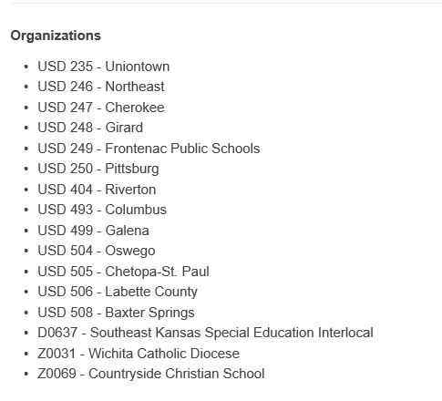
Provider Profile
Data Analysis and Public Data Request
How many IEP students are placed in the Coop Day school?
How many SPED teachers are providing services in the Coop Day school?
6 students / 72 teachers = 12 teachers for each student.
16

Slide 17
Importing providers
Troubleshooting
If the provider data is cut from a template / Excel and pasted into a blank text file such as Notepad, be sure the cursor is positioned to the right of the last data field submitted. If the cursor falls to the beginning of a new row below the data, simply backspace once to move the cursor to the end of the row above, to the right of the last data field submitted and save it.
17

Slide 18
Importing template created records
Troubleshooting
Note the location of the curser after template fields are pasted into the text file. Be sure the curser is at the end of the last data field, not starting a new row. Backspace once to move the curser.
18

Slide 19
all Submissions
Save Imported files
If questions arise regarding data changes between Preliminary, Final and Subsequent data,
It helps to keep a history of records submitted to troubleshoot changes in data over time
Develop a file naming convention and organized system to find and retrieve files easily
19

Slide 20
New Verification
0224
December 1st Responsible school, area of Disability or Educational Environment has changed from the final 12-1 report.
Companion to verification 0203. The reason why the federally reported December 1 data changed.
20

Slide 21
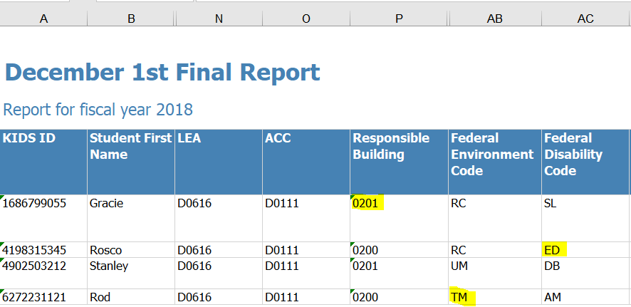
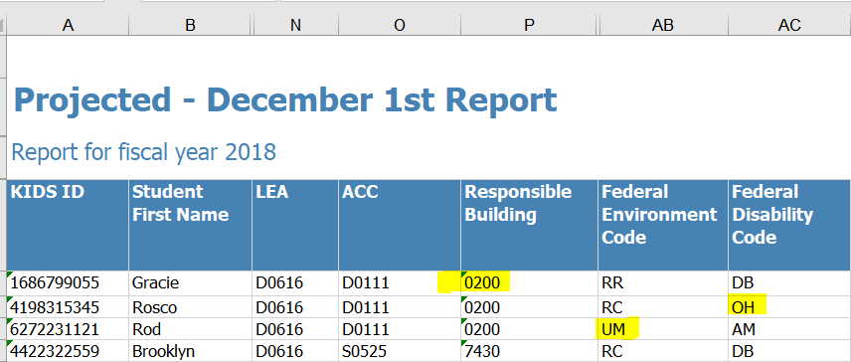
Verification 0224 Analysis
Look for changes in the data
A Projected December 1 report run today will show what has changed from the Final report
21

Slide 22
Primary Cause
0224 – Disability Change
Mid-IEP changes are applied to the entire IEP by date.
Example, 9/26/2017 IEP. Area of disability changes on 03/15/2018
New disability listed on service lines 9/26/2017 to 05/21/2018
Example, 08/05/2017 IEP. Service location changes on 02/11/2018
New location listed on service lines 08/05/2017 to 05/21/2018
22

Slide 23
Primary Cause
0224 – Responsible School Change
Responsible school relevant to the prior school year is not updated for the current school year.
Example, 03/26/2017 IEP, 2017 responsible school is 8080 Lincoln Elementary. The 2018 responsible school is 8101 Adams Middle school. The 03/26/2017 IEP begins the 2018 school year listing 8080 Lincoln Elementary.
The 2018 responsible school does not get updated and reported until new IEP is completed (March), after the December 1 report is final.
23

Slide 24
Primary Cause
0224 - OSEP Environment Change
OSEP Environment relevant to the prior school year is not updated for the current school year.
Example, 04/11/2017 IEP, 2017 service are provided in preschool locations. The 2018 service are provided in the Kindergarten classroom. The 04/11/2017 IEP begins the 2018 school year listing preschool settings.
The 2018 OSEP environment changes when record is updated with new IEP in (April), after the December 1 report is final. New grade level, classroom session minutes, new settings change the environment.
24

Slide 25
Primary Cause
0224 - OSEP Environment Change
OSEP Environment changes with subsequent updates to the student record.
Example, OSEP Environment calculated services, settings, minutes, frequency, days per week and total days from 5 service lines.
After the December 1 report is final, record is updated .
25

Slide 26
Private / parochial category
0224 - OSEP Environment Change
Private / Parochial OSEP Environment is determined by the student’s neighborhood school. Data Dictionary page 9, examples 5-8
Example, Student profile initially lists a Private / Parochial neighborhood school (X0 or Z0) organization. As the student receives general education in a Private / Parochial school. Student counts in the PP category for December 1
Subsequent record update changes the neighborhood school to a public school (D0) organization. OSEP Environment changes to the public school calculation resulting in a different OSEP Environment category.
26

Slide 27
0224 - OSEP Environment Change, other examples of data updates
Homebound services from prior year reported in current year. Removed when next IEP is submitted.
Grade level of student promoted to KG in July, then resubmitted with Exit status. Services in a preschool program with no KG sessions. December 1 days = zero
K time not present on December 1, record updated to include K time
Current year IEP was amended in October. Amended services first reported in April when next IEP is submitted.
27

Slide 28
New Verification
0224
What action is required?
If the December 1 data is accurate and has changed, then the December 1 data must be updated to the correct values
If the current data is accurate, then no additional updates are required.
28

Slide 29
Verification 0044
Clarification
Trigger – Reported service minutes exceed the Class minutes.
Verification logic – to flag service minutes that are artificially high. Resulting in a more favorable OSEP environment calculation.
Note: If the student receives IEP support during the lunch period, then a separate service line is required to account for the lunch period minutes
29

Slide 30
Non-accredited Private Schools
New Organization X0440
Note: Non-Accredited Private / Parochial schools are found under Organization X0440. Organization X0440 will filter to the top of the Neighborhood school organization list on the profile drop down. Buildings bounded within the User’s catchment will be listed for selection in the Neighborhood school list. Note: Non-Accredited Private / Parochial schools are found under Organization X0440. Organization X0440 will filter to the top of the Neighborhood school organization list on the profile drop down. Buildings bounded within the User’s catchment will be listed for selection in the Neighborhood school list.
30

Slide 31
Reports
Guidence
31

Slide 32
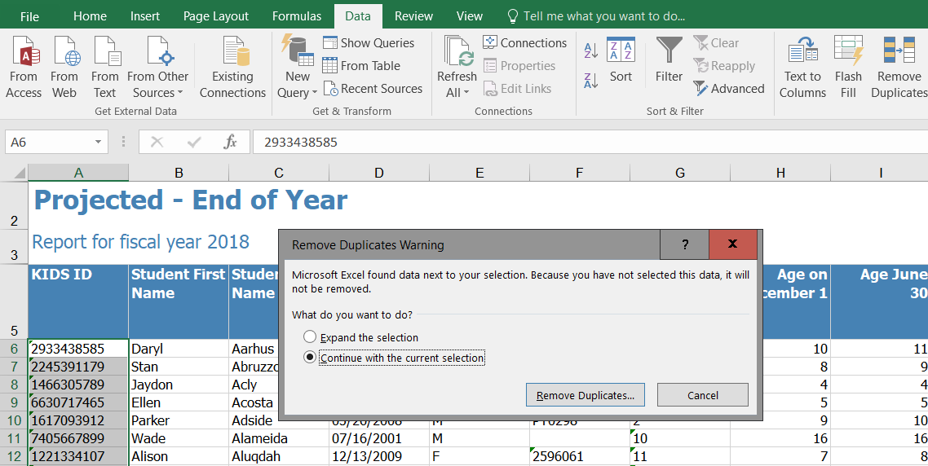
Check for Duplicate records
Are Duplicate records present?
3
2
Highlight KIDS ID numbers
Select Data Tab
Remove Duplicates, Warning Box
Keep Current Selection
Click Remove Duplicates
1
4
5
32

Slide 33
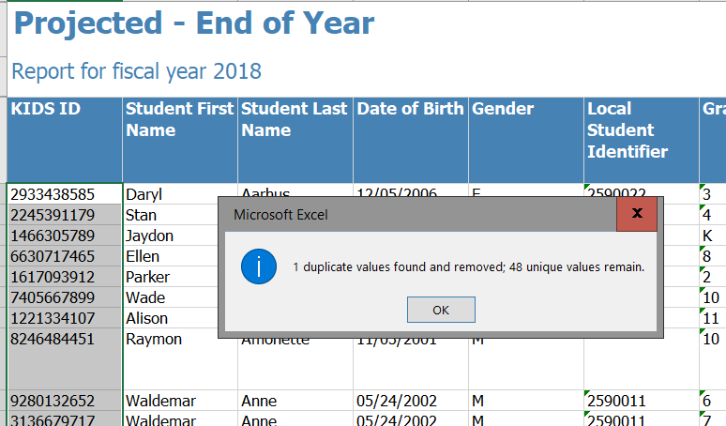
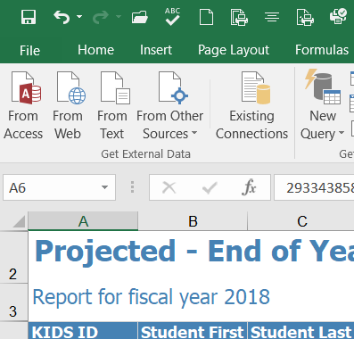
Check for Duplicate records
Reverse the Remove Duplicate Action and put the Duplicates back in the report.
Pop-Up Alert identifies the number of Duplicates, if any
33

Slide 34
Find Duplicate records
2
1
3
34

Slide 35
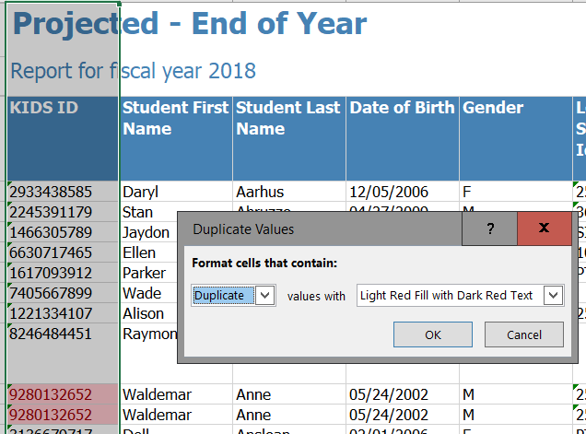
Duplicate records are Highlighted
Remove Duplicate records found
Note: Active Records & Inactive Records for the same student represents a duplicate
Delete Duplicates and retain a single record
5
35

Slide 36
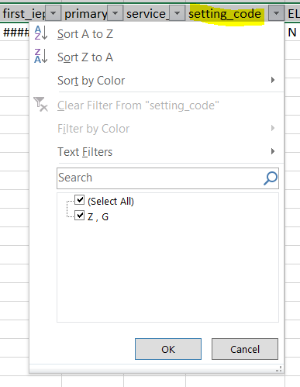
Projected reports
Look for invalid settings
“Z” indicates an invalid setting code is listed on the student’s service line
36

Slide 37
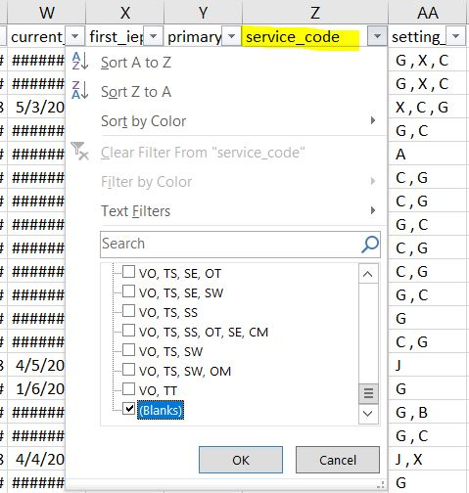
Projected reports
Look for Missing Services
“Blank” indicates an No Service code is listed on the student’s service line
37

Slide 38
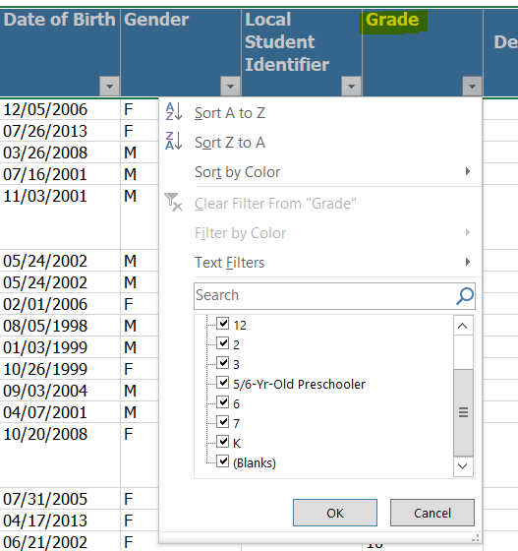
Projected reports
Look for Missing Grade Level
“Blank” indicates an No Grade is present. No Grade means Calendar, Building and Class minutes are not found. OSEP Environment can not be accurately calculated
38

Slide 39
Discussion
Verifications, Reports, Alerts
How could these be better communicated so I know what needs to be fixed and what are notifications only?
39

Slide 40
OSEP Reports and federal data in SPEDPro
Guidance
40

Slide 41
Knowing the three federal data reports pulled from SPEDPro
Child count and Environment – Table 1, Table 3
Exiting – Table 4
Discipline – Table 5
41

Slide 42
Child Count – Table 1
Also Known As
December 1 child count.
The unduplicated number of students, age 3-21 identified with a disability receiving services on / intersecting the December 1 date.
42

Slide 43
Educational environments – Table 3
Also Known As
OSEP Environment
Federal Environment – SPEDPro reports
Indicator 5 & 6 categories
Where the student received IEP services by OSEP the Category
43

Slide 44
Educational environments – Table 3
What is it?
Same population as the December 1 child count
8 Early Childhood Environment Categories, Age 3-5
8 School Age Environment Categories, Age 6-21
See Data Dictionary for the category codes and descriptions.
44

Slide 45
Educational environments – Table 3
Basic Calculation - School Age students age 6-21
Service lines intersecting the December 1 date.
Separate School = SS Time outside of the regular class
Private / Parochial = PP Time in the school day
Correctional Facility = CF
Residential Facility = RF
Home bound / Hospital = HH
= 0-20%
= 21-59%
= 60-100%
RC
RR
SC
45

Slide 46
Educational environments – Table 3
Basic Calculation – Early Childhood
Preschool & KG student ages 3-5
Service lines intersecting the December 1 date.
46

Slide 47
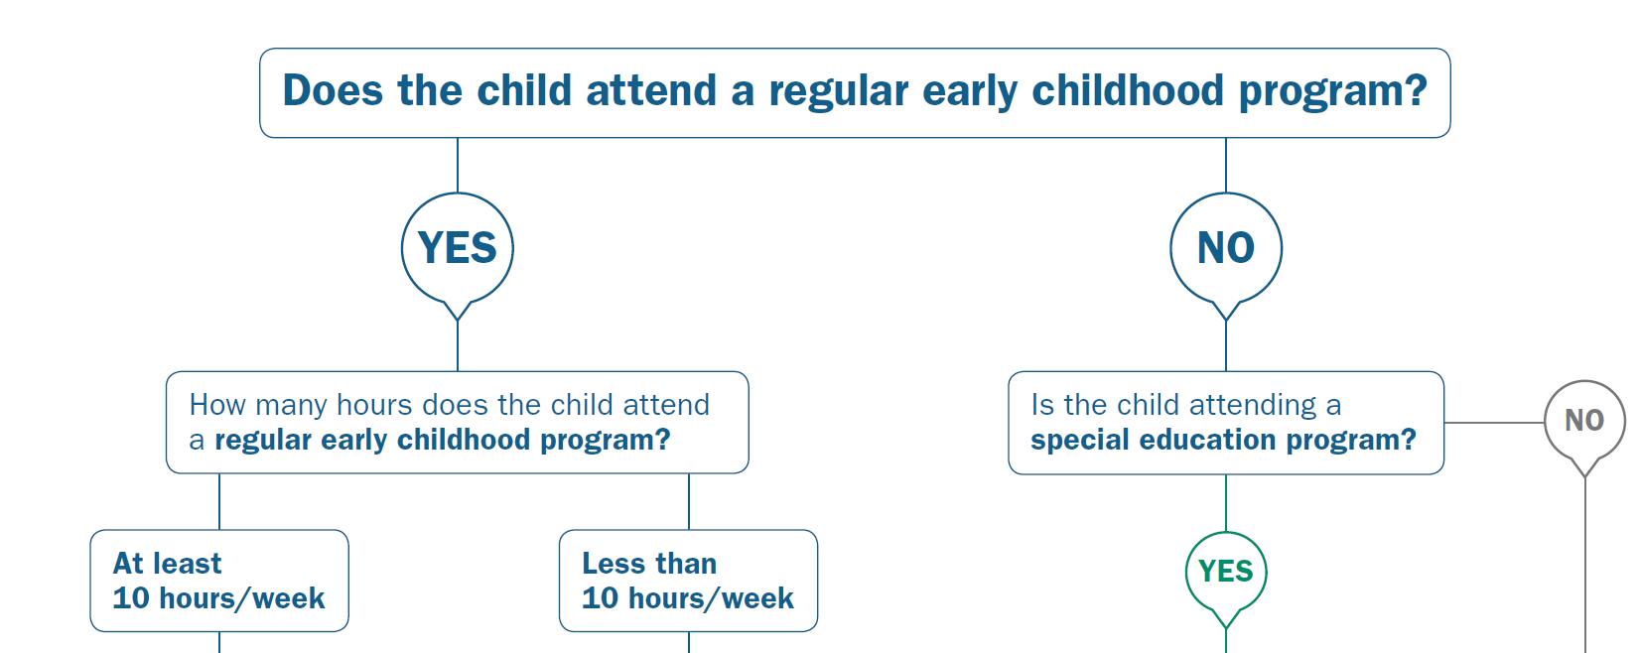
Educational environments – Table 3
Basic Calculation – Early Childhood
HO
PL
T
U
SP
SS
47

Slide 48
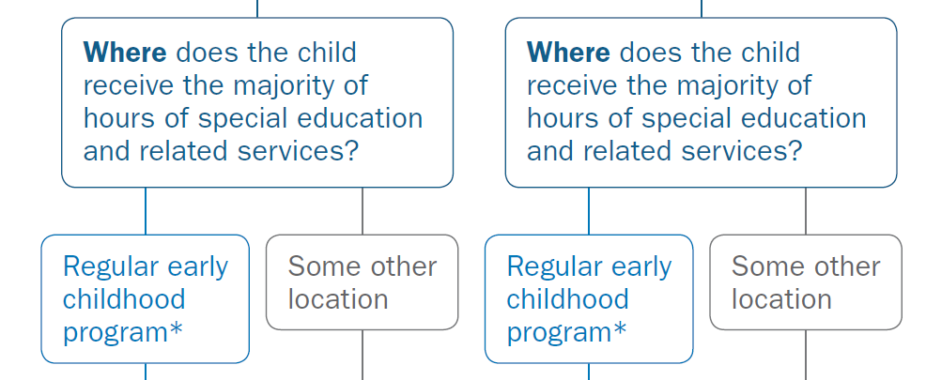
Educational environments – Table 3
Basic Calculation
Early Childhood
TM
TL
UM
UL
48

Slide 49
Exiting
Guidance
49

Slide 50
OSEP exiting report – table 4
Which students qualify?
Unduplicated set of student
Age 14 – 21
No longer in a special education program
Only the last exit of the school year counts
50

Slide 51
Exiting guidance
Exit Status Report
IEP services stop in March 2018. Drop out status is listed
Request for records are received from Colorado in April 2018
What is the reported EOY status for 2018?
L – Left State
51

Slide 52
Exiting guidance
Projected Table 4 Exit Report
IEP services stop in March 2018. Drop out status is listed
Request for records are received from Utah in August 2018 for the new school year
What is the reported EOY status for 2018?
D – Drop Out
52

Slide 53
Exiting guidance
Projected Table 4 Exit Report
IEP services stop in March 2018. When student began homeschooling
Parents did not revoke consent for services. Request for records are received from a parochial school in April 2018.
What is the reported EOY status for 2018?
A – Action Initiated withdrawal
53

Slide 54
Exiting guidance
Projected Table 4 Exit Report
IEP services stop on the last day of school May 2018. Drop out status is listed
Request for records are received from Kansas City in August 2018 for the new school year
What is the reported EOY status for 2018?
T – In state transfer
54

Slide 55
Exiting guidance
Projected Table 4 Exit Report
IEP services stop in April 2018. Drop out status is listed
Student revoked consent for services on the last day of services and did not continue in General Education
What is the reported EOY status for 2018?
D – Drop Out
55

Slide 56
Discipline
56

Slide 57
Discipline crosscheck
Look for mis-classification in KIAS as IDEA student or missing IEP services.
Student reported in KIAS as IDEA, not found with IEP services on the date of the incident. KIAS identification may be in error, or MIS data is incomplete.
57

Slide 58
OSEP data elements pulled from SPEDPro
Report | Age on 12-1 | OSEP Disability | KIDS Race / Ethnicity | KIDS Gender | KIDS ELL Status | KIDS Resp. Building | KIDS Resp. Organization | Current Status | OSEP environment | KIAS Disciplinary Removal
Table 1 & 3 Child count Environment | X | X | X | X | X | X | X |  | X
Table 4 Exiting | X | X | X | X | X |  | X | X
Table 5 Discipline |  | X | X | X |  |  | X |  |  | X
58

Slide 59
SPEDPRo elements used to Calculate OSEP data
Report | School Year | Primary & Secondary Disability | Service line dates | Service settings | Service Minutes | Total Days of service. Frequency Days per week | Directory session Times | Directory Building Attributes | Exit date | Overlap Duplicate Check
Table 1 & 3 Child count Environment | X | X | X | X | X | X | X | X |  | X
Table 4 Exiting | X | X | X |  |  |  |  |  | X | X
Table 5 Discipline | X | X | X |  |  |  |  |  |  | X
59

Slide 60
Trouble shooting
Guidance
60

Slide 61
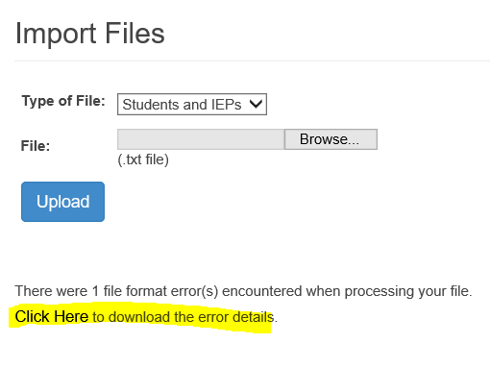
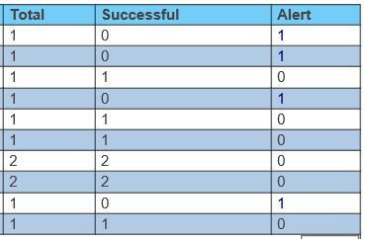
Import alerts
Import History identifies records triggering an Alert. A successful = 0 nor an Alert are not an indications the complete record failed to Import. Review the Alert message to see why the Alert is present. There could be individual service lines that failed to import.
61

Slide 62
Building Minutes
Begin Year Set Up August / September
Trouble shooting building minutes
Print the building information from SPEDPro and check for incorrect and missing class time minutes
Make corrections to the Directory before December 1
April Discovery
62

Slide 63
Building Minutes
Begin Year Set Up August / September
Trouble shooting building data
Do not list Kitchen Units, District Central Offices, Infant Toddler Networks, Day Care Centers as service locations
63

Slide 64
Building types
Begin Year Set Up August / September
Trouble shooting building types
Early childhood Program- General should only be listed for the after school K time program
64

Slide 65
Building types
Begin Year Set Up August / September
Trouble shooting building types
Early childhood Program- General Setting “X” and “T” cannot be listed for this building type
Has to be fixed by KSDE on the back end by Oct. 1
65

Slide 66
Organizations
Organizations are
Organizations are categorized by a letter code followed by a 4 digit identifier
A0 - | Vocational and Technical Schools |  | M0 - | Miscellaneous Programs
C0 - | Infant toddler networks |  | P0 - | Parents as Teachers
D0 - | Public schools |  | S0 - | State Operated Schools
J0 - | Community Colleges |  | X0 - Z0 - | Private / Parochial Schools
66

Slide 67
Verifications
Step 1 – Look at the data submitted in SPEDPro.
View the student profile.
Check the status, exit date, grade, claiming code.
View the IEP page
Check the IEP dates, check “allow gap” value
Check each individual service line
Service location (prior USD service building)
Service dates (before or after the student was served)
Total days of service (zero)
67

Slide 68
Verifications
Verification 0011 – Number of days of service exceeds the calendar days.
Happens if the calendar changes after student records are populated.
Preventive action – Don’t change the calendar
Post Calendar Change – Go to the service line in edit mode and the application recalculates to the new value, save
68

Slide 69
Verifications
Verification 0012 - Service End Date outside of the calendar range or overlaps the next IEP. What is triggering this?
You list a service line end date of 5/21/2019, but the calendar shows the last day of school in 5/18/2019.
First IEP services ends on 11/25/2018. Subsequent IEP services begin on 11/20/2018
69

Slide 70
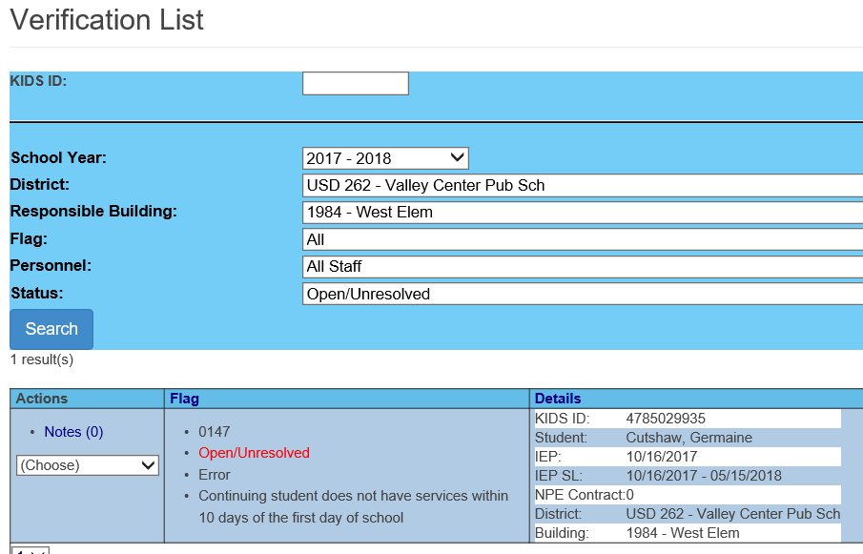
Verifications
Unexpected results
How to avoid the issue of not finding all services?
Always search on All Responsible Buildings
70

Slide 71
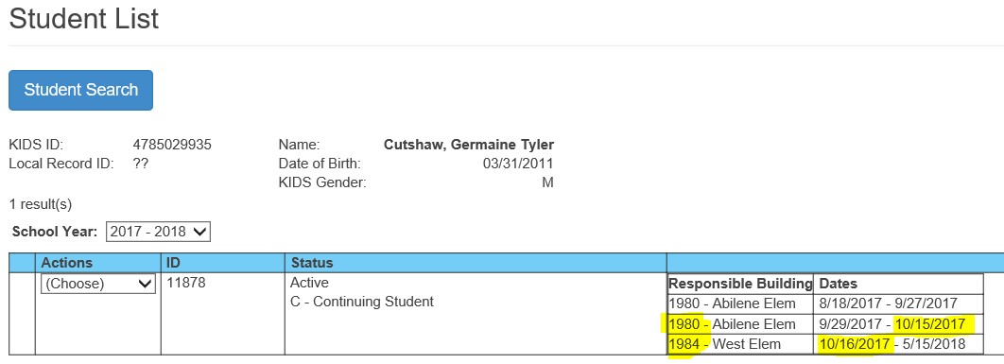
Verifications
Unexpected search results – searching on a single school only returns service lines from the searched building.
71

Slide 72
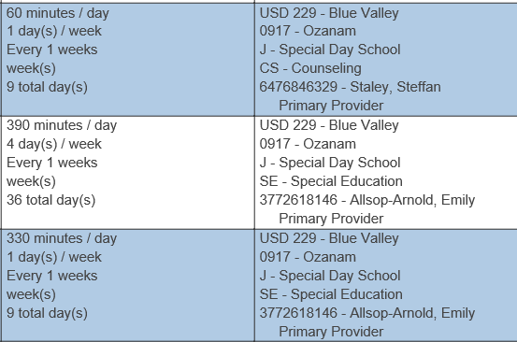
NPE Crosschecks
Match the service line hours to the NPE hours for regular term
Service lines = 17,550 minutes = 293 hours
NPE only seeks reimbursement for 18 hours
72

Slide 73
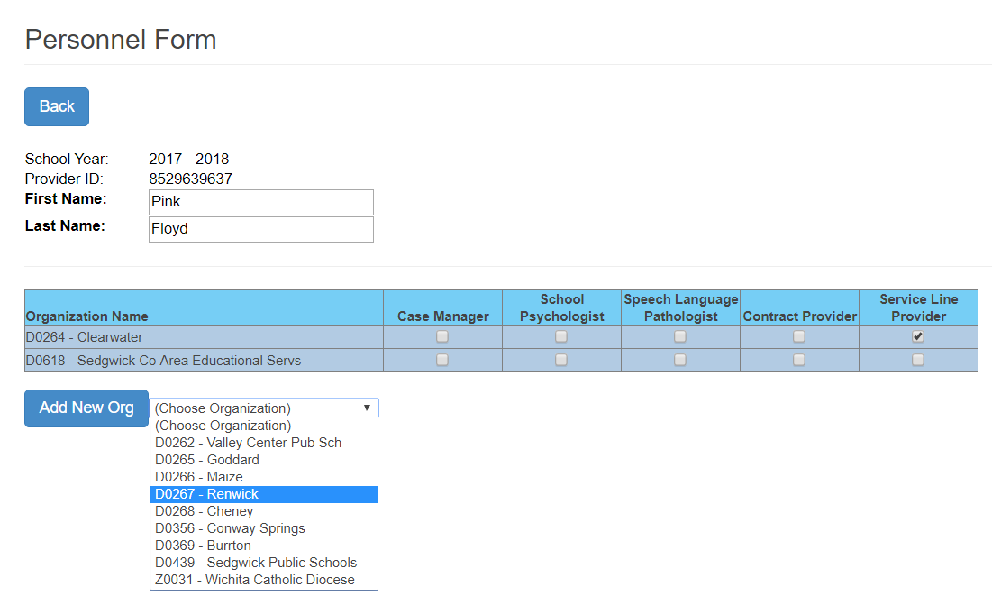
Personnel List – New Page Layout
Service line provider roles is required for all providers listed
Only mark the organizations of buildings where the provider serves students.
Remove organizations where the provider does not serve students.
Provider roles are unique to service organizations
73

Slide 74
Reminder
Questions
74

Slide 75
Provider profile
Jane Doe is a Coop 735 provider teaching only in Lincoln High a USD 535 school. She provides services to USD 123, 302 & 510 students. Which organizations are marked on Jane Doe’s Profile?
D0123, D0302, D0501, D0535, D0735
D0123, D0302, D0501, D0535
D0535, D0735
D0535
75

Slide 76
Verification Search
Searching for verifications related to provider Suzie Smith will return students with?
Verifications with Suzie Smith marked as Primary Provider.
Verifications with Suzie Smith listed on the service line.
Verifications with Suzie Smith listed as Case Manager.
Verifications with Suzie Smith matching the responsible school.
76

Slide 77
Verification Flags
A verification flag will trigger if, the reported SPEDPro data lists …….
Student George Washington is listing as a Female.
18 year old John Hancock is reported as a 4 year old preschooler
Lincoln Elementary School has zero minutes of Lunch time.
USD 123 has no Holidays marked off their school calendar.
Service line minutes in the “G” setting should actually be “C”
None of the above
77

Slide 78
Student Search
Searching for student Roger Ramjet by ID, name and date of birth returns no results when I search “In SPEDPro”. How do I troubleshoot the missing student?
Confirm the ID number in KIDS Assignment
Limit the search to a single data point
Confirm the presence of a KIDS record by searching “In KIDS”
All of the above
78

Slide 79
Begin Year set up
Which of the following tasks is not completed at the beginning of the school year?
Assigning the role of Contract Provider on all provider profiles
Discovering the special education programs offered in each building
Checking the Building Information for accurate class minutes
In-Service providers on MIS requirements and new updates
All of the Above
79

Slide 80
Begin Year set up
What is the result of building minutes in error and not corrected in the directory before December 1?
Verifications triggering based on erroneous minutes
Inaccurate calculations of OSEP Environments
Indicators 5 & 6 have incorrect totals
Loss of points for Timely and Accurate data reporting.
All of the Above
80

Slide 81
Service minutes and k time minutes
What is the maximum amount of minutes possible, per service line?
435
180
195
480
81

Slide 82
Non-public equivalency
Which type of special education program will qualify for NPE reimbursement?
Kansas School for the Blind and School for the Deaf summer programs
Other Kansas School districts, Coops or Interlocals which charge a fee for providing services.
Contracted services from a Private Residential or Day school program with no affiliation or fiscal association to a Kansas public school, Coop or Interlocal.
Parochial schools where service providers are claimed for Categorical Aid.
A and C only
82

Slide 83
Claiming a Student
True or False ?
For every student, I am able to read in my IEP program, the value listed in the Claiming field reported in the MIS, before the student record is submitted to SPEDPro?
True
False
83

Slide 84
Question, Comments, Suggestions?
84

Slide 85
Thank You
Be good in school

