Slide 1
Leadership
FY 2019

Slide 2
Data Dictionary
UPDATES
2

Slide 3
Revised format
Forward, Definition and Appendix sections merged into a single document.
3

Slide 4
Data Dictionary Clarification
Service initiation dates removed as invalid IEP date. The ignition date can be designated by the team as the IEP date
Setting “U”, Under Suspension / Under Expulsion: - Interim Alternative Educational Settings (IAES) added to definition. Students reported in KIAS as removed to Interim Alternative Educational Settings would be reported with a service location setting of “U” for the time served in the IAES.
4

Slide 5
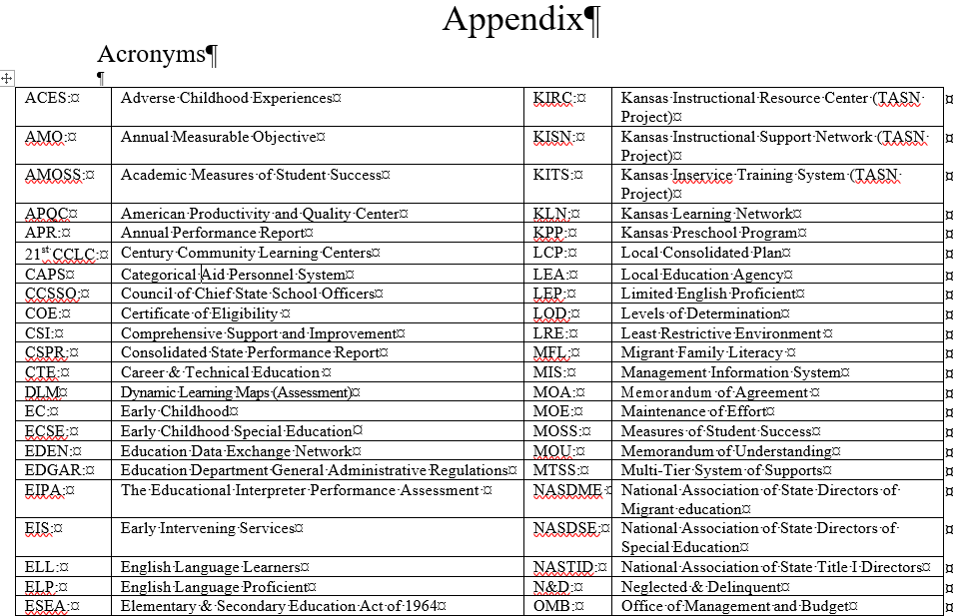
Acronyms
List of common acronyms added
5

Slide 6
Directory updates
New Directory application for FY 2019
Security Updates made
New look to data entry screen
Same functionality for entering building attributes
New building level code for KG-12 buildings (formerly other)
Same functionality for entering building & program session times
6

Slide 7
Directory updates
New Organization for Private Special Education Programs
Disassociate private programs from USD and State level organizations. Create new private X0 organization.
KSDE to maintain the Directory Updates for these programs following USD guidance.
New building numbers will be assigned and be accessible to all MIS clerks as service locations or neighborhood schools.
7

Slide 8
Initial Submission
September 1, target Initial data submission, later submissions may be problematic
Meets monthly update requirement
Finds unresolved exits from prior school year
Populates projected December 1 and EOY reports
8

Slide 9
Continuous Activity
Guidance for Timely Reporting
Updating student records close to “real time”.
Review projected reports.
Finding expected and discover unexpected results
Indicator data may be skewed negatively if data is not current
Target Dates for pulling data for Federal reports
February 28 - Child Count & Educational Environments.
September 15 – IDEA Exiting & IDEA Discipline
Subsequent changes to federal data may affect LOD
9

Slide 10
Year Long Training
Monthly FAQ
Nov – Common verifications, explanations - why verification is triggering
Dec – Import Alerts, what do the alert messages mean upon Import.
Jan – Reports, which reports help manage my December 1 data
Feb – MIS task check list review, Is everything complete for the child count
March – Non-Public and Catastrophic aid claims, Pre-submission preparation
April – The December 1 data has changed. What is causing this?
May – End of Year preparation, which reports help manage my EOY data
Aug – Begin year setup, starting the school year check list
Sept – Closing the prior school year. Finding summer exits.
10

Slide 11
Service code
ST – Special education transportation as documented on the student’s IEP.
Transportation before or after school – service location = “T” Extracurricular
Transportation during school hours – service location = “G” special education outside of the classroom
11

Slide 12
Exit date
Clarification – The date services cease. Profile exit date and latest service end date are equal. The same date.
Not an exit date
The day the exit is discovered that the student is no longer being served by the LEA.
The day a request for records were received.
The date withdrawal documents were signed.
Anticipated dates the student is expected to exit, such as anticipated graduation date.
The first day of school for students who moved over the summer.
Students who move between a Coop or Interlocal’s member districts do not qualify as exiters
12

Slide 13
New kids record
SPED record type
Intent – To provide a KIDS record for association to SPEDPro without claiming the student for Accountability or Funding.
When used – No KIDS records are present that contain required OSEP data elements such as current year organization and building association, demographics, etc. Examples include –
Students served at the start of the school year then exit before 9/20
Private / Parochial IEP students without USD and building association
Any student without a current year KIDS collection record.
Note: SPED records will not be listed in KIDS Assignment
13

Slide 14
Unresolved Exit
Clarification
Active students from the prior year not found in the current school year will be listed as unresolved exits. To resolve these students, update the prior year record with exit data or include the student in the current year population. Unresolved Exits may affect the determination of reporting accuracy.
14

Slide 15
Provider profile
Organizations
The organization associated to the buildings where the provider delivers services.
Organizations associated to the student are not relevant in the provider profile.
Where does the provider work?
15

Slide 16
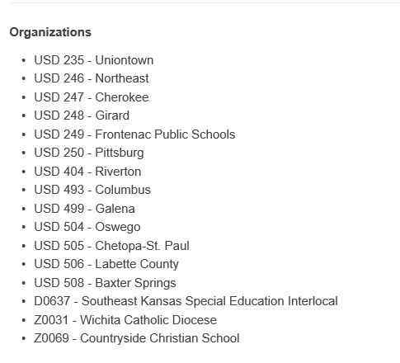
Provider Profile
Data Analysis and Public Data Request
How many IEP students are placed in the Coop Day school?
How many SPED teachers are providing services in the Coop Day school?
6 students / 72 teachers = 12 teachers for each student.
16

Slide 17
all Submissions
Save Imported files
If questions arise regarding data changes between Preliminary, Final and Subsequent data,
It helps to keep a history of records submitted to troubleshoot changes in data over time
Develop a file naming convention and organized system to find and retrieve files easily
17

Slide 18
New Verification
0224
December 1st Responsible school, area of Disability or Educational Environment has changed from the final 12-1 report.
Companion to verification 0203. The reason why the federally reported December 1 data changed.
18

Slide 19
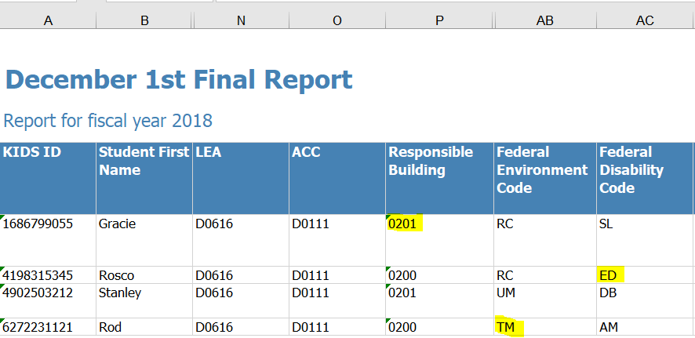
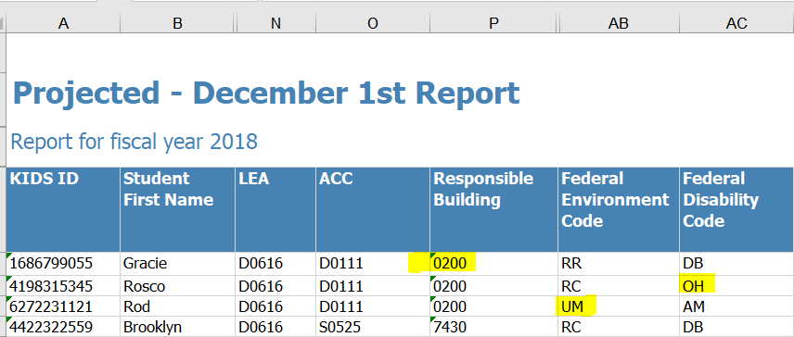
Verification 0224 Analysis
Look for changes in the data
A Projected December 1 report run today will show what has changed from the Final report
19

Slide 20
Primary Cause
0224 – Disability Change
Mid-IEP changes are applied to the entire IEP by date.
Example, 9/26/2017 IEP. Area of disability changes on 03/15/2018
New disability listed on service lines 9/26/2017 to 05/21/2018
Example, 08/05/2017 IEP. Service location changes on 02/11/2018
New location listed on service lines 08/05/2017 to 05/21/2018
20

Slide 21
Primary Cause
0224 – Responsible School Changed
Responsible school relevant to the prior school year is not updated for the current school year.
Example, 03/26/2017 IEP, 2017 responsible school is 8080 Lincoln Elementary. The 2018 responsible school is 8101 Adams Middle school. The 03/26/2017 IEP begins the 2018 school year listing 8080 Lincoln Elementary.
The 2018 responsible school does not get updated and reported until new IEP is completed (March), after the December 1 report is final.
21

Slide 22
Primary Cause
0224 - OSEP Environment Change
OSEP Environment relevant to the prior school year is not updated for the current school year.
Example, 04/11/2017 IEP, 2017 service are provided in preschool locations. The 2018 service are provided in the Kindergarten classroom. The 04/11/2017 IEP begins the 2018 school year listing preschool settings.
The 2018 OSEP environment changes when record is updated with new IEP in (April), after the December 1 report is final. New grade level, classroom session minutes, new settings change the environment.
22

Slide 23
Private / parochial category
0224 - OSEP Environment Change
Private / Parochial OSEP Environment is determined by the student’s neighborhood school. Data Dictionary page 9, examples 5-8
Example, Student profile initially lists a Private / Parochial neighborhood school (X0 or Z0) organization. As the student receives general education in a Private / Parochial school. Student counts in the PP category for December 1
Subsequent record update changes the neighborhood school to a public school (D0) organization. OSEP Environment changes to the public school calculation resulting in a different OSEP Environment category.
23

Slide 24
0224 - OSEP Environment Change, other examples of data updates
Homebound services from prior year reported in current year. Removed when next IEP is submitted.
Grade level of student promoted to KG in July, then resubmitted with Exit status. Services in a preschool program with no KG sessions. December 1 days = zero
K time not present on December 1, record updated to include K time
Current year IEP was amended in October. Amended services first reported in April when next IEP is submitted.
24

Slide 25
New Verification
0224
What action is required?
If the December 1 data is accurate and has changed, then the December 1 data must be updated to the correct values
If the current data is accurate, then no additional updates are required.
25

Slide 26
Reports
Guidence
26

Slide 27
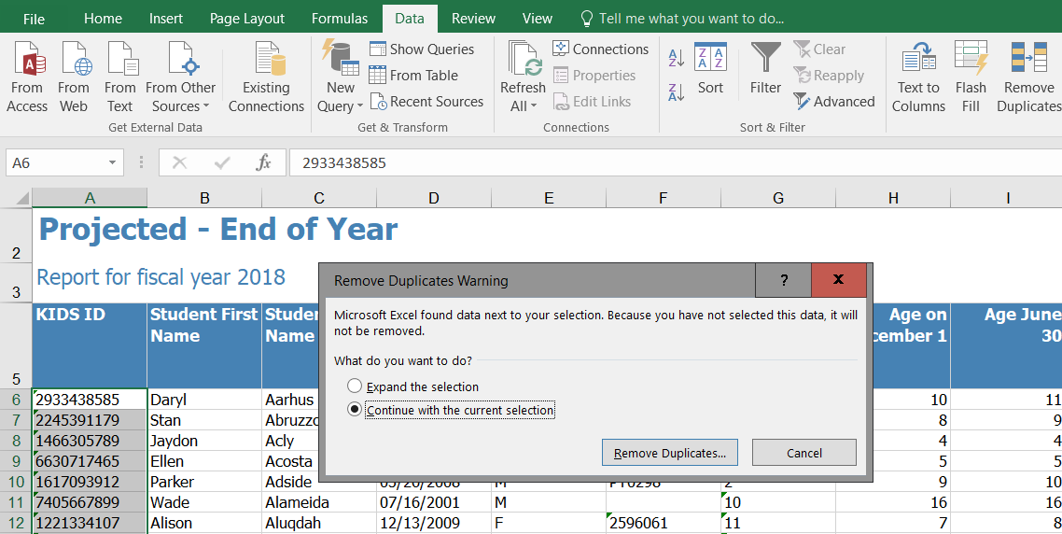
Check for Duplicate records
Are Duplicate records present?
3
2
Highlight KIDS ID numbers
Select Data Tab
Remove Duplicates, Warning Box
Keep Current Selection
Click Remove Duplicates
1
4
5
27

Slide 28
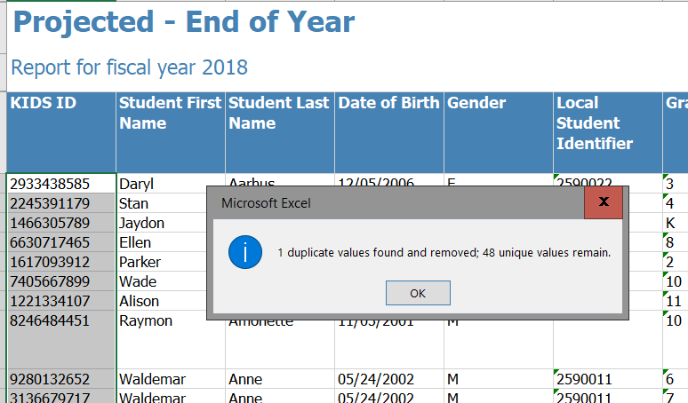
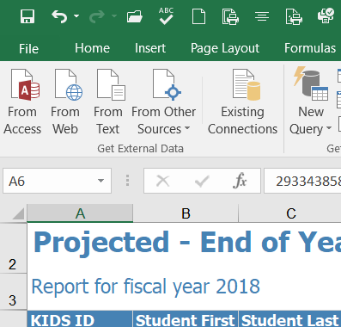
Check for Duplicate records
Reverse the Remove Duplicate Action and put the Duplicates back in the report.
Pop-Up Alert identifies the number of Duplicates, if any
28

Slide 29
Find Duplicate records
2
1
3
29

Slide 30
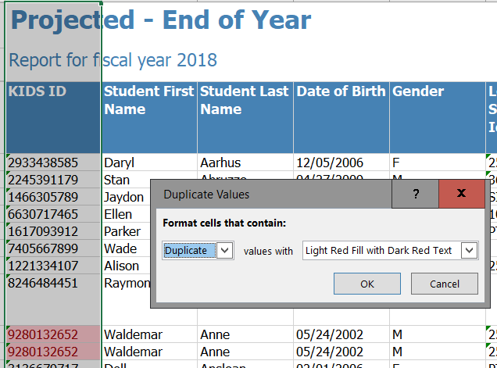
Duplicate records are Highlighted
Remove Duplicate records found
Combine Partial Records
Active Records
Inactive Records
Delete exact Duplicates
5
30

Slide 31
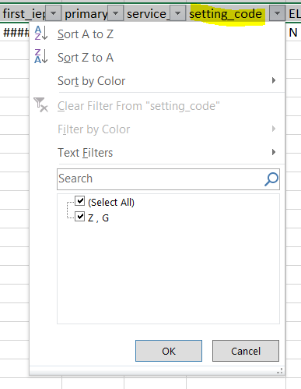
Projected reports
Look for invalid settings
“Z” indicates an invalid setting code is listed on the student’s service line
31

Slide 32
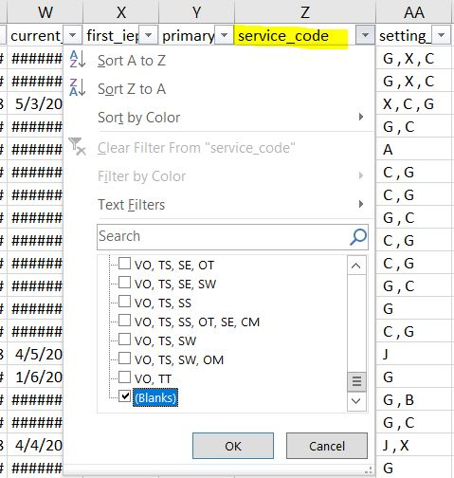
Projected reports
Look for Missing Services
“Blank” indicates an No Service code is listed on the student’s service line
32

Slide 33
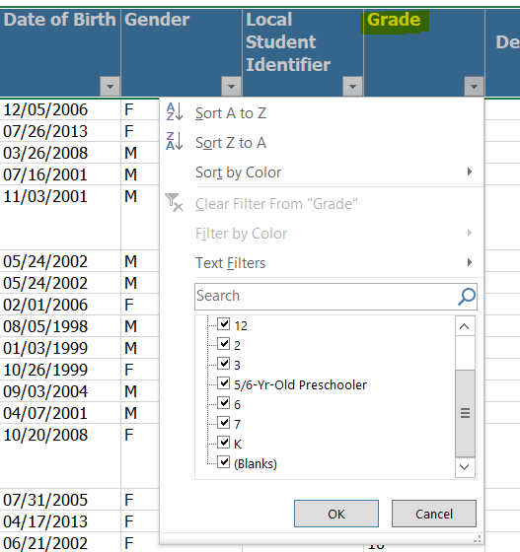
Projected reports
Look for Missing Grade Level
“Blank” indicates an No Grade is present. No Grade means Calendar, Building and Class minutes are not found. OSEP Environment can not be accurately calculated
33

Slide 34
Discipline crosscheck
34

Slide 35
OSEP Reports and federal data in SPEDPro
Guidance
35

Slide 36
Knowing the three federal data reports pulled from SPEDPro
Child count and Environment – Table 1, Table 3
Exiting – Table 4
Discipline – Table 5
36

Slide 37
Child Count – Table 1
Also Known As
December 1 child count.
The unduplicated number of students, age 3-21 identified with a disability receiving services on / intersecting the December 1 date.
37

Slide 38
Educational environments – Table 3
Also Known As
OSEP Environment
Federal Environment – SPEDPro reports
Indicator 5 & 6 categories
Where the student received IEP services by OSEP the Category
38

Slide 39
Educational environments – Table 3
What is it?
Same population as the December 1 child count
8 Early Childhood Environment Categories, Age 3-5
8 School Age Environment Categories, Age 6-21
See Data Dictionary for the category codes and descriptions.
39

Slide 40
Exiting
Guidance
40

Slide 41
OSEP exiting report – table 4
Which students qualify?
Unduplicated set of student
Age 14 – 21
No longer in a special education program
Only the last exit of the school year counts
41

Slide 42
Discipline
42

Slide 43
Discipline crosscheck
Look for mis-classification in KIAS as IDEA student or missing IEP services.
Student reported in KIAS as IDEA, not found with IEP services on the date of the incident. KIAS identification may be in error, or MIS data is incomplete.
43

Slide 44
OSEP data elements pulled from SPEDPro
Report | Age on 12-1 | OSEP Disability | KIDS Race / Ethnicity | KIDS Gender | KIDS ELL Status | KIDS Resp. Building | KIDS Resp. Organization | Current Status | OSEP environment | KIAS Disciplinary Removal
Table 1 & 3 Child count Environment | X | X | X | X | X | X | X |  | X
Table 4 Exiting | X | X | X | X | X |  | X | X
Table 5 Discipline |  | X | X | X |  |  | X |  |  | X
44

Slide 45
SPEDPRo elements used to Calculate OSEP data
Report | School Year | Primary & Secondary Disability | Service line dates | Service settings | Service Minutes | Total Days of service. Frequency Days per week | Directory session Times | Directory Building Attributes | Exit date | Overlap Duplicate Check
Table 1 & 3 Child count Environment | X | X | X | X | X | X | X | X |  | X
Table 4 Exiting | X | X | X |  |  |  |  |  | X | X
Table 5 Discipline | X | X | X |  |  |  |  |  |  | X
45

Slide 46
Trouble shooting
Guidance
46

Slide 47
Verifications – November FAQ
Step 1 – Look at the data submitted in SPEDPro.
View the student profile.
Check the status, exit date, grade, claiming code.
View the IEP page
Check the IEP dates, check “allow gap” value
Check each individual service line
Service location (prior USD service building)
Service dates (before or after the student was served)
Total days of service (zero)
47

Slide 48
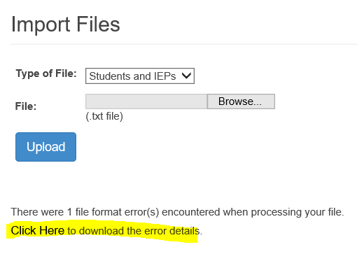
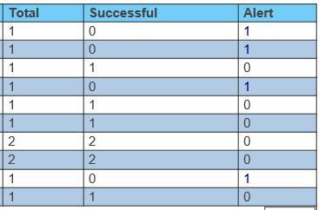
Import alerts – December FAQ
Import History identifies records triggering an Alert. A successful = 0 nor an Alert are not an indications the complete record failed to Import. Review the Alert message to see why the Alert is present. There could be individual service lines that failed to import.
48

Slide 49
Building Minutes – FY2018 workshop
Begin Year Set Up August / September
Trouble shooting building minutes
Print the building information from SPEDPro and check for incorrect and missing class time minutes
Make corrections to the Directory before December 1
April Discovery
49

Slide 50
Building Minutes
Begin Year Set Up August / September
Trouble shooting building data
Do not list Kitchen Units, District Central Offices, Infant Toddler Networks, Day Care Centers as service locations
50

Slide 51
Building types
Begin Year Set Up August / September
Trouble shooting building types
Early childhood Program- General should only be listed for the after school K time program
51

Slide 52
Building types
Begin Year Set Up August / September
Trouble shooting building types
Early childhood Program- General Setting “X” and “T” cannot be listed for this building type
Has to be fixed by KSDE on the back end by Oct. 1
52

Slide 53
Future considerations
Virtual school service location
Virtual location offered to all students participating in the virtual program.
Virtual location specific to IEP students participating in the virtual program.
53

Slide 54
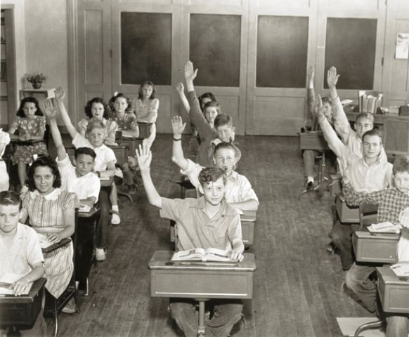
Question, Comments, Suggestions?

