Slide 1
MIS Clerk Workshops
FY2015
Notes:
This template can be used as a starter file for presenting training materials in a group setting.
Sections
Right-click on a slide to add sections. Sections can help to organize your slides or facilitate collaboration between multiple authors.
Notes
Use the Notes section for delivery notes or to provide additional details for the audience. View these notes in Presentation View during your presentation.
Keep in mind the font size (important for accessibility, visibility, videotaping, and online production)
Coordinated colors
Pay particular attention to the graphs, charts, and text boxes.
Consider that attendees will print in black and white or grayscale. Run a test print to make sure your colors work when printed in pure black and white and grayscale.
Graphics, tables, and graphs
Keep it simple: If possible, use consistent, non-distracting styles and colors.
Label all graphs and tables.

Slide 2


Welcome

Slide 3
Topics
Reporting Tips
Avoiding Timely & Accurate Issues
Auditing Reminder
KSSD KSSB Summer Program
KAN_Service updates
Data Dictionary updates
KAN_Service reports survey

Slide 4
Tips for Improving Reporting Quality
Status codes
1
2
Aligning Directory programs
Aligning Directory Programs
3
Changing data for transitioning students
4
Reporting MIS for participation in Gen Ed programs
5
Begin year set up

Slide 5
Tips for Improving Reporting Quality
1
Status codes
Annual Status
First Active status of the school year
Auto populated by application
Upon the first entry of the student record
Saved and stored in the system

Slide 6
Tips for Improving Reporting Quality
1
Status codes
Current Status
Entered by the user
May change if student exits or returns
Current active or inactive status

Slide 7
Tips for Improving Reporting Quality
Status code uses
Annual Status
Annual Status
Current Status
Current Status
Used in verification logic such as expecting service at the start of school
Used to determine population for Indicators
Used for basis of OSEP exiting SPED report
Used in verification logic such as overlaps

Slide 8
Tips for Improving Reporting Quality
Importing status codes
Importing
Report active status consistently
If only inactive status listed
Contradicting active status will result in failed imports
Example:
Student X
IEP Record 1: Entering status
IEP Record 2:
Continuing status
Students starting the year as inactive will result in failed imports

Slide 9
Tips for Improving Reporting Quality
2
Aligning Directory Programs
Aligning Directory Programs
Align directory program types to MIS setting codes
Find out what an “All other” programs represent ?
Setting codes and program types will be compared
Verification 0214 will trigger if unequal
Recommendation:
Notify USD board clerk of errors or when programs / session times change

Slide 10
Tips for Improving Reporting Quality
Aligning Directory Programs
Examples of unequal matches
Directory lists 4 year old at risk program
“W” setting is reported on service line
Student in MIS is grade KG
K time is listed on service lines
MIS setting codes do not list a “B” setting
Directory does not list reverse mainstream program
No KG schedule is entered in the directory
No qualifying K time program is present in the directory for grade level

Slide 11
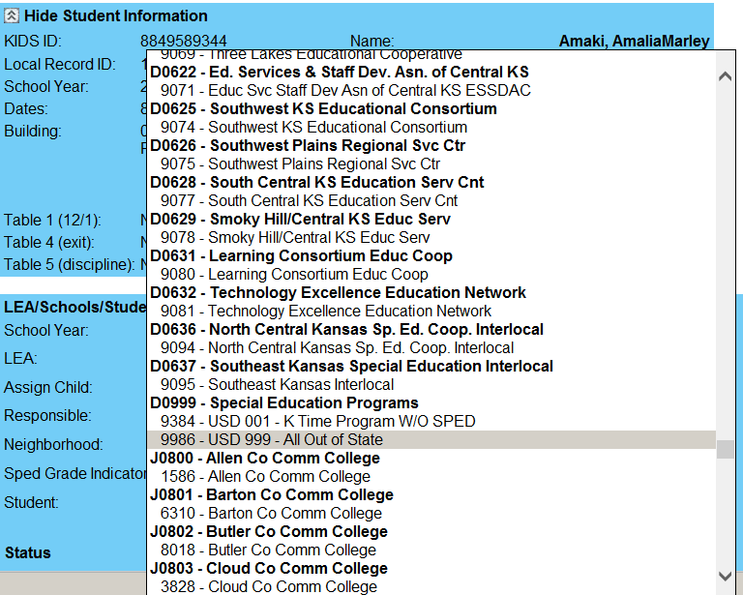
Out of State Students
Use generic out of state for neighborhood school
Notes:
Add slides to each topic section as necessary, including slides with tables, graphs, and images.
See next section for sample table, graph, image, and video layouts.

Slide 12
Tips for Improving Reporting Quality
3
Changing data for transitioning students
Preschooler last year
Promoted to KG this school year
IEP services address preschool program F/D/L
Preschool data rolled over into KG school year

Slide 13
Tips for Improving Reporting Quality
Example Problems with “blind” rollover
Frequency
Duration
Location
Grade level factor
Daily support may change from 3 or 4 days to 5 days
Class schedules may change from 1/2 day to all day
Classroom type may change to a more inclusive environment
LRE numerator and detonator will be unequal if services address PR program and grade = KG. Resulting calculation will be skewed.
Recommendation:
Review, adjust MIS services according to new grade or building schedule & program

Slide 14
Tips for Improving Reporting Quality
Vocational / Work Study Programs
Tips for Improving Reporting Quality
Para support on the job
IEP addresses student’s participation in a vocational program
None, student works independently in program without support
Enter direct service time in the MIS
Do not enter direct service time in the MIS
What level of support will the student receive?

Slide 15
Tips for Improving Reporting Quality
Vocational / Work Study Programs
What is the reporting effect?
Should pass validation checks with proper coding
Additional time applied to outside or regular class
Indicator 20 may come into play
No direct SPED minutes apply to regular class participation
Incorrect data may not be reviewed because no verifications present
Unintended effect on LRE if non-school or pull out setting used
Inaccurate reporting of OSEP environments
For LRE & OSEP environments, consultation / indirect minutes do not apply to time outside of regular class
Recommendation:
Identify level of IEP support before MIS data entry

Slide 16

Tips for Improving Reporting Quality
Check directory updates for session times and program type accuracy
Administrators and clerks should meet and confirm SPED programs offered in each building before the school starts
Inaccuracies requiring change after Dec. 1 is finalized may impact Indicator 20
Inaccuracies requiring change after Dec. 1 is finalized may impact Indicator 20
Check local private / parochial schools
Open new buildings in directory to account for new locations

Slide 17
Tips for Improving Reporting Quality
Note:
Designation of Primary Provider is not required
Verify current year service providers
Confirm Contract Provider role with KSDE prior to designation of Contract Provider role
Remove providers who are not active in current year
Change provider assignments if service organization changes

Slide 18

New Work
Mr. Smartphone is looking for the organization for the generic out of state building to use as neighborhood school.
Under which organization is generic out of state building found found?
D0999
Notes:
Add slides to each topic section as necessary, including slides with tables, graphs, and images.
See next section for sample table, graph, image, and video layouts.

Slide 19
Auditing Reminder
Documenting off campus support on Sept 20
Who?
Where ?
Why ?
What is required ?
Pre-schoolers
Private
Parochial
students
In outside locations of where public school attendance is not taken
To document IEP support during the Sept. 20 collection window for General State Aid
Service log documenting IEP support was delivered per IEP service frequency
Notes:
Add slides to each topic section as necessary, including slides with tables, graphs, and images.
See next section for sample table, graph, image, and video layouts.

Slide 20
KSSD KSSB summer NPE claims
KSSD KSSB summer program
Identify potential participants by March
Claim student in KIDS at USD level or ask KSD / KSB to submit KIDS record with USD central office as funding school
Prepare and file NPE claim by in KAN_Service April 30. Make student a eligibility / fund 5 in the MIS
NPE pays ≈ $375.00
Notes:
Add slides to each topic section as necessary, including slides with tables, graphs, and images.
See next section for sample table, graph, image, and video layouts.

Slide 21
Avoiding Timely & Accuracy Issues
1
Correct December 1 population
2
Timely reporting of all exits
3
Tips for using methods and tools to discover exits

Slide 22
Avoiding Timely & Accuracy Issues
1
Correct December 1 population
Counted on 12-1 but should not have
How?
OSEP criteria removed after OSEP submission
When? After collection closes end of March
Verification 210

Slide 23
Avoiding Timely & Accuracy Issues
Who should not have counted?
Prior year exits
Current year exits
Non eligible students
Bad data sharing
Students who did not enrol or attend in the current school year
Students who did receive current year services but exit before 12-1
Students with draft IEPs that are imported into the MIS
IEPs are exchanged electronically for transferring students with services extending past the exit date, then imported in the MIS
Recommendation:
Check current version of the Preliminary child count for outliers

Slide 24
Avoiding Timely & Accuracy Issues
1
Correct December 1 population
Should count on 12-1 but did not
How?
OSEP criteria added after OSEP submission
When? After collection closes end of March
Verification 203

Slide 25
Avoiding Timely & Accuracy Issues
Why did they not count?
Late data
Claimed in KIDS
Unresolved verifications
Directory and service issues
New students are not reported before OSEP data submitted
KIDS records come in after OSEP data submitted
Verifications dealing with minutes, calendars & settings prevents the calculations of OSEP environments
Class time and session minutes do not align with service lines because directory updates reflect a change rom when the IEP was developed
Recommendation:
Match the Preliminary child count population with your IEP program

Slide 26
Avoiding Timely & Accuracy Issues
2
Timely reporting of all exits
Unreported exits
from prior school year
Unresolved exit report, Listed by student
Who? Students qualifying for OSEP exit report
When? From end of school to Sept. 15

Slide 27
Avoiding Timely & Accuracy Issues
What exits are at issue?
Students with active status
Student does not return
OSEP requirements apply
Student data indicates exit date
Services reported as continuing though the last day of school
There are no MIS records for the student in the next school year
OSEP requires exits to be report in the school year an LEA ceases to provide services
If services ceased prior year, exit date and basis of exit is required in prior year. If services continue, current year data must be entered
Recommendation:
Run provider rosters early to confirm current year case loads and summer exits

Slide 28

Doing Your Best Work
Mr. Generic Coffee Drinker is using which MIS feature to discover specific students need to have exit data entered for the prior school year?
Unresolved Exit Report
Notes:
If there is relevant video content, such as a case study video, demo of a product, or other training materials, include it in the presentation as well.

Slide 29
Avoiding Timely & Accuracy Issues
Methods and tools to discover exits
KIDS administrators
Update IEP program
Providers /
Case Manager
Update MIS
Caseloads & Roster
Reports
by provider
MIS clerk
Caseloads & Roster
Reports
by building

Slide 30
Avoiding Timely & Accuracy Issues
Tips for using Methods and tools to discover exits
  Attempt to discover exits several times a year
    Beginning of the school year
    Late November / early December
    End of the school year
Many USD’s are aligning KIDS data systems with SPED data systems / IEP programs
  Understand exiting requirements in KIDS is different
    Different collection cycle, not July 1 to June 30
    OSEP exits may not be KIDS exits
    KIDS exits may not be OSEP exits

Slide 31
Avoiding Timely & Accuracy Issues
  Examples of differences
    KIDS exit of value 22 means the student is 18-21 and still active in special education transition program
    KIDS exit type of value 12, long term suspension / expulsion does not apply to IDEA students
    KIDS exit type of value 99 means prior basis of exits reported are incorrect and do not apply
    Revocation of service and objectives completed are not exit categories in KIDS collection
    KIDS exit type of value 14, 16, 17, 19, 20, 21, all count as drop out in both KIDS and MIS
      Discontinued school, Unknown, GED, not known continuing

Slide 32
Avoiding Timely & Accuracy Issues
  Areas that may need more information
    KIDS exit of value 2 means in-state transfer & continuing
      These can change to drop out if no subsequent KIDS records.
      Always record the evidence as to where in the MIS
        Note: Parents / provider word is not evidence of continuing
    KIDS exit dates are not always reliable
      USD may keep students as absent long after exiting
      KIDS exit dates within the first days of school is commonly a summer exit. Use last day of school as exit date in MIS
    MIS = Drop out
      Discontinued school, Unknown, GED, not known continuing

Slide 33
Name 3 KIDS exits that are not exits in the MIS?
1
  Long term suspension or expulsion
2
  Participation in 18-21 transition program
3
  First day of school exit date
Notes:
This is another option for an Overview slide.

Slide 34

Move to Educator ID
KSDE License
SSN
Educator ID
Licensed elsewhere
Provider Identifiers
SSN

Slide 35
KAN_Service Updates
Move to Educator ID starting in FY2015
Future MIS Reporting
Added to import specifications in 2016
SSN
Educator ID
SSN is retired
Licensed elsewhere
SSN
Kept in import specifications
Provider Identifiers

Slide 36
Data Dictionary Updates
Applicable starting in FY2015
IEP Date
Student name help
Provider ID
EC SPED preschool program / class re-defined
Clarification to include all procedural requirements
Reminder Last name in KIDS determines, last name in import files. Add hyphens
or generation codes if in KIDS last name
Gradual conversion
of provider SSN to Educator ID, both accepted in FY2015
Term “Integrated” removed from title as the classroom may be 100% IEP or a blend of not more than 50% peers.

Slide 37
Data Dictionary Updates
Starting in FY2015
File import specification
Total day calculation
New Frequency value
Indicator 20
The import specification have not changed, though an improved method is recommended
Weeks of service has been removed from the DD because it is not being used. It remains in the file specification
Value 99 applies only 1 total day within the service date range. It is intended for a service delivered once per year.
Change in terminology: General Supervision – Timely and Accurate Reporting

Slide 38

Learning Objectives
Mr. Hit on the new girl in the office is asking, what new data field will recognize providers licensed by KSDE in the MIS?
Educator ID
Notes:
What will the audience be able to do after this training is complete? Briefly describe each objective how the audience will benefit from this presentation.

Slide 39
File import recommendation
Determining total days of service
Field R10 = Days per week
Problems when the calculation or date range factors an odd number of days
Calculated value is populated on service line
10 + 12
Applied to calendar
Field R12 = Frequency
Field R13 = Total days
Default value is populated on service line

Slide 40
File import recommendation
Determining total days of service
Service line 1.
5 days per week, every week
= 101 total days
Problem:
60 + 40 = 100
Not 101
Example
of problem
Service line 2.
3 days per week, every week
= 60 total days
Dates:
11 -13 - 2014
To
05 – 21 – 2015
101 total days
Results are potential false verifications
0199
Service line 3.
2 days per week, every week
= 40 total days

Slide 41
File import recommendation
Recommendation to IEP vendor
Populate
R10, R12 & R13
before submitting data to KSDE
Field R10 = Days per week
Field R12 = Frequency
Field R13 = Total days
1 day / 4 day
2 day / 3 day
Combinations can be determined prior to submission
If verifications are generated
Results
Application stores all R10,R12 & R13 values. Clerk can toggle on any or all service lines that do not align with the others and reset days to potentially fix

Slide 42
KAN_Service updates, Summer 2014 release
Verification process
Results viewed in the AM
User initiated
Auto-run upon Import
Auto-run on all students daily at midnight
Run on single students
Auto-run on batches of 5 or less

Slide 43
KAN_Service updates, Summer 2014 release
Application functionality
Application Speed and response time
Automatic loading of data upon log in
Problem
Remedy
All Students will not automatically preload. Users will search for student(s) to find desired student record(s)
MIS records entered may associate to prior year KIDS records
Association to KIDS records
Remedy
Problem
Automatic update to most recent KIDS record during off hours (2 a.m.)

Slide 44
KAN_Service updates, Summer 2014 release
Starting in FY2015
New Frequency value
Reporting weeks per year option
Provider ID
New Import routine
If provider ID is manually applied, then system will retire provider SSN and use provider ID
Value 99 will be available with the FY2015 application upgrade
Weeks per year has been removed. It has not been used in 2 years
Catastrophic Aid application can be imported

Slide 45
KAN_Service updates, Summer 2014 release
Starting in FY2015
Processing speed of the application
Report
Improvements
Data Rollover from one school year to the next
Association to KIDS records
Students will not be auto loaded upon log in. To bring up a single student, a group or all students a search for the set is done first
System will auto align to most recent KIDS record. Auto correct associations made when MIS is entered prior to Sept 20.
Additional data fields will be added to December & EOY final reports and report Wizard for consistency
Improved functionality when prior year building is closed. Options to select new target buildings

Slide 46
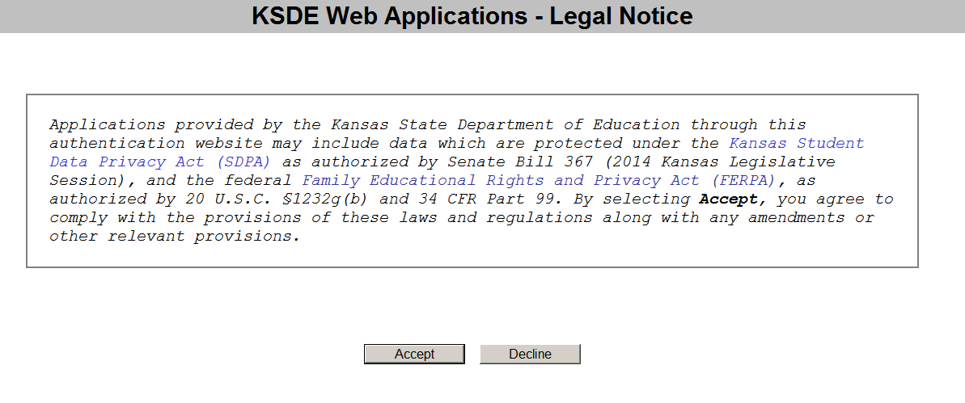
KAN_Service updates, Summer 2014 release
Senate Bill 367
Association to KIDS records

Slide 47
Next Version of the MIS system
System Redesign
Moving areas of exceptionalities from profile to IEP page
New Import specifications
New Application Name
Remove evaluation data
Provider ID added
Remove Weeks per year
Allow gap

Slide 48
KAN_Service report survey results
80% get reports from K-S
40% get reports 3-4 times a year.
Majority only when asked to so.
25% have not saved the December 1 or EOY final reports for any year.
Report usage
User activity

Slide 49
KAN_Service report survey results
What if past year’s reports are inaccessible?
32% say loss of existing reports will have minimal or no negative effect.
30% use their IEP program to generate reports.
Report usage
20% never use the K-S reports or reporting process
User Impact

Slide 50
KAN_Service report survey results
Conclusion
  Those who use the report tools and report files will most likely continue usage as in prior years.
  KAN_Service will be operational for FY2015
After 2015
  KAN_Service would be functional through the transition school year.
    2015 data goes into K-S through September deadlines,
    New MIS system will be operational collecting 2016 MIS
  July 2016 KAN_Service will be retired
Notes:
Give a brief overview of the presentation. Describe the major focus of the presentation and why it is important.
Introduce each of the major topics.
To provide a road map for the audience, you can repeat this Overview slide throughout the presentation, highlighting the particular topic you will discuss next.

Slide 51

After hours of searching, Miss Underpaid data Clerk discovers in a dream, which KIDS record will apply to the student demographics in the MIS record?
New Work
Current / last KIDS record submitted
Notes:
This is another option for an Overview slides using transitions.

Slide 52
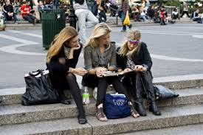
The 2015 Data Dictionary is out
Miss Blue Purse needs help finding the 3 data fields to import to establish total days on a service line. What are they?
Frequency
Days per Week
Total days within service range

Slide 53


Professor Geek is trying to cipher the new frequency value. What is it and what’s the code?
1 day of service per school year
99

Slide 54

Old Work
Which old preschool classroom had a name change, but has essentially the same definition?
From – Integrated Classroom
To – Early Childhood special education classroom
Notes:
Use a section header for each of the topics, so there is a clear transition to the audience.

Slide 55

Case Study
Who ?
  On his first day
  Made numerous mistakes
  Ultimately successes was achieved
  The moral of the story
  Nothing that is broke, cant be fixed.
  Call me first
Notes:
Add a case study or class simulation to encourage discussion and apply lessons.

Slide 56
Discussion
Who is this man?
I have no idea. The picture came with the PowerPoint
Thanks for asking
Notes:
Discuss outcomes of the case study or class simulation.
Cover best practices.

Slide 57
Questions?

Slide 58
Thank You!

